Slide 1
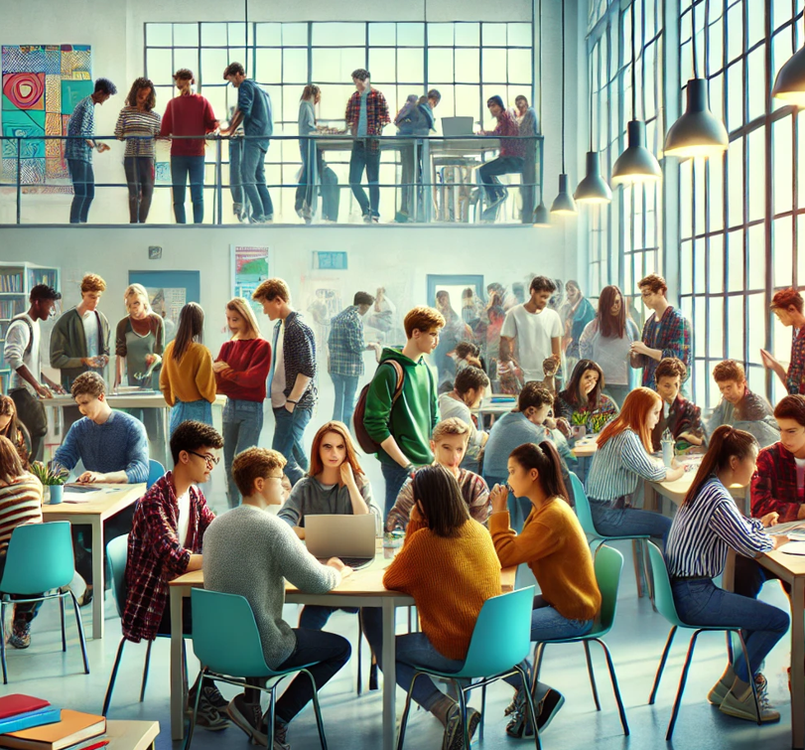
Plagiarism
What is it?
Why is it wrong?
What are the consequences?

Slide 2
What is plagiarism?
Plagiarism is defined as the unacknowledged copying from, or reproduction of published sources or incomplete referencing. This can include but is not limited to:
  Copying from another learner, books or the internet
  Inappropriate paraphrasing
  Letting someone else complete work for you, or working with others if the work was meant to be completed independently
  Submitting the same piece of work for different purposes
  Using online tools and other resources inappropriately so that the submitted work is not your own. This includes the inappropriate use of Generative Artificial Intelligence (for example, ChatGPT or Grammarly)

Slide 3
Why is plagiarism wrong?
Plagiarism is fundamentally wrong and dishonest.
It compromises your integrity and calls into question the value of all the work that you produce. Plagiarism is contrary to the values and ethos of the College.
It is also intellectual theft and therefore can have very serious consequences with organisations outside of the College such as exam boards.

Slide 4
What are the potential consequences of plagiarism?
The College takes plagiarism very seriously.
Where a teacher suspects plagiarism, it may be investigated. The College may also need to report this to the relevant exam board as malpractice.
Such an investigation may lead to a student being awarded zero marks for a unit, or potentially disqualification from one or all qualifications.
It may lead to disciplinary action taken against a student which may result the student being asked to leave the College.
Students should be aware that in line with JCQ guidance, suspicion of plagiarism is in itself enough to start an investigation.

Slide 5
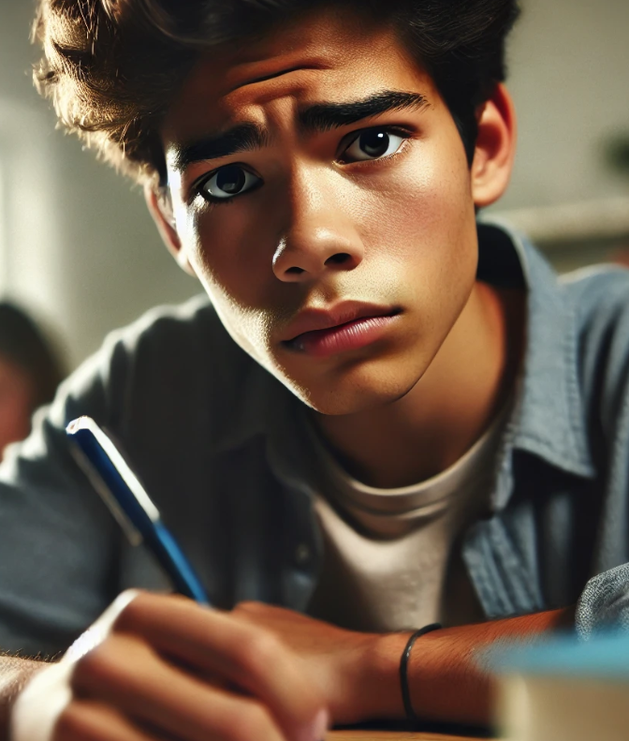
What should I do if I am concerned about plagiarism?
The College and your teachers are aware that students may accidentally plagiarise, for example if you have not referenced a quote, or referenced incorrectly
If you have questions about plagiarism, or are worried that you may have accidentally plagiarised, you should speak to your teacher
If you come across plagiarism, you should report it to your teacher
You can avoid issues with plagiarism by listening to teacher instructions, asking questions if you are unsure and working hard to produce the very best work you can and meet all deadlines.

Slide 6
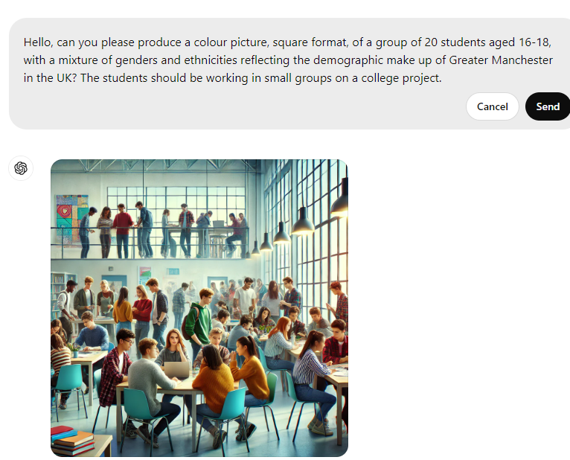
Did you notice the picture on the first slide….
Almost all of the students are wearing blue denim
All the male students have same hair style
Some students on the upper level seem to have no feet (or the perspective is wrong) and two are floating off the ground…
Image was generated with DALL-E/ChatGPT-4
AI can be biased and unreliable (the prompt asked for a group of 20 students – got nearly 50!)

Slide 7
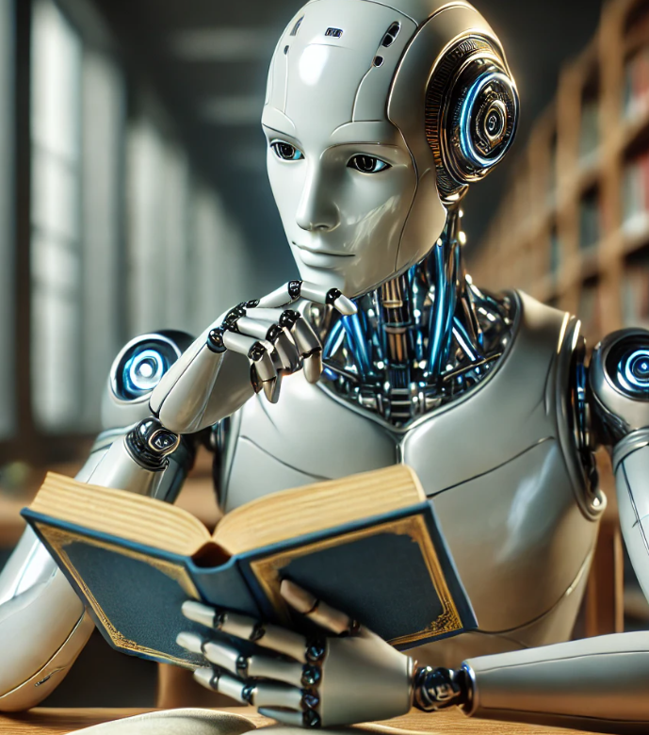
Generative Artificial Intelligence (GAI) and Assessments
You are expected to maintain academic integrity, and demonstrate your own knowledge, skills and understanding.
GAI can be a useful learning tool if use ethically and in-line with your teacher’s guidance.
However, if used, you must still demonstrate that you have independently met assessment criteria. This means:
You cannot copy or paraphrase GAI content
If you have used GAI, you must acknowledge this, stating:
  The name of the AI source, full URL and date accessed
  The prompt used and content generated in a non-editable format (e.g. screenshot)
  Fully explain how it has been used in the assignment

Slide 8
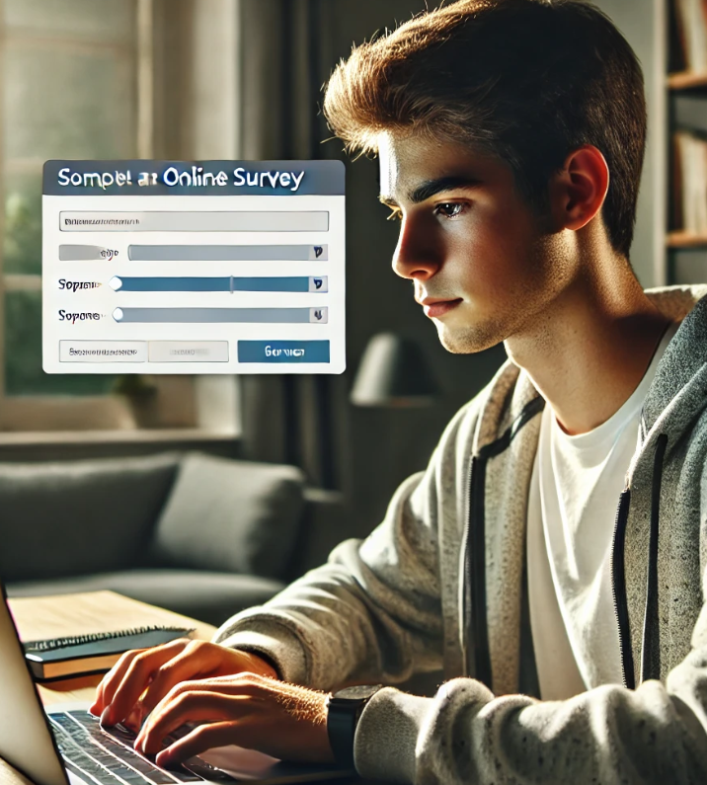
Acknowledging that you have understood plagiarism
Your teacher will send a link to a MS Form document – you must read through and complete this, acknowledging that you understand the issues around plagiarism.

Slide 9
Subject specific info [if required]
[you may wish to add some course-specific info if required]

