Slide 1

MANUAL CAMERA

Slide 2
MANUAL CAMERA
ISO
EXPOSURE
APERTURE

Slide 3
MANUAL CAMERA
ISO
EXPOSURE
APERTURE
SENSITIVITY OF THE CAMERA
3200 - 80
LOW LIGHT
BRIGHT LIGHT

Slide 4
MANUAL CAMERA
ISO
EXPOSURE
APERTURE
SENSITIVITY OF THE CAMERA
SHUTTER SPEED
3200 - 80
1200/1 - 1 (SEC)
LOW LIGHT
BRIGHT LIGHT
FAST SHUTTER SPEED
SLOW SHUTTER SPEED

Slide 5

MANUAL CAMERA
ISO
EXPOSURE
APERTURE
DEPTH OF FIELD
f.8 - f.2.8
GREAT DEPTH OF FIELD
SHALLOW DEPTH OF FIELD

Slide 6
MANUAL CAMERA
ISO
EXPOSURE
APERTURE
SENSITIVITY OF THE CAMERA
SHUTTER SPEED
DEPTH OF FIELD
6400 - 80
1200/1 - 1 (SEC)
f.8 - f.2.8
LOW LIGHT
BRIGHT LIGHT
FAST SHUTTER SPEED
GREAT DEPTH OF FIELD
SLOW SHUTTER SPEED
SHALLOW DEPTH OF FIELD

Slide 7
ANSEL ADAMS

Slide 8
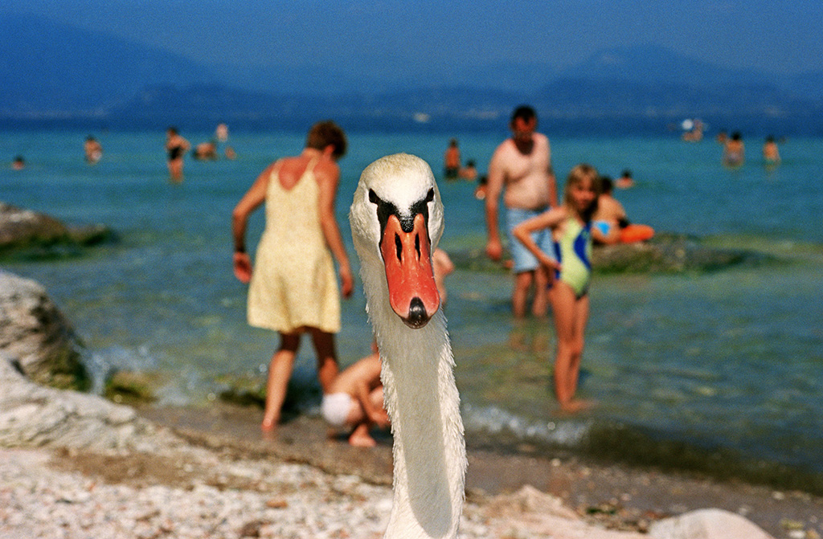
MARTIN PARR

Slide 9
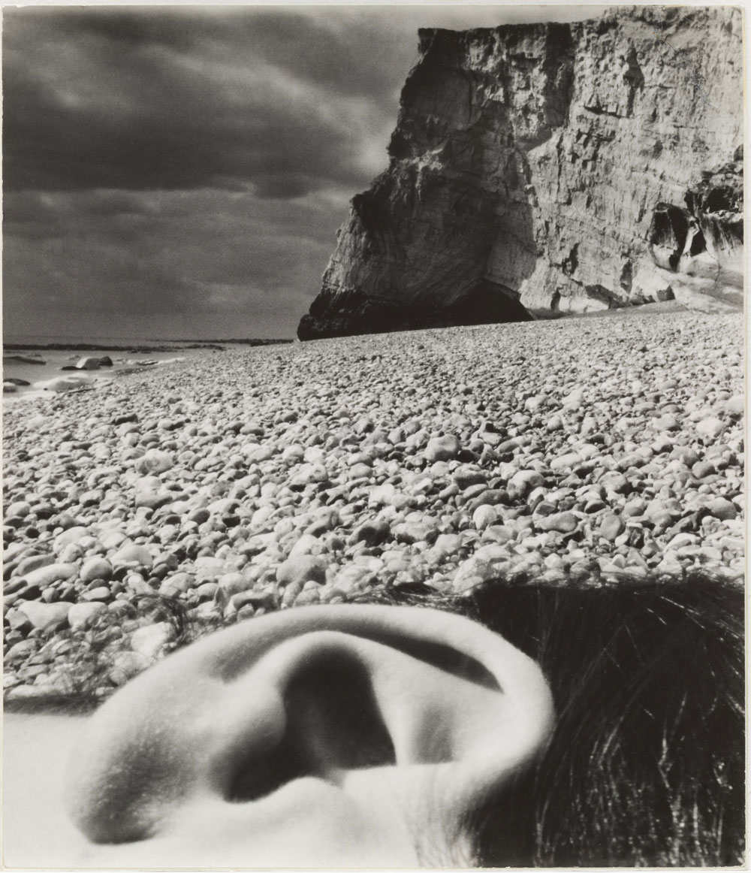
BILL BRANDT

Slide 10
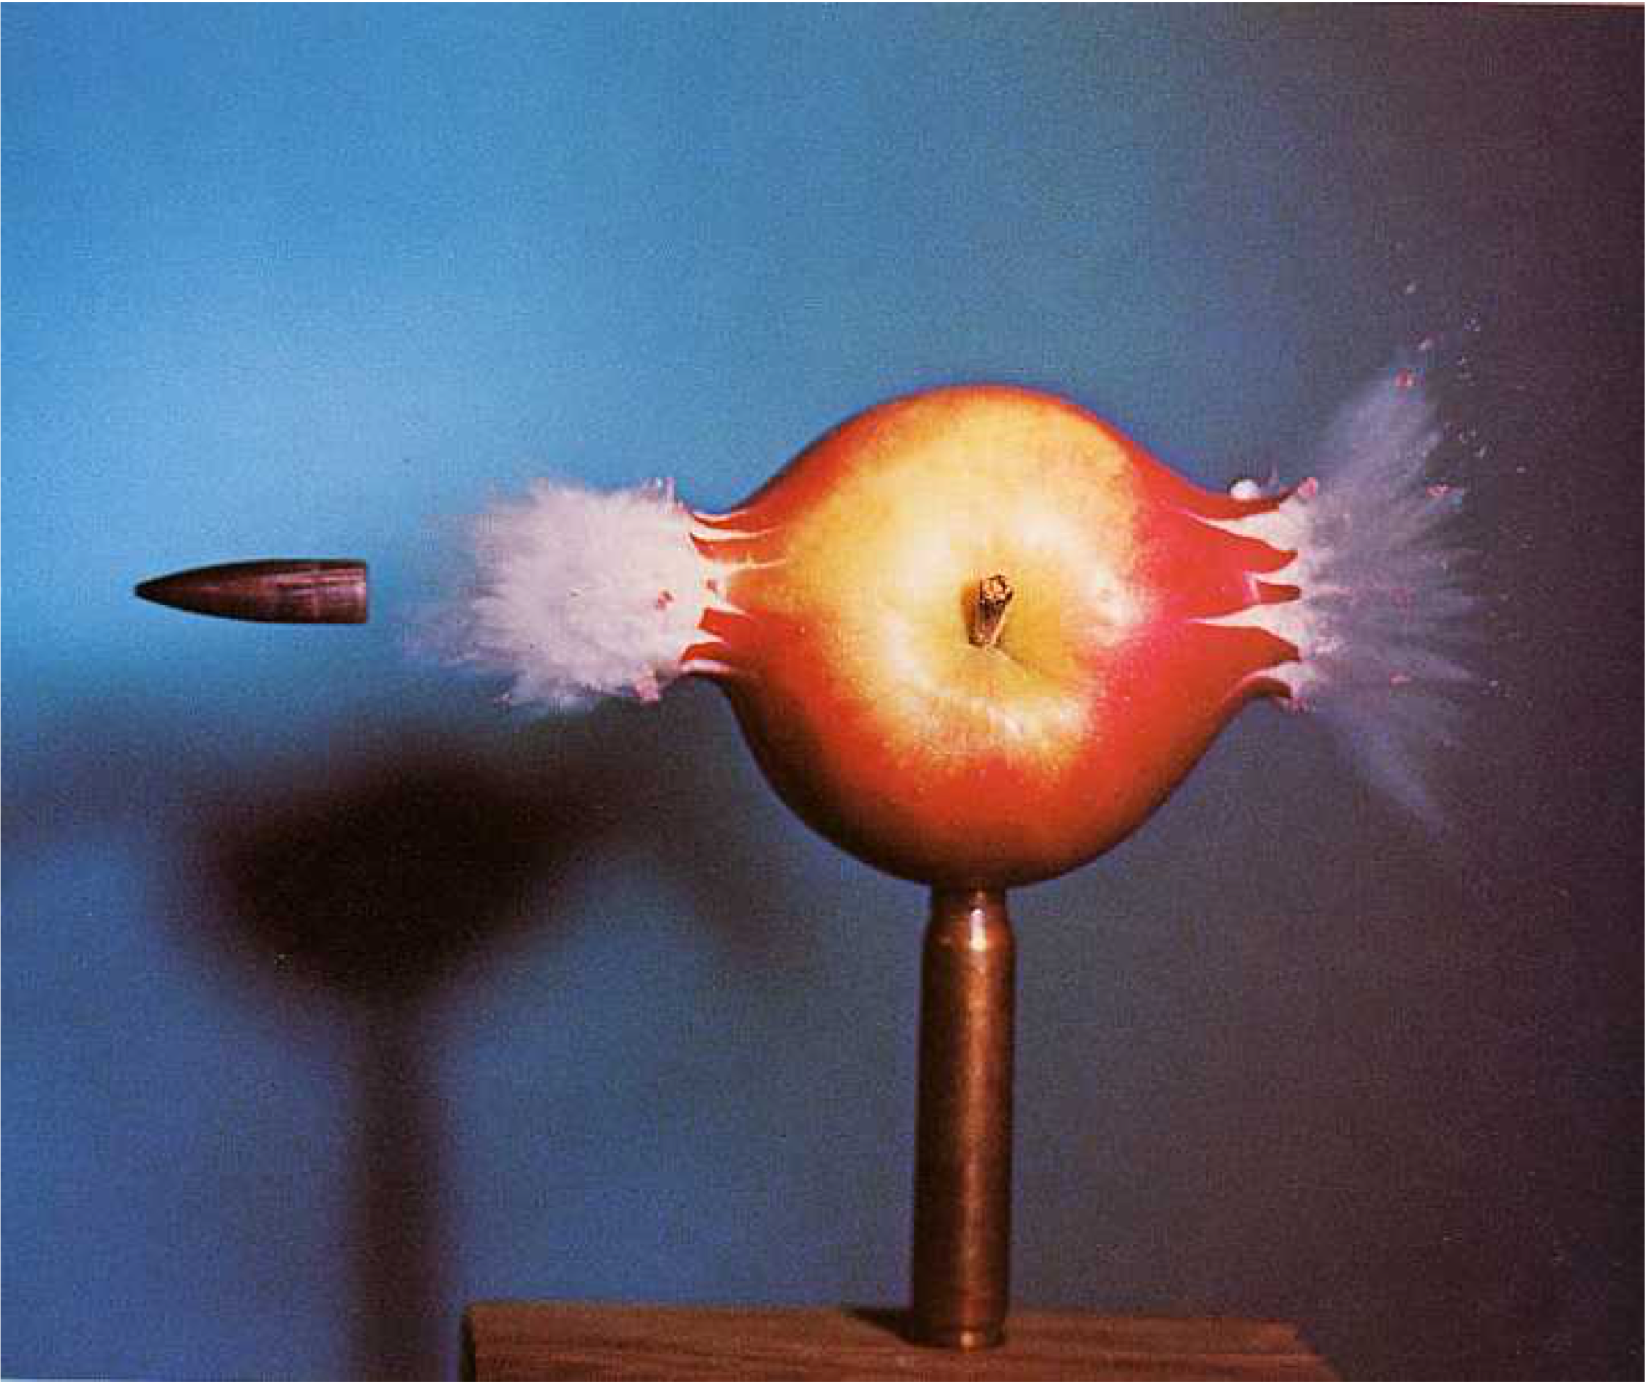
HAROLD EDGERTON

Slide 11
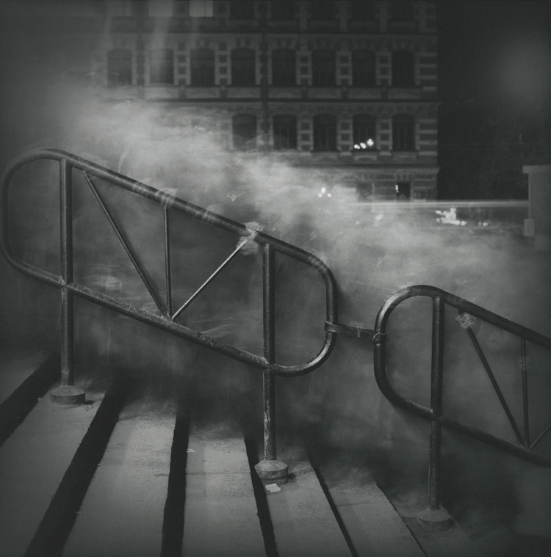
ALEXEY TITARENKO

Slide 12
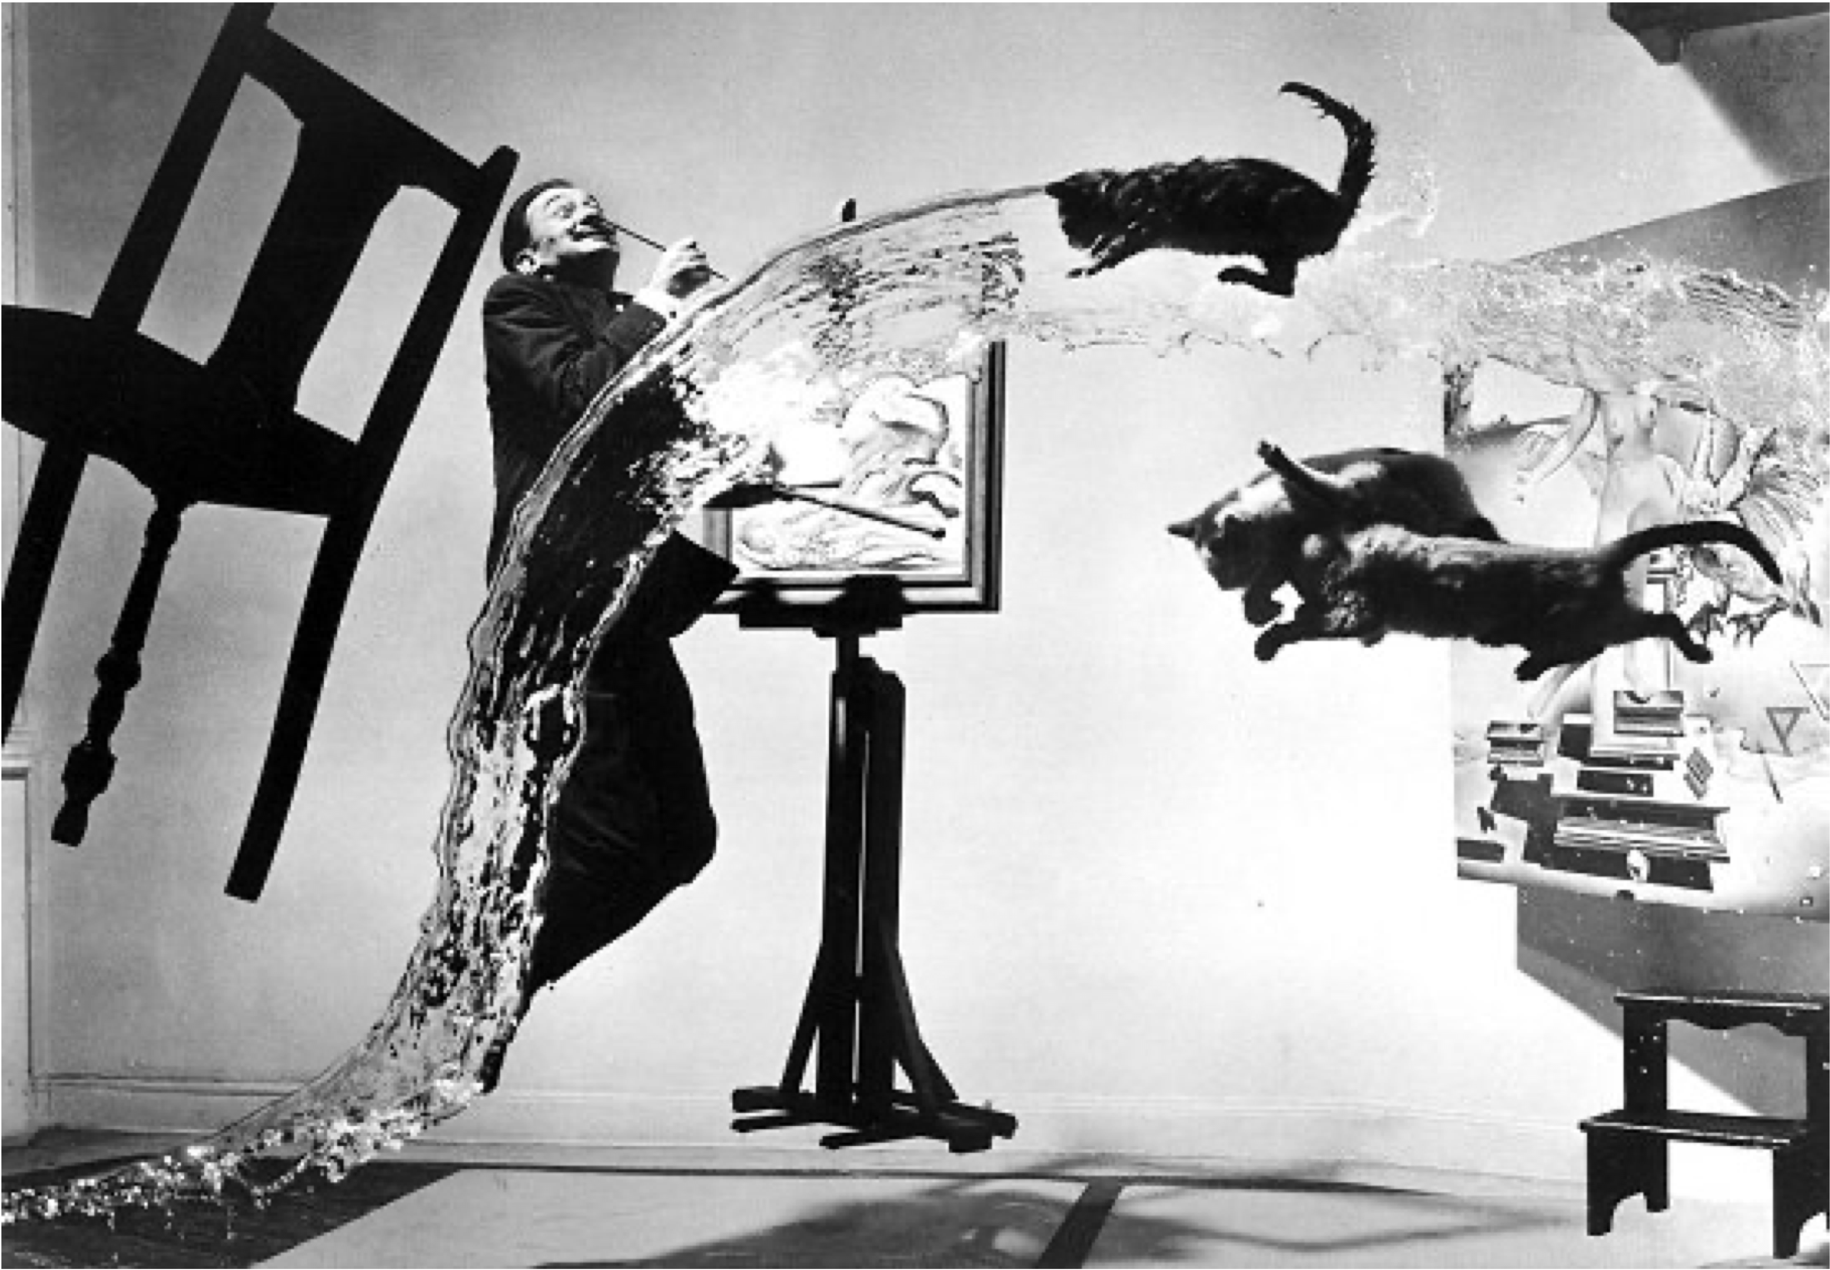
P. HALSMAN

Slide 13
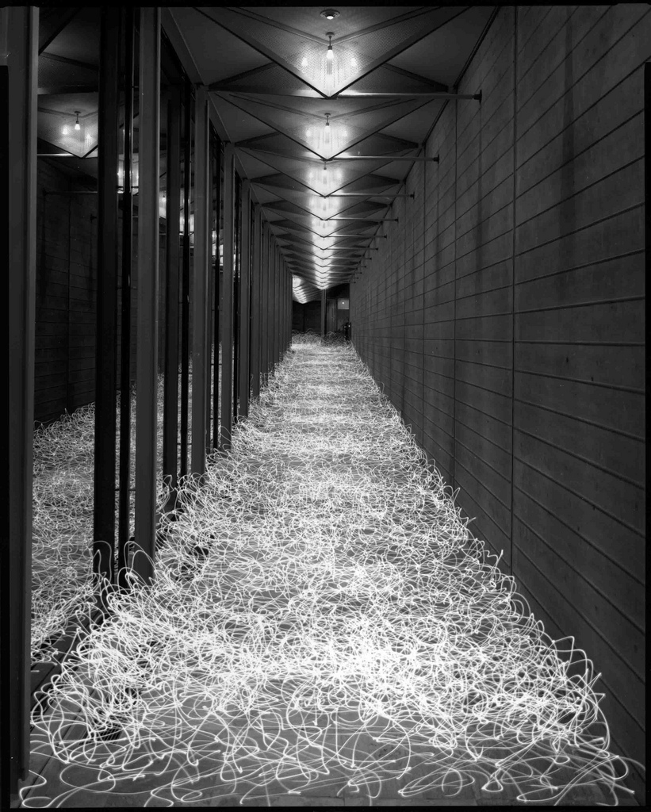
TOKIHIRO SATO

Slide 14
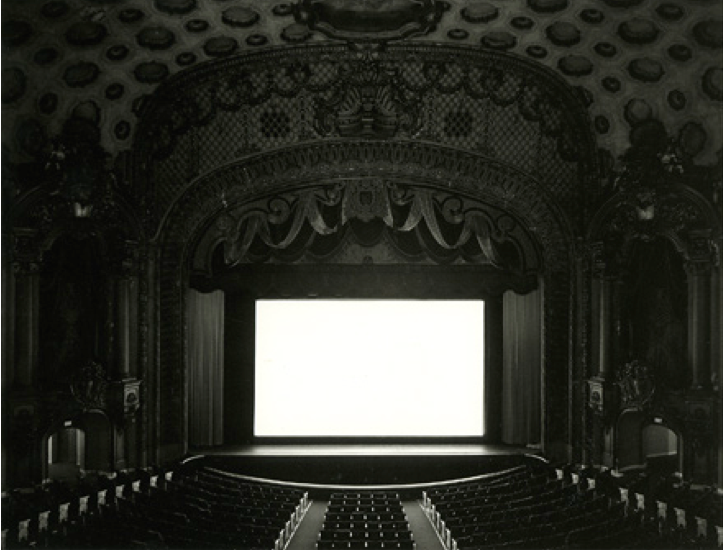
H. SUGIMOTO

Slide 15
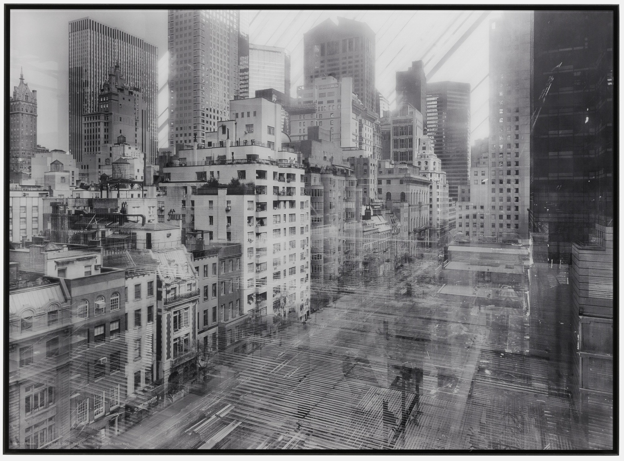
MICHAEL WESLEY

Slide 16
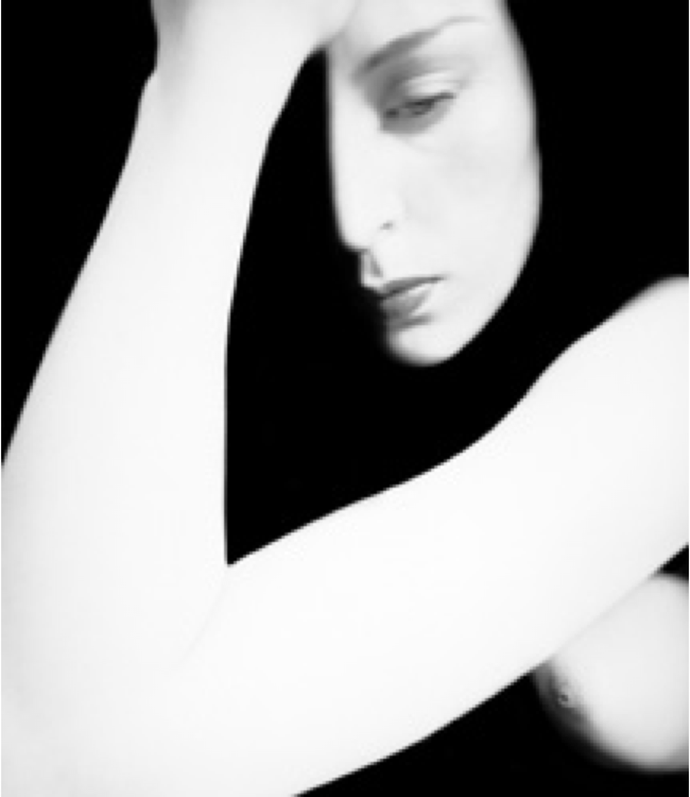
BILL BRANDT

Slide 17
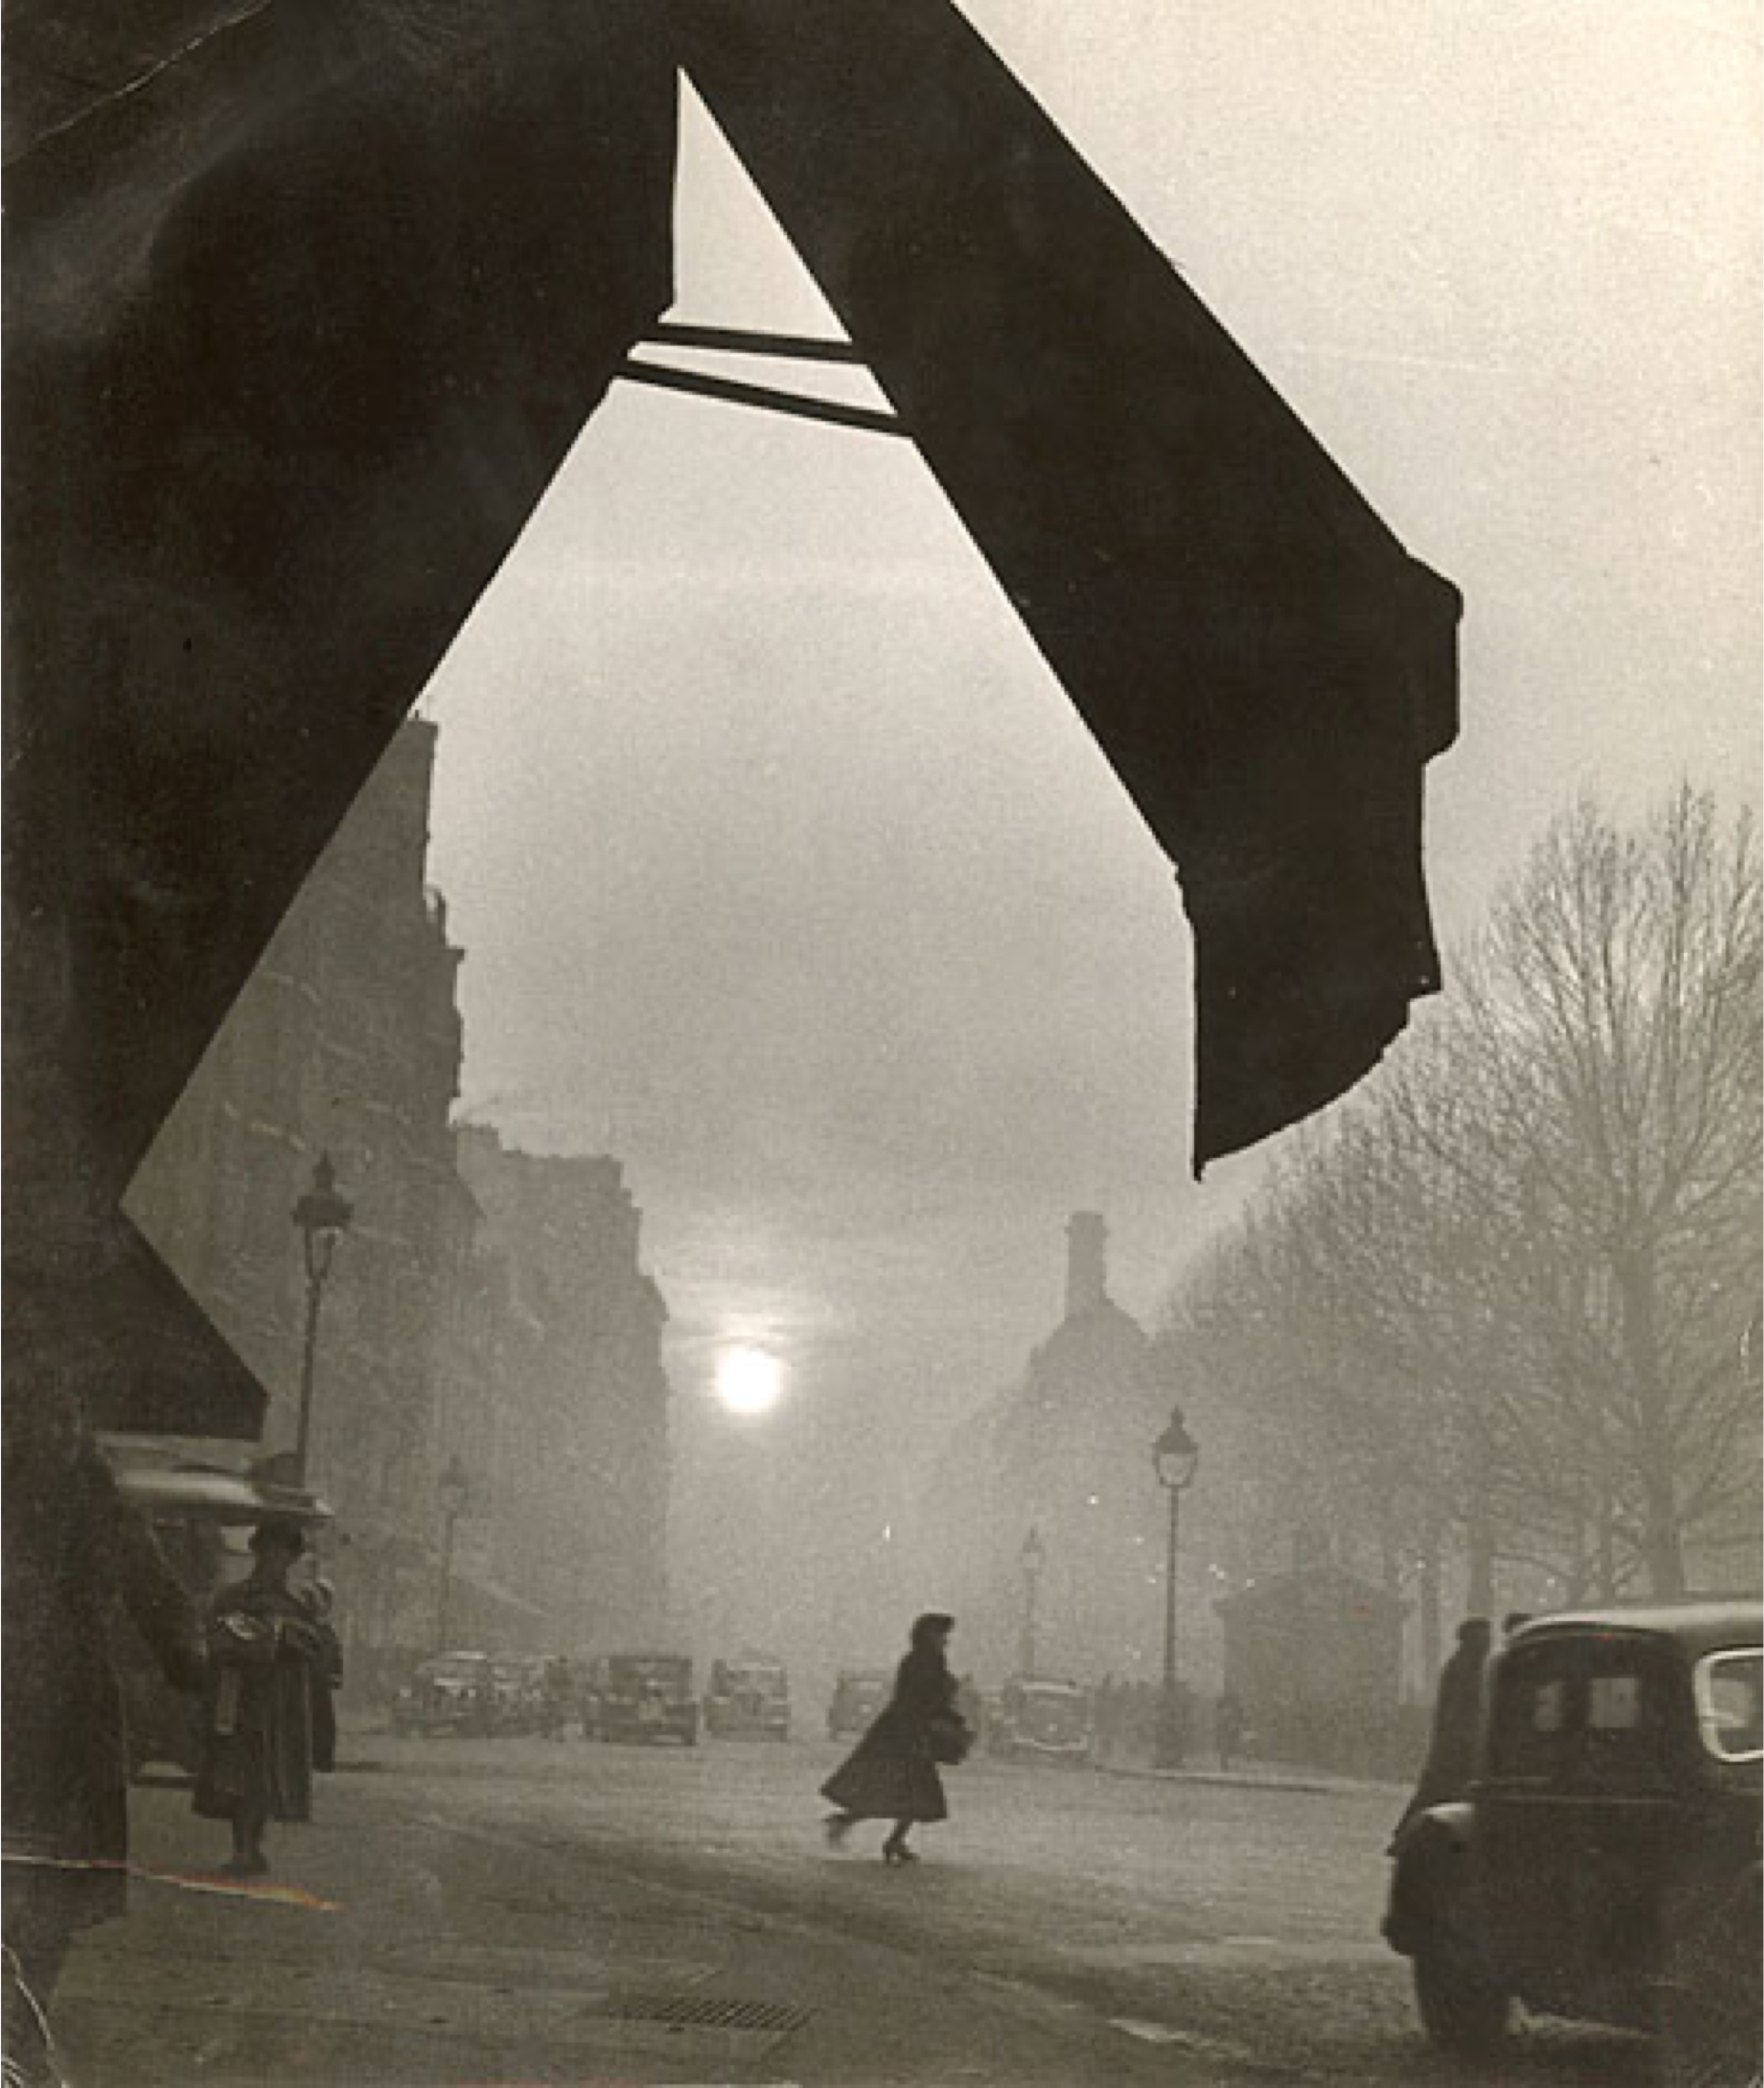
WILLY RONIS

Slide 18
MANUAL CAMERA
ISO
EXPOSURE
APERTURE
CORRECT
EXPOSURE
OVER
EXPOSED
UNDER
EXPOSED
FAST
SHUTTER SPEED
SLOW
SHUTTER SPEED
GREAT
DEPTH OF FIELD
SHALLOW
DEPTH OF FIELD

Slide 19
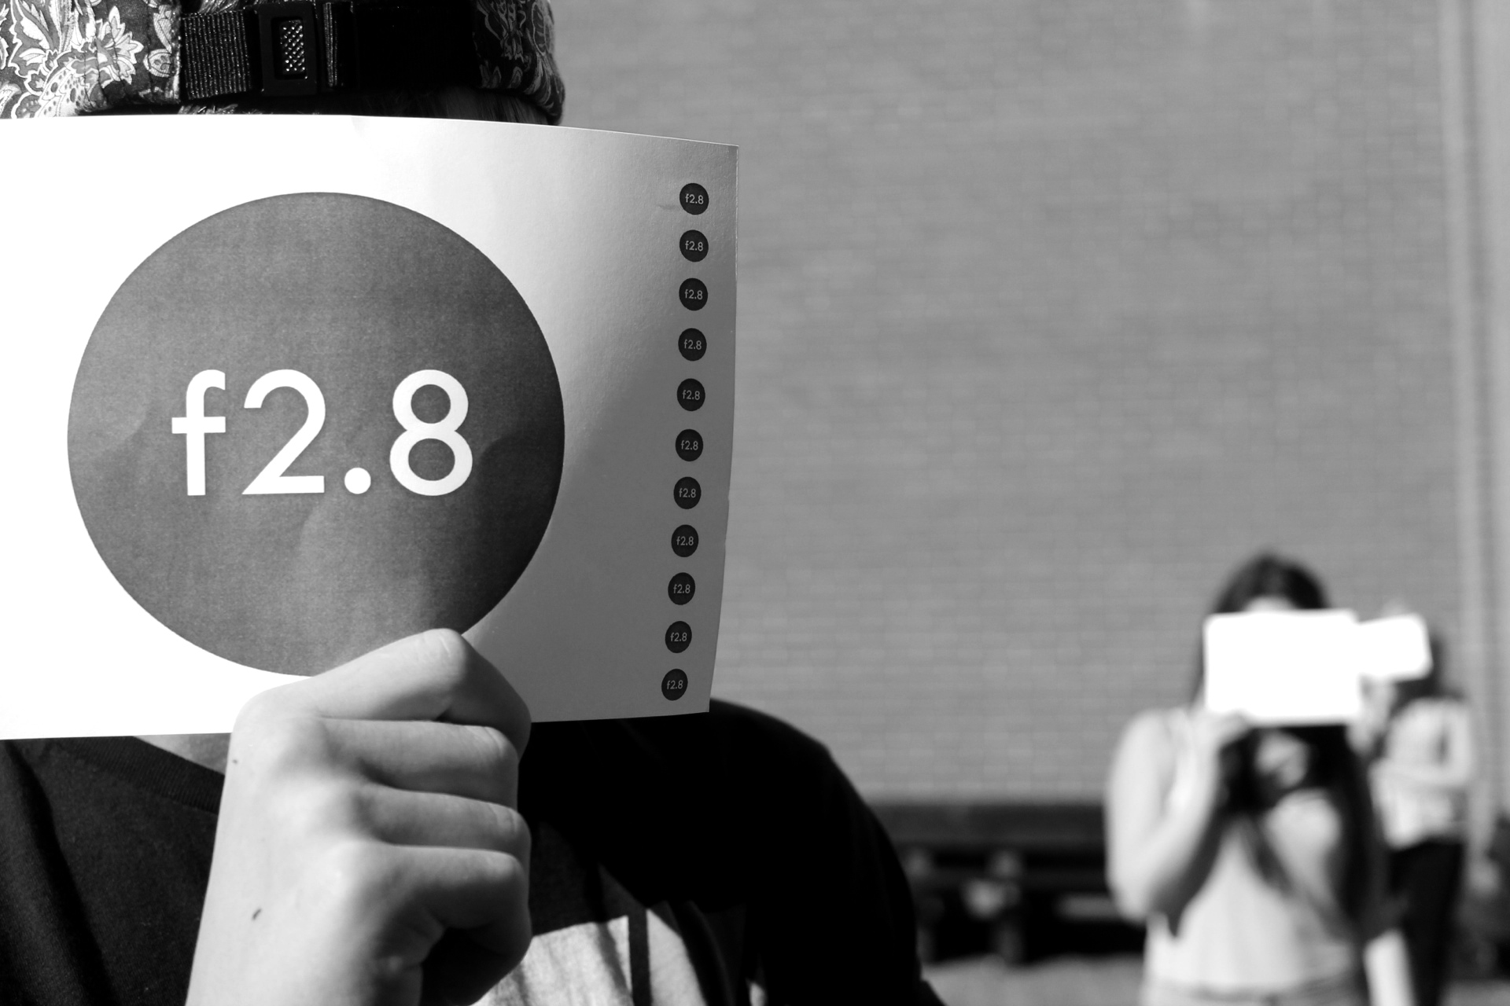
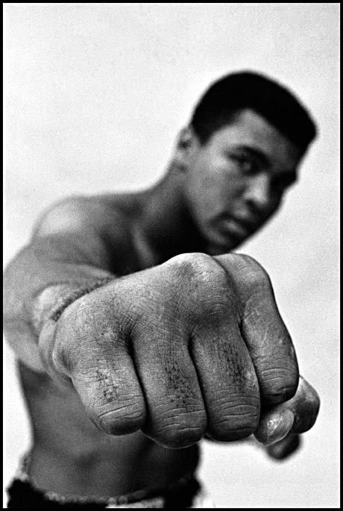
MANUAL CAMERA
CORRECT
EXPOSURE
OVER
EXPOSED
UNDER
EXPOSED
FAST
SHUTTER SPEED
SLOW
SHUTTER SPEED
GREAT
DEPTH OF FIELD
SHORT
DEPTH OF FIELD
SHORT
DEPTH OF FIELD
ISO 400_1/125_f.2.8
THOMAS HOEPKER

Slide 20
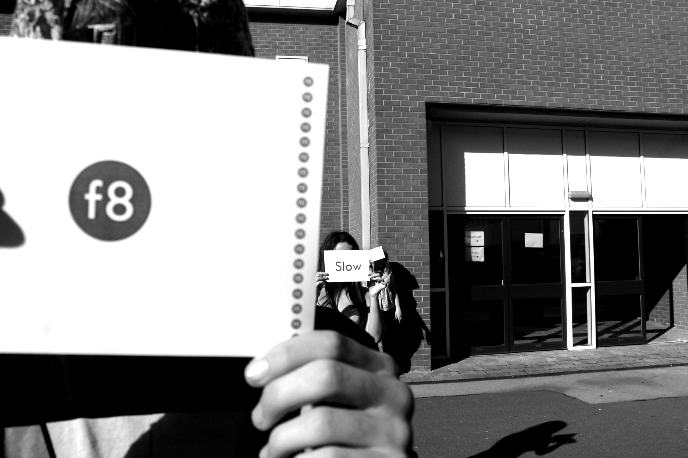
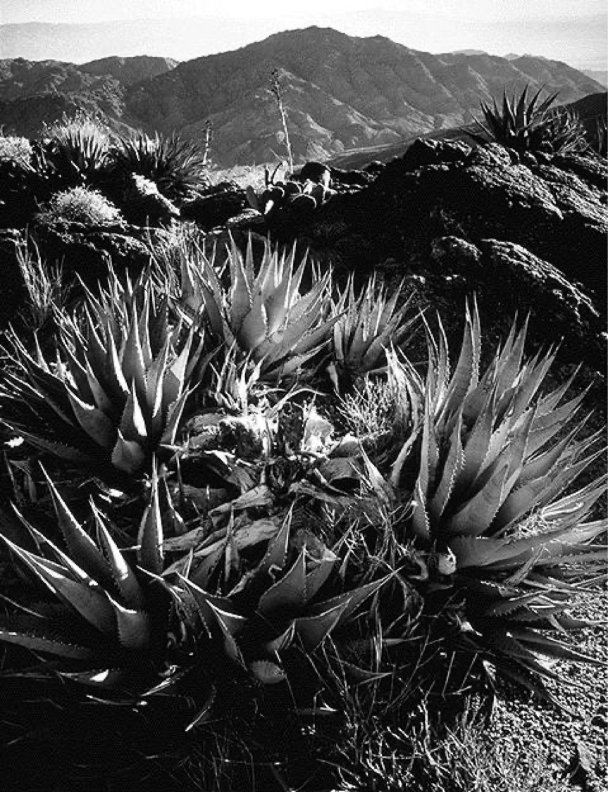
MANUAL CAMERA
CORRECT
EXPOSURE
OVER
EXPOSED
UNDER
EXPOSED
FAST
SHUTTER SPEED
SLOW
SHUTTER SPEED
GREAT
DEPTH OF FIELD
SHORT
DEPTH OF FIELD
GREAT
DEPTH OF FIELD
ISO 400_1/60_f.8
ANSEL ADAMS

Slide 21
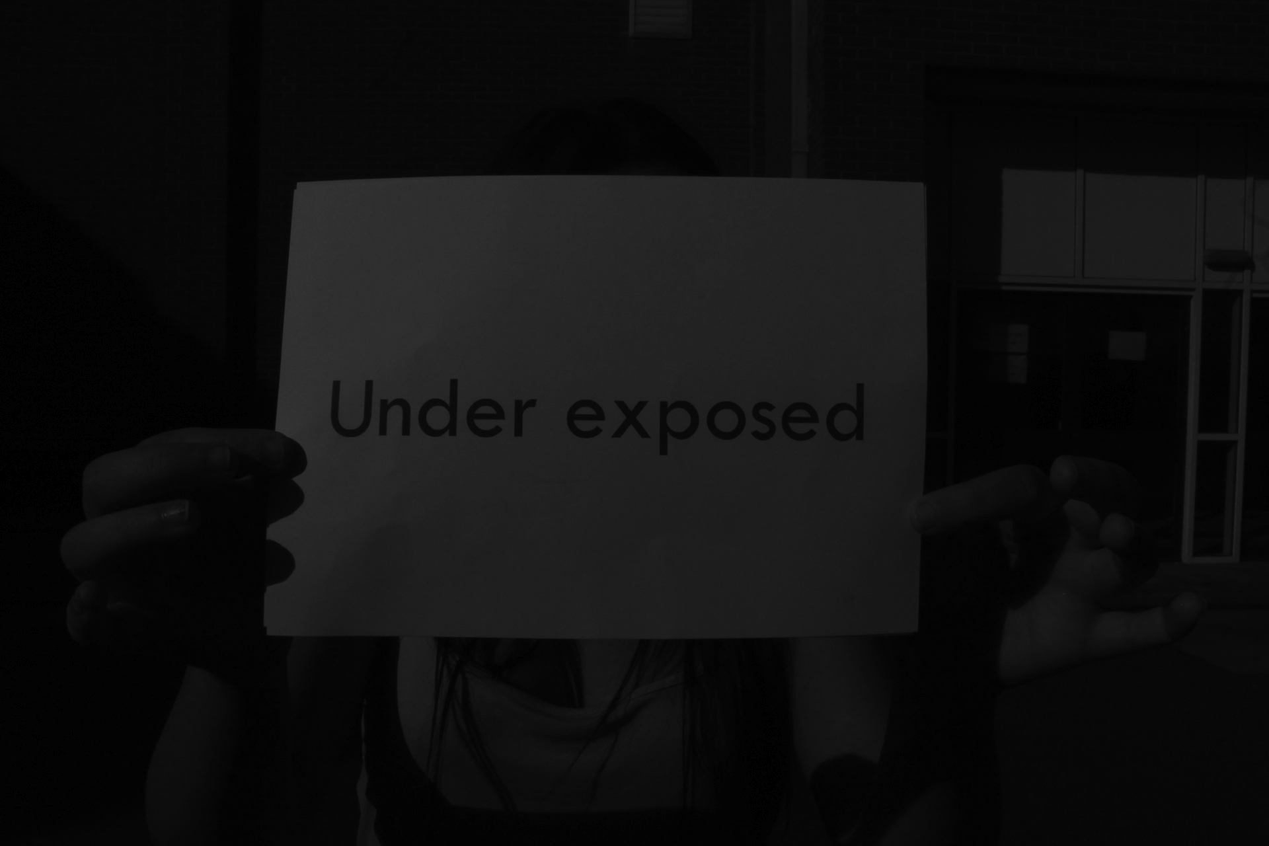
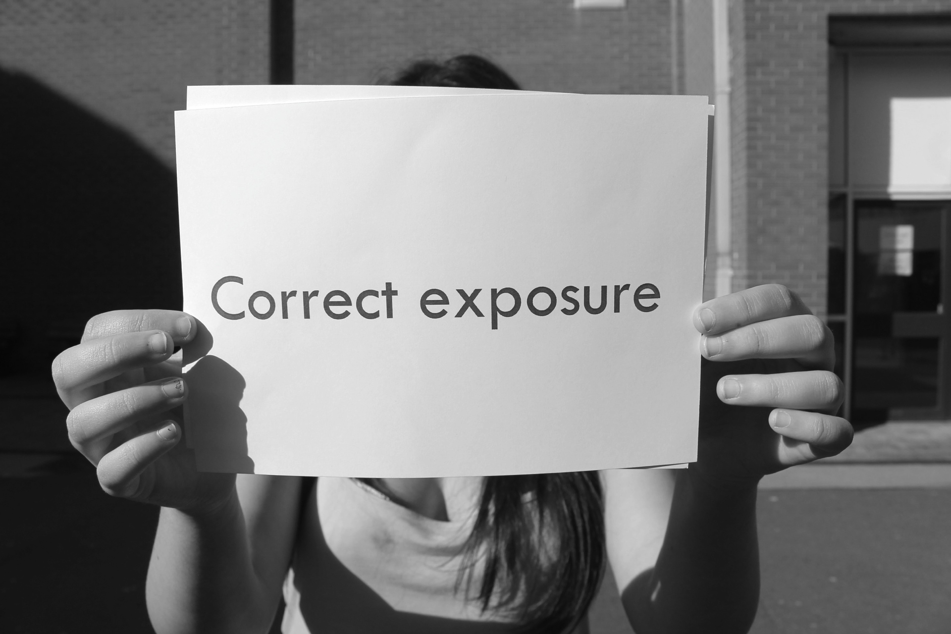

MANUAL CAMERA
CORRECT
EXPOSURE
OVER
EXPOSED
UNDER
EXPOSED
FAST
SHUTTER SPEED
SLOW
SHUTTER SPEED
GREAT
DEPTH OF FIELD
SHORT
DEPTH OF FIELD
UNDER EXPOSED
ISO 400_1/250_f.5.4
CORRCT EXPOSURE
ISO 400_1/125_f.5.4
OVER EXPOSED
ISO 400_1/25_f.2.8

Slide 22
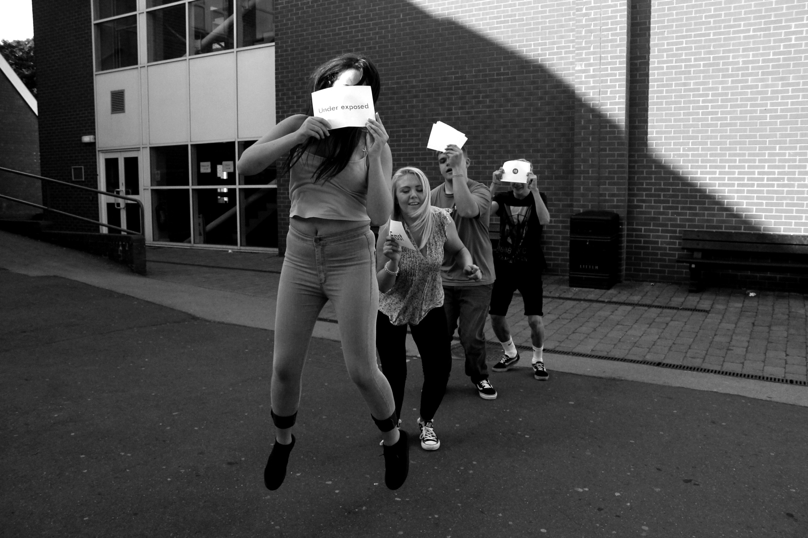
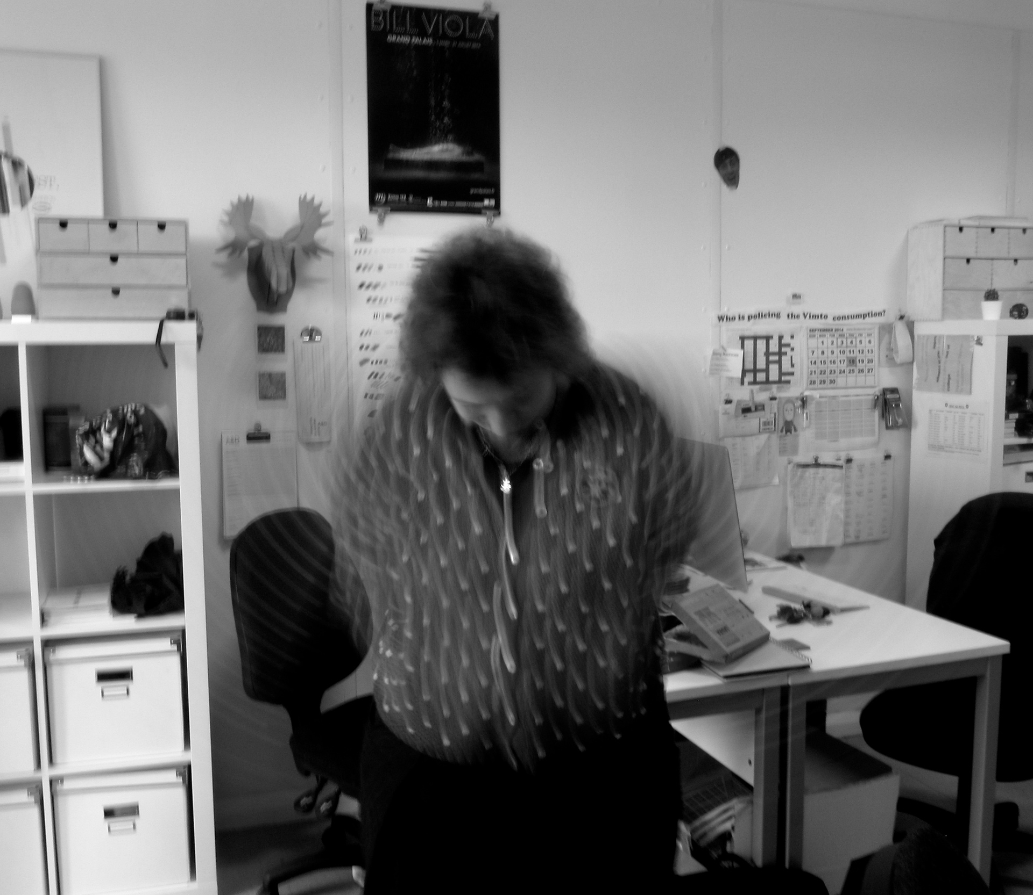
MANUAL CAMERA
CORRECT
EXPOSURE
OVER
EXPOSED
UNDER
EXPOSED
FAST
SHUTTER SPEED
SLOW
SHUTTER SPEED
GREAT
DEPTH OF FIELD
SHORT
DEPTH OF FIELD
FAST SHUTTER SPEED
ISO 1600_1/1250_f.2.8
SLOW SHUTTER SPEED
ISO 100_1”_f.8

Slide 23
MANUAL CAMERA
CORRECT
EXPOSURE
OVER
EXPOSED
UNDER
EXPOSED
FAST
SHUTTER SPEED
SLOW
SHUTTER SPEED
GREAT
DEPTH OF FIELD
SHORT
DEPTH OF FIELD
http://camerasettings.tumblr.com

Slide 24
MANUAL CAMERA
SELECT 3 - 4 ARTISTS FROM THIS PRESENTATION
AND PRODUCE 2 RESEARCH PAGES FOR EACH ARTIST
THIS WILL BE DISPLAYED IN YOUR DIGITAL GALLERY SKETCHBOOK

Slide 25
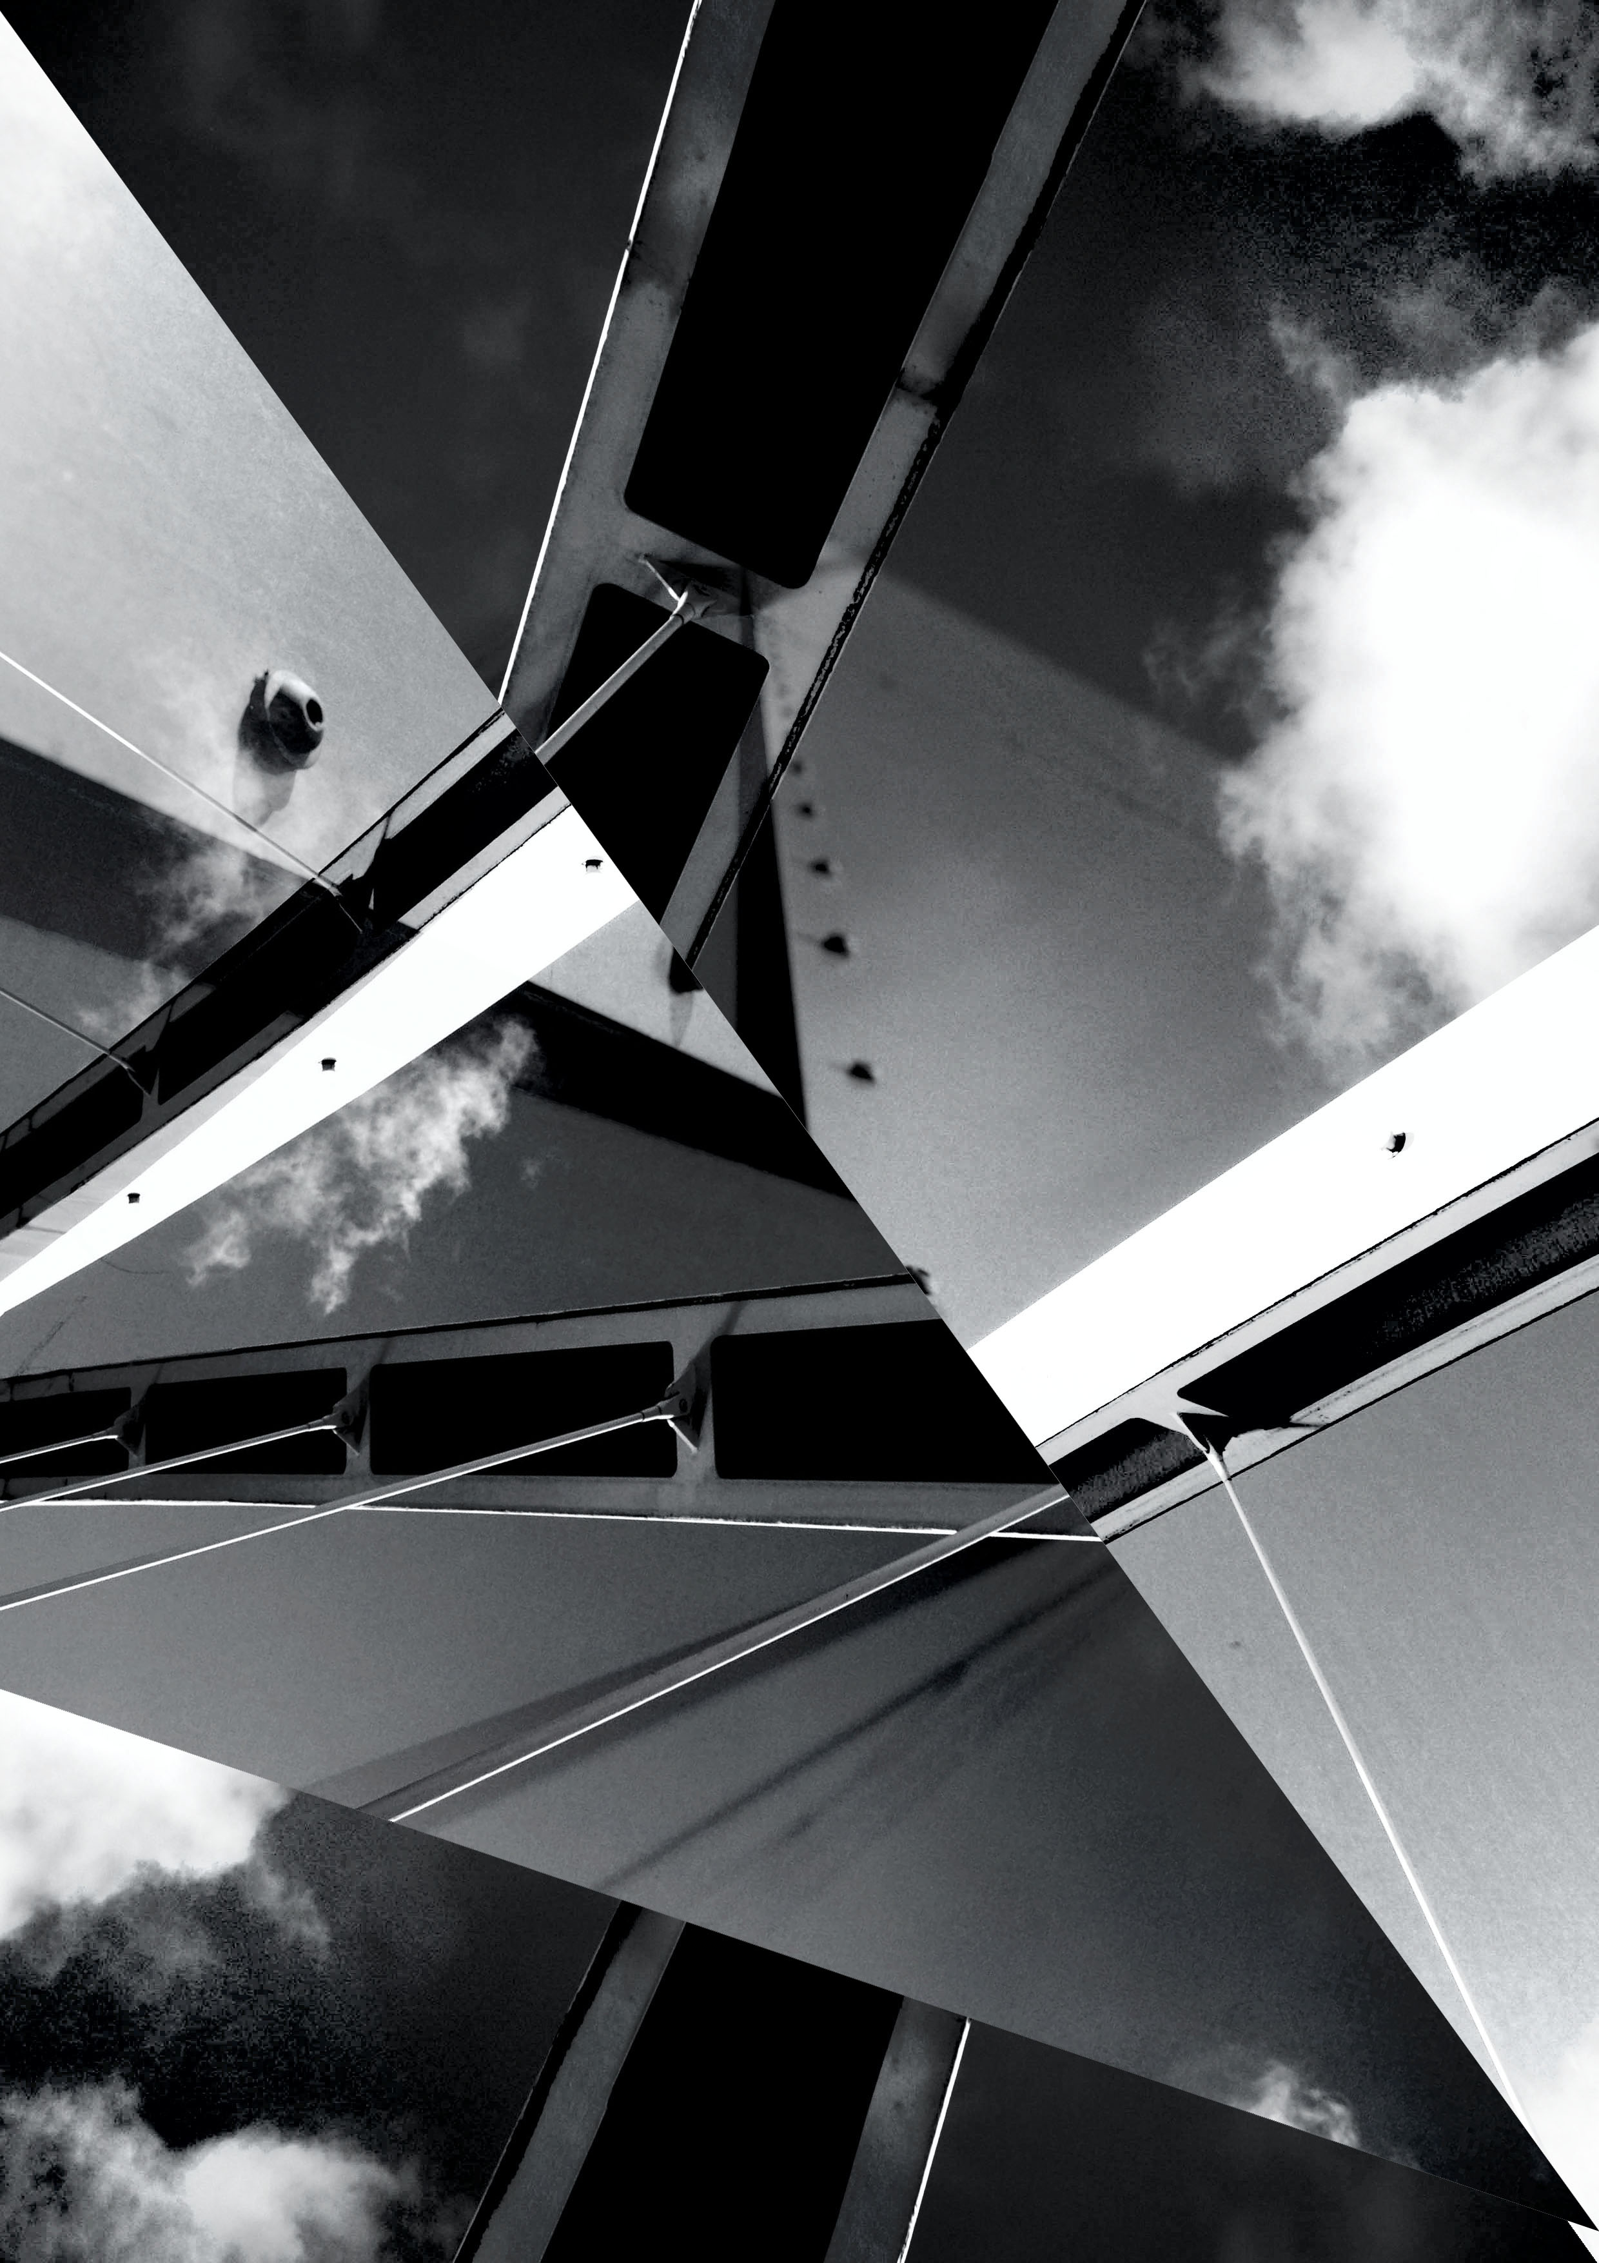
MANUAL CAMERA
OR
SELECT 3 - 4 ARTISTS FROM THIS PRESENTATION
AND PRODUCE 2 RESEARCH PAGES FOR EACH ARTIST
THIS WILL BE DISPLAYED IN YOUR DIGITAL GALLERY SKETCHBOOK
COMPLETE 6 DEVELOPMENT PIECES

