Slide 1
Design a PROTEST in a box

Slide 2
Designers and artists making protest art

Slide 3
Banksy

Slide 4
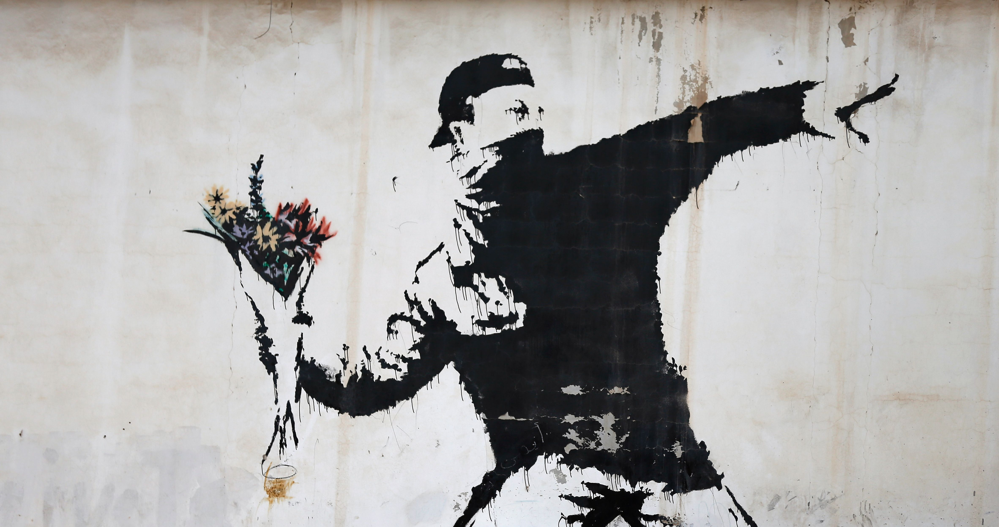
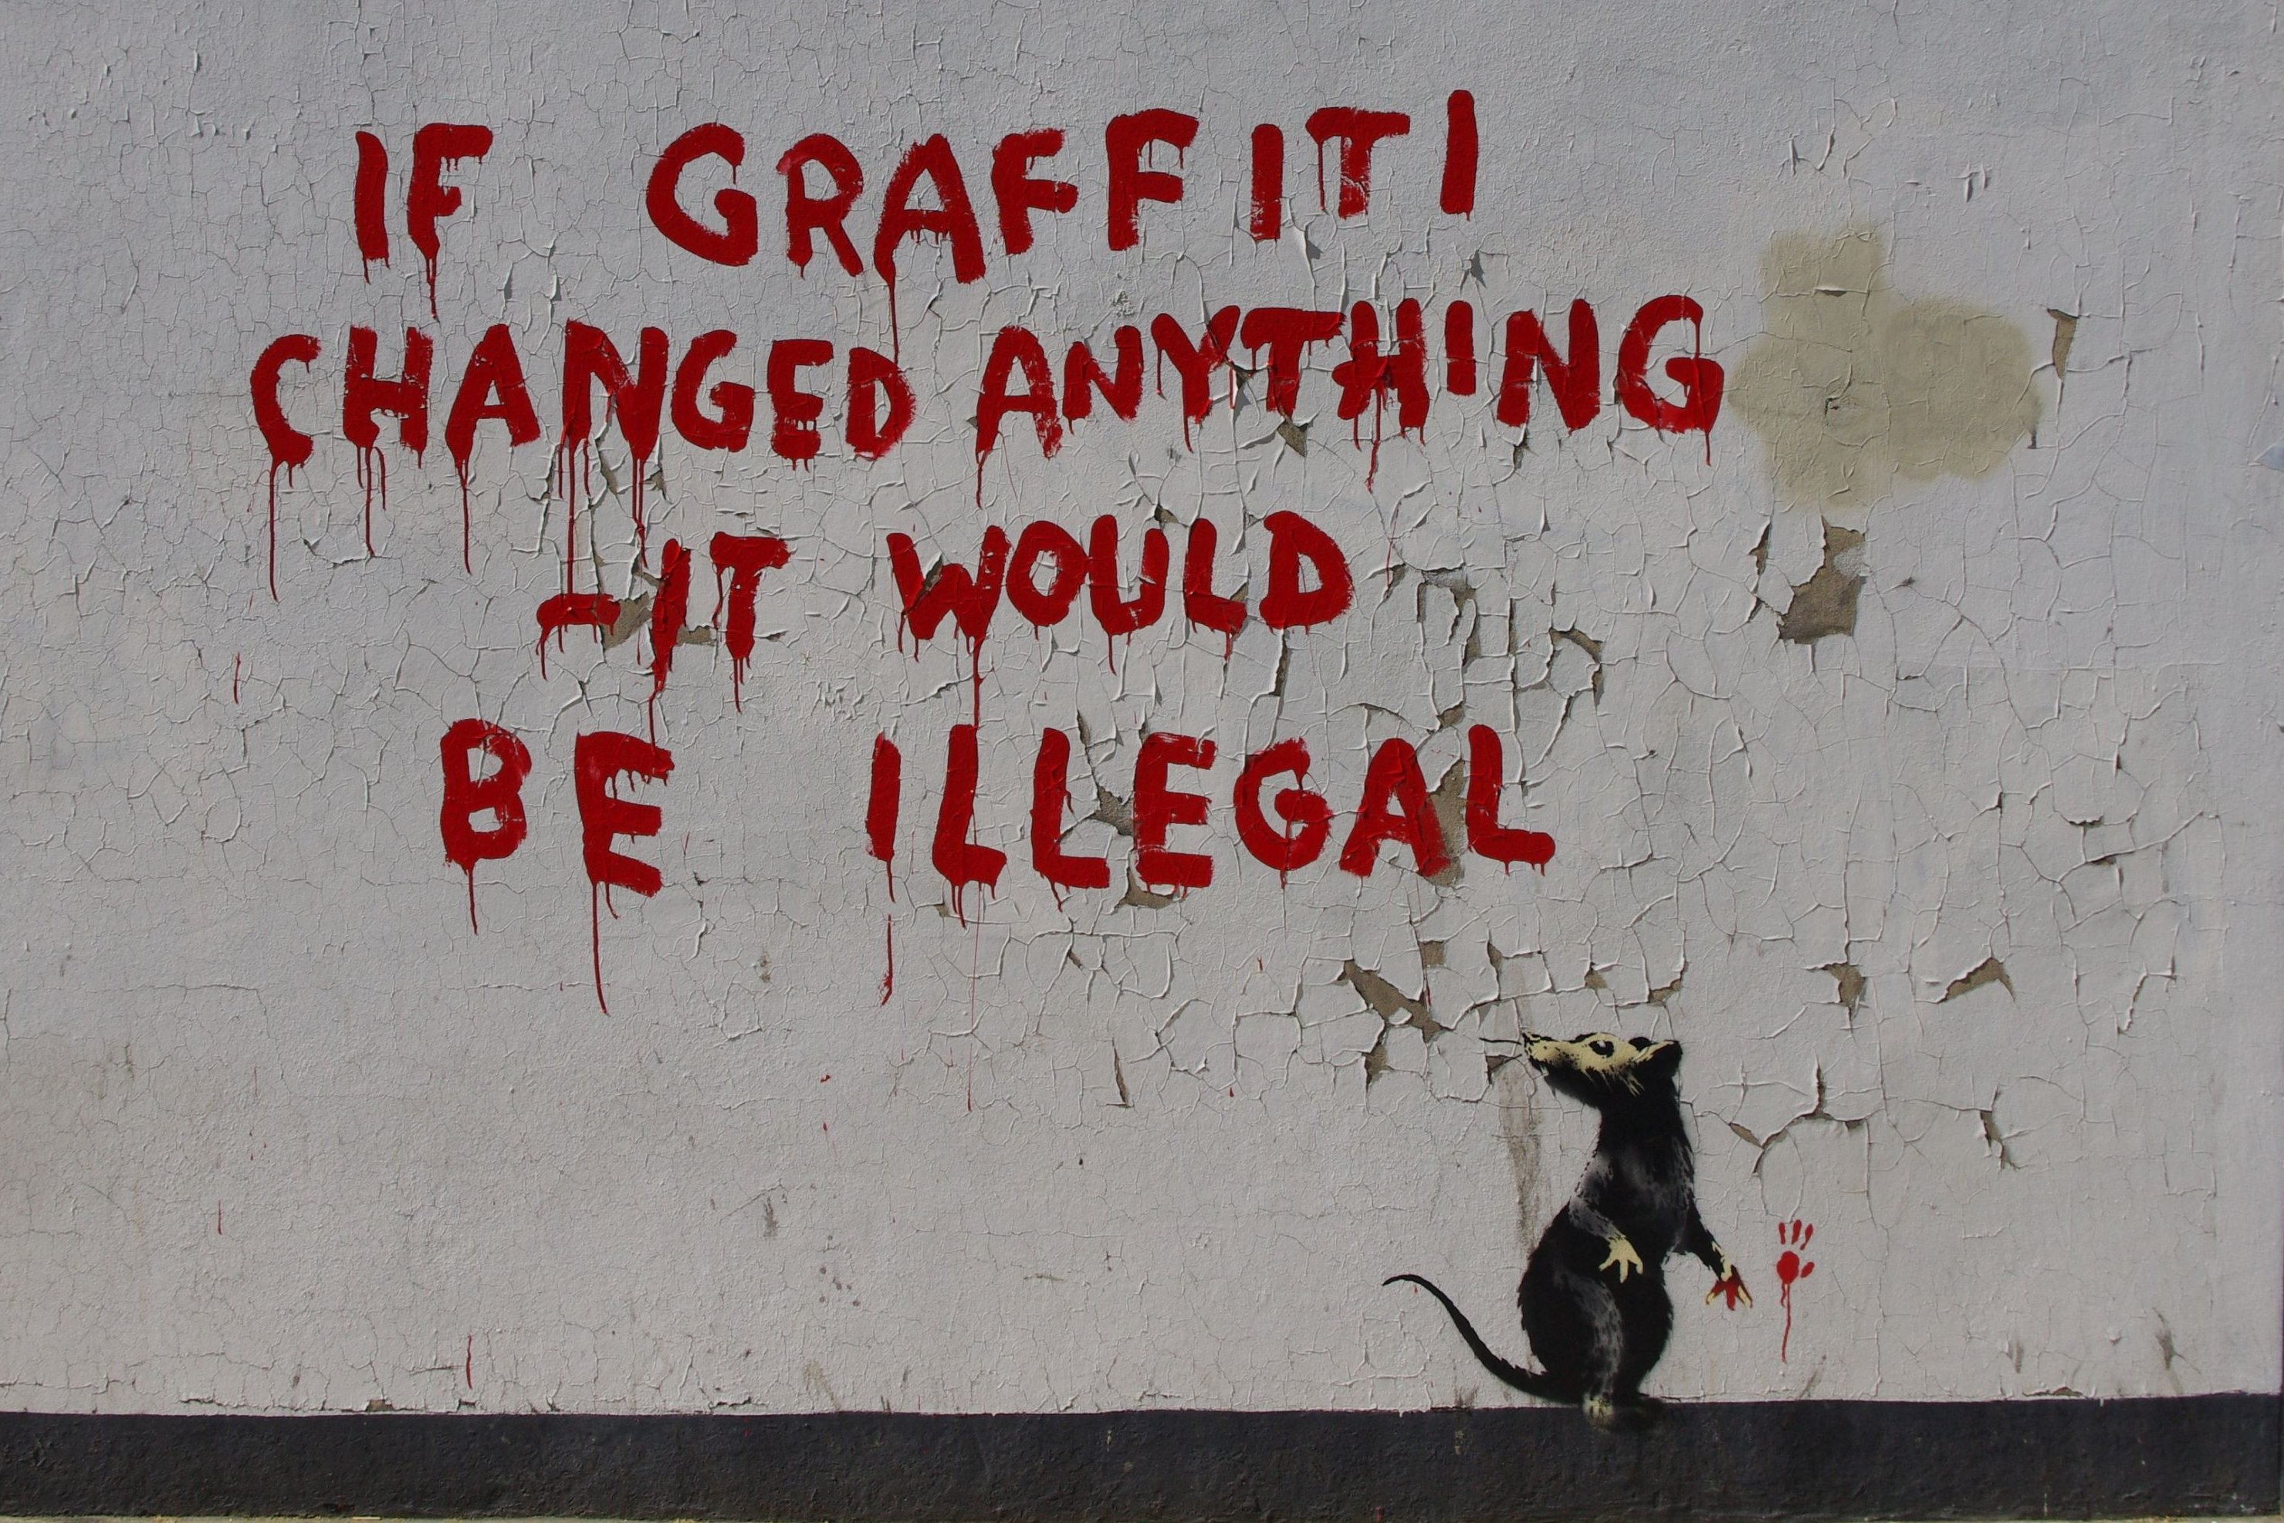

Slide 5
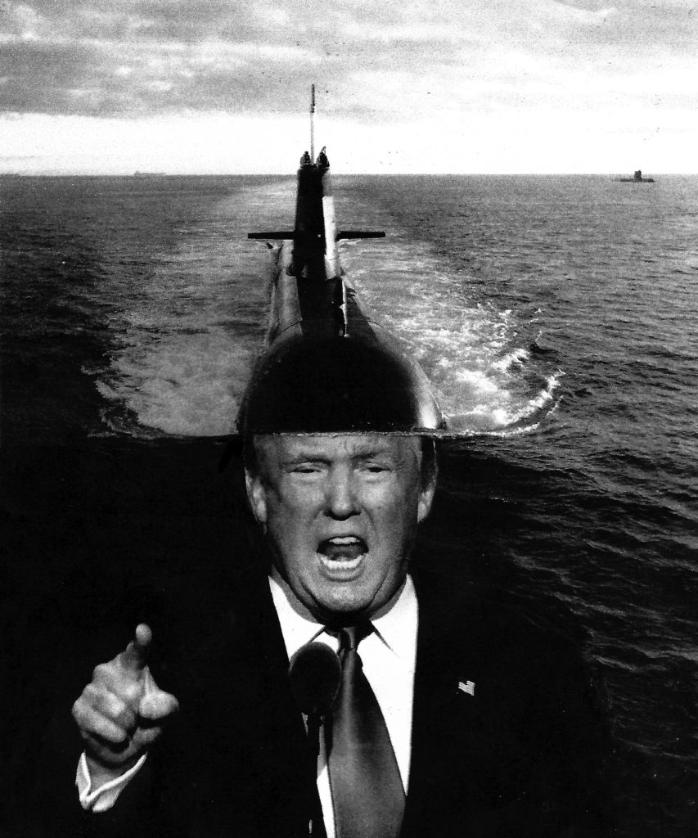
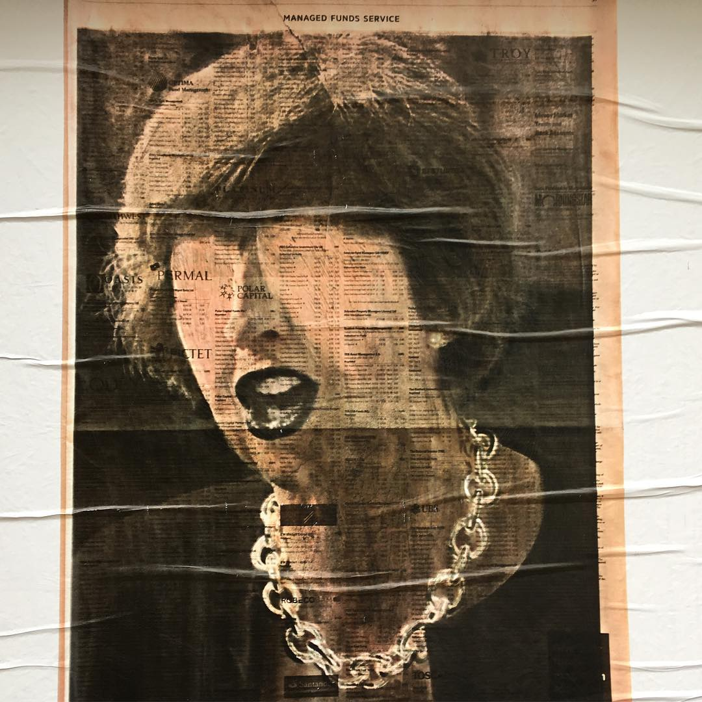
Peter Kennard and Cat Phillipps

Slide 6
Greenpeace: Save the Arctic campaign artwork for their video A Song of Oil, Ice and Fire. Click the image to see the film.

Slide 7
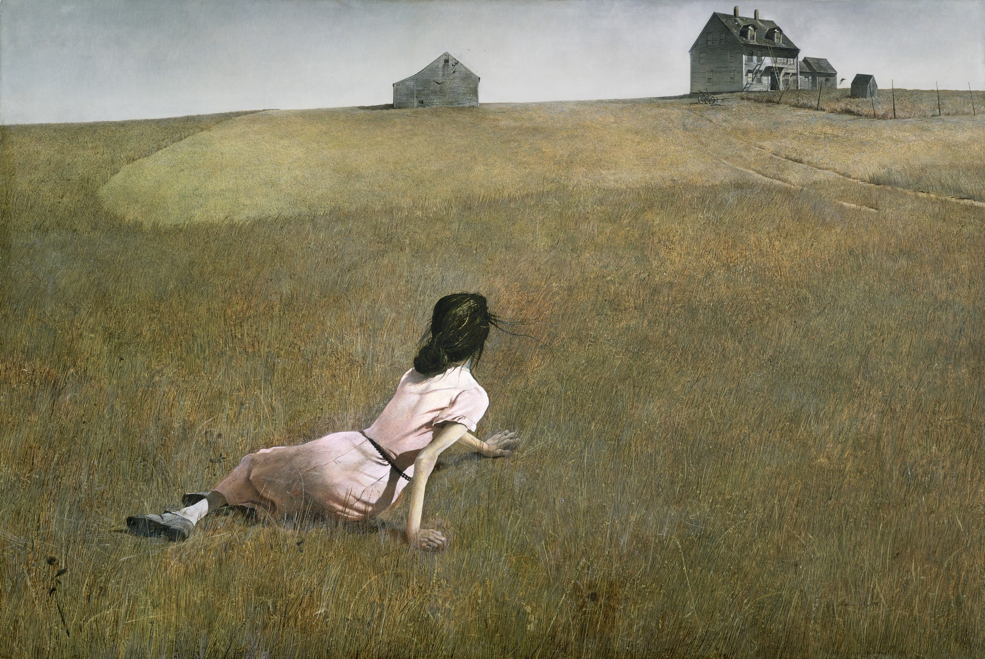
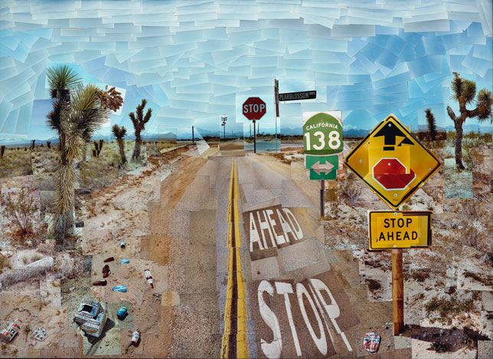
Andrew Wyeth - Christina’s World
David Hockney - Pearblossom Highway #1

Slide 8
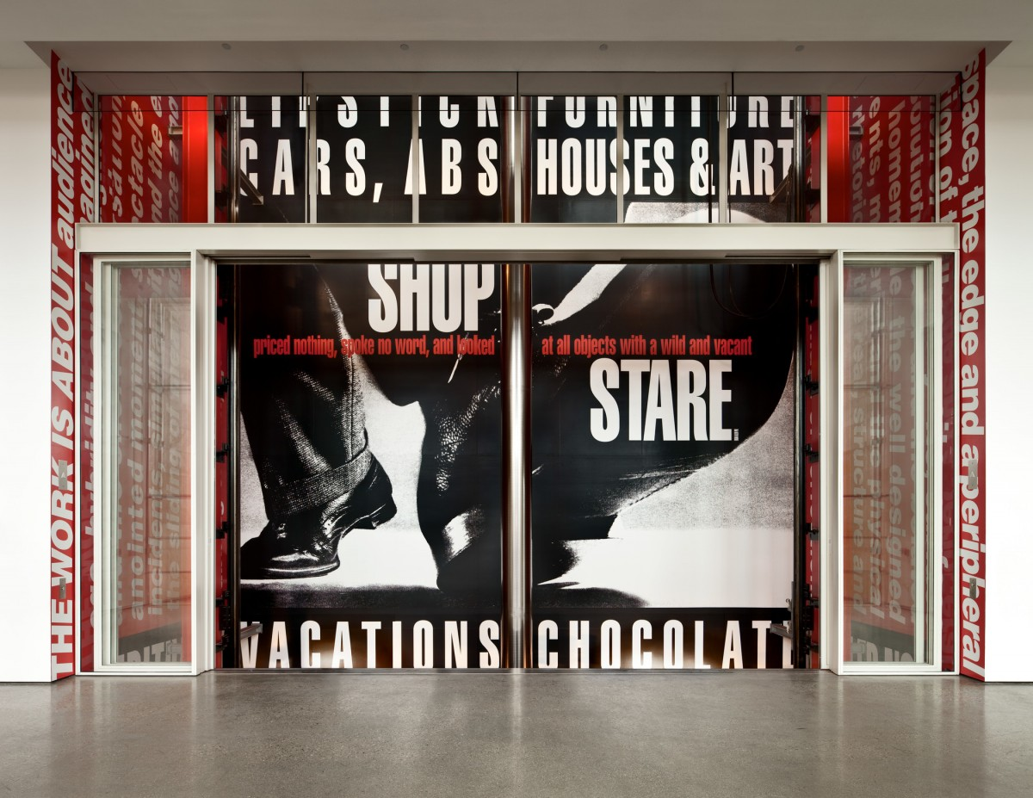
Barbara Kruger

Slide 9
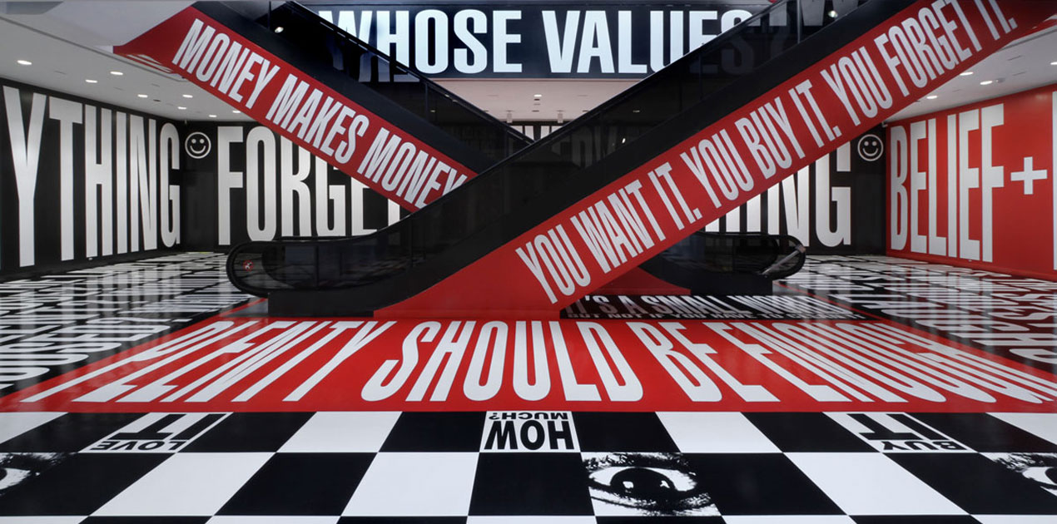
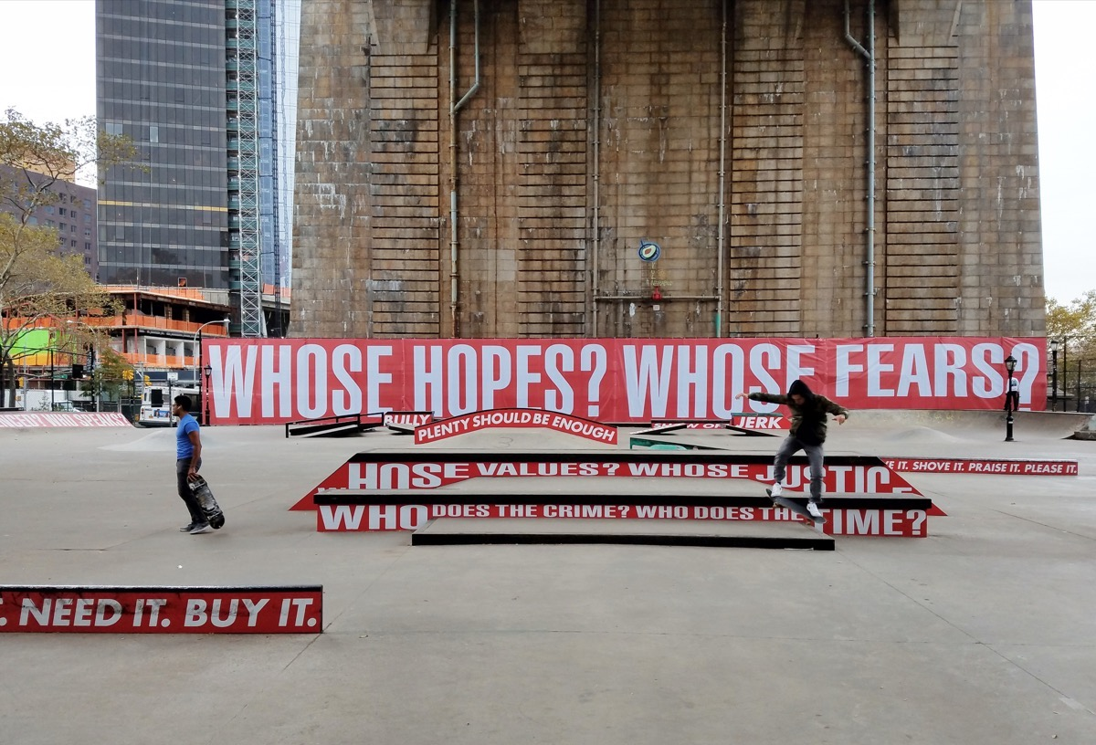

Slide 10
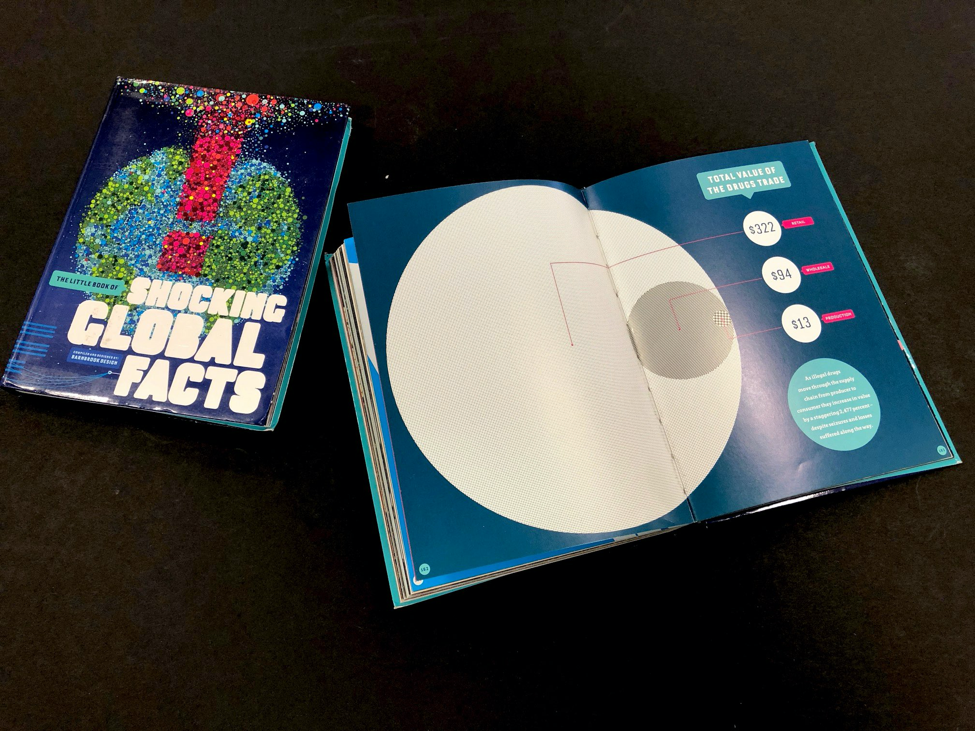
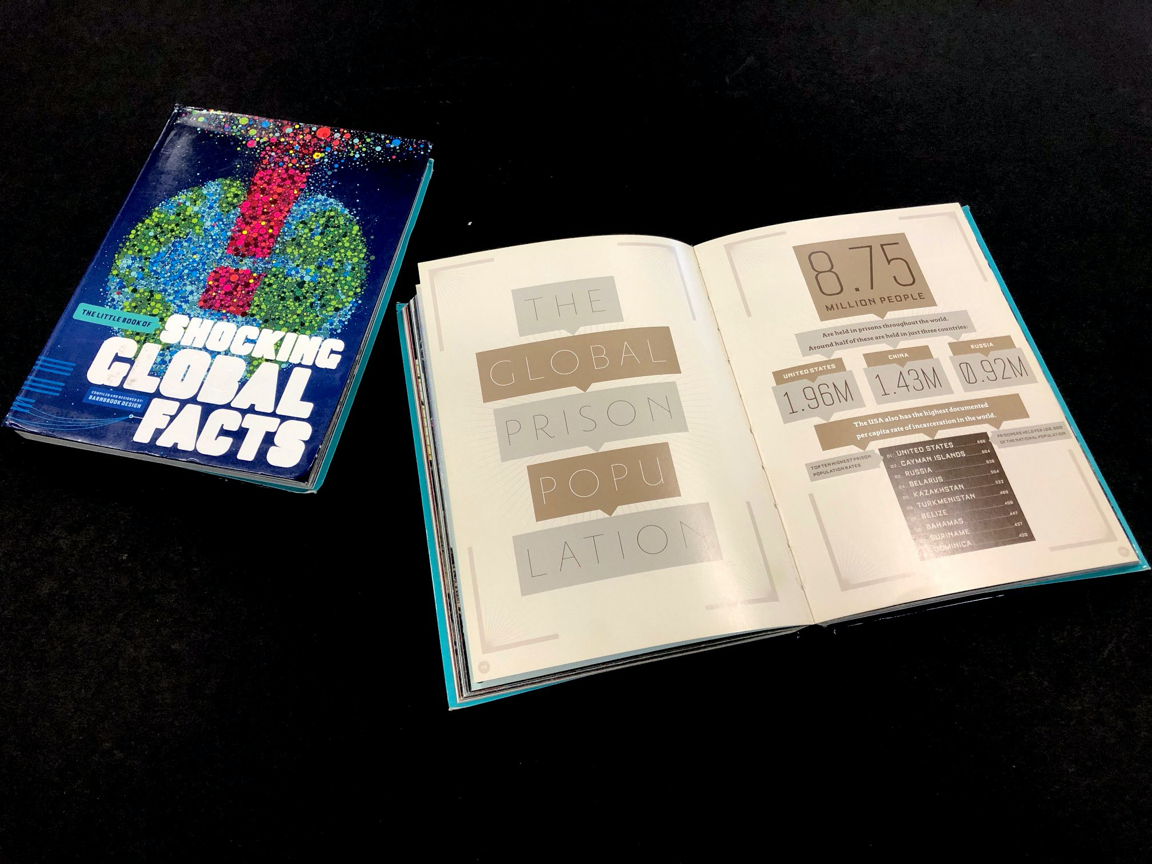
Jonathan Barnbrook

Slide 11
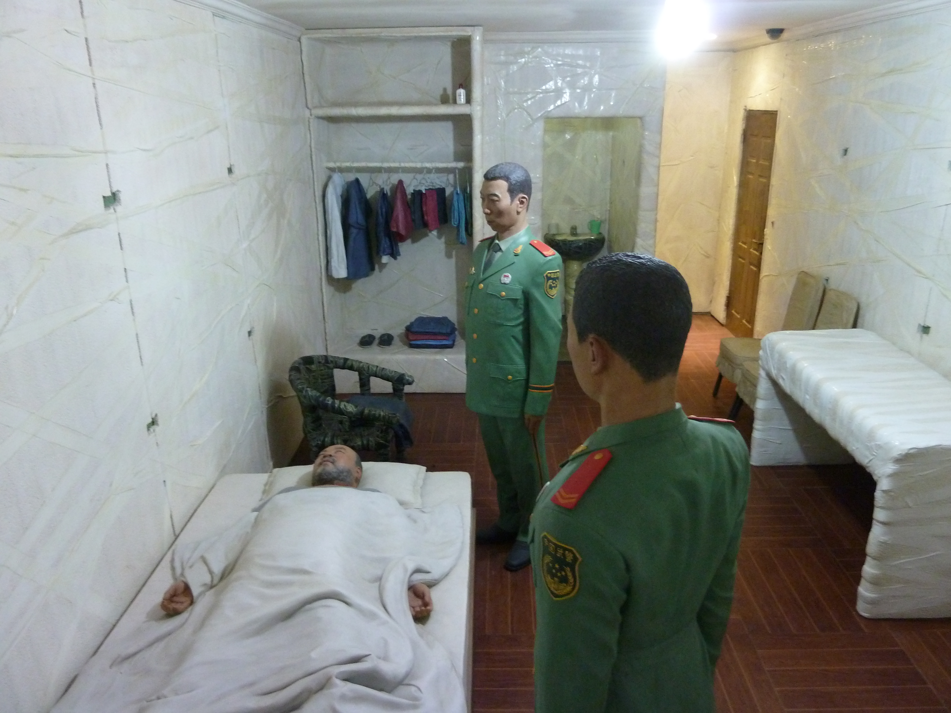
Ai WeiWei

Slide 12
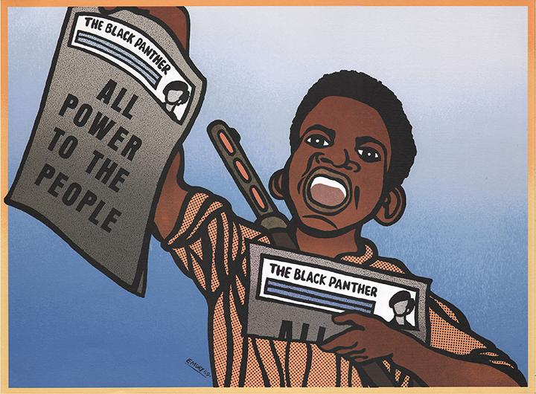
Emory Douglas

Slide 13
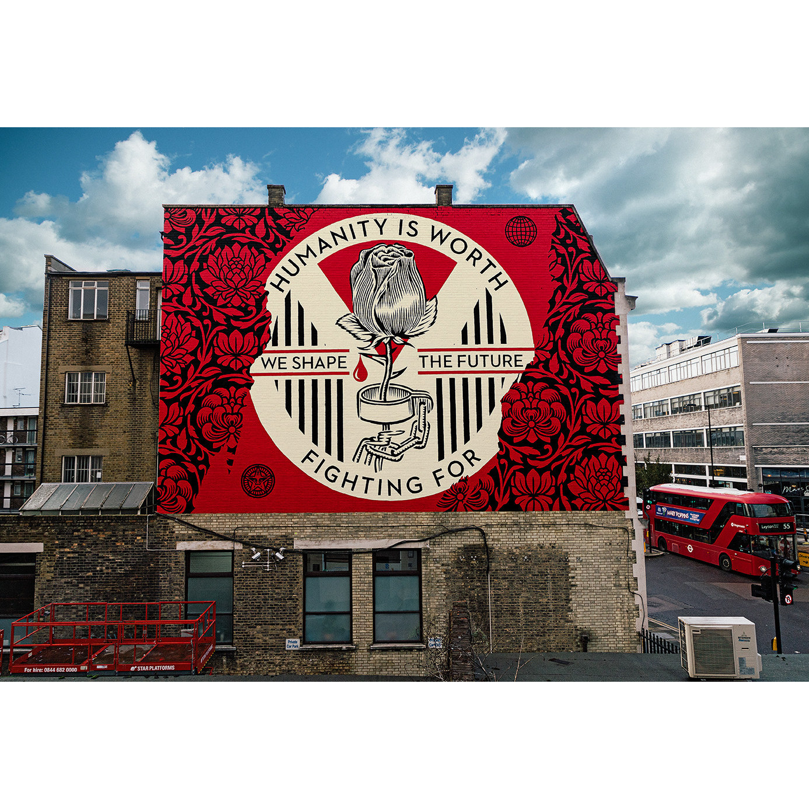
Shepard Fairey

Slide 14
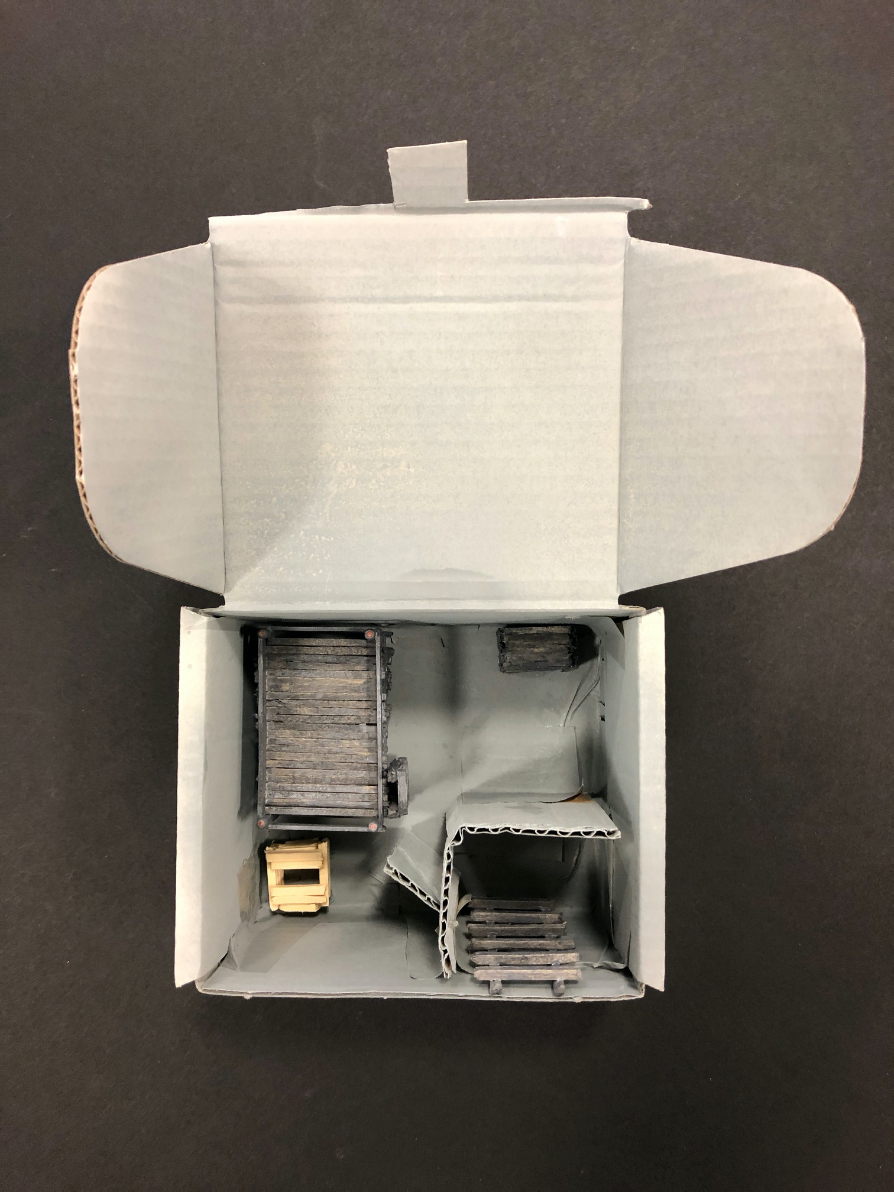
Student work

Slide 15
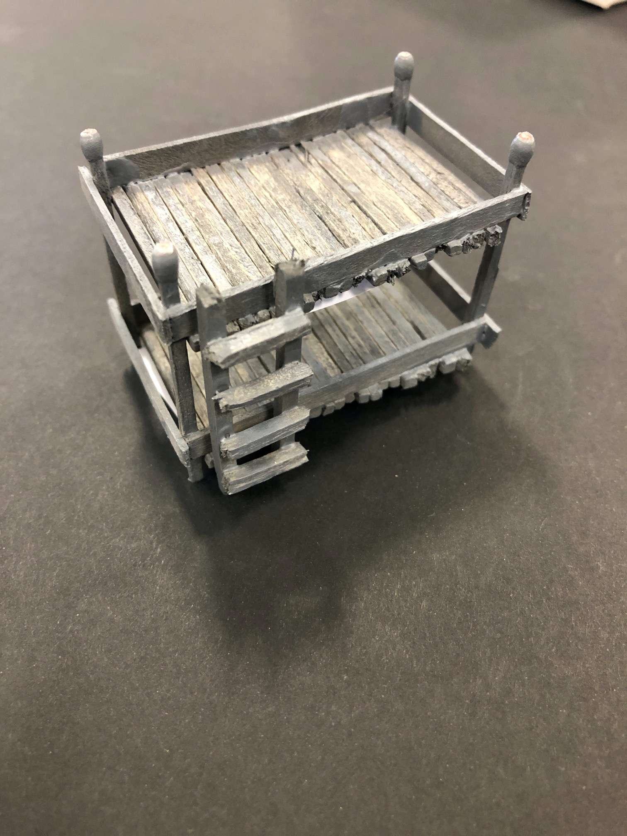
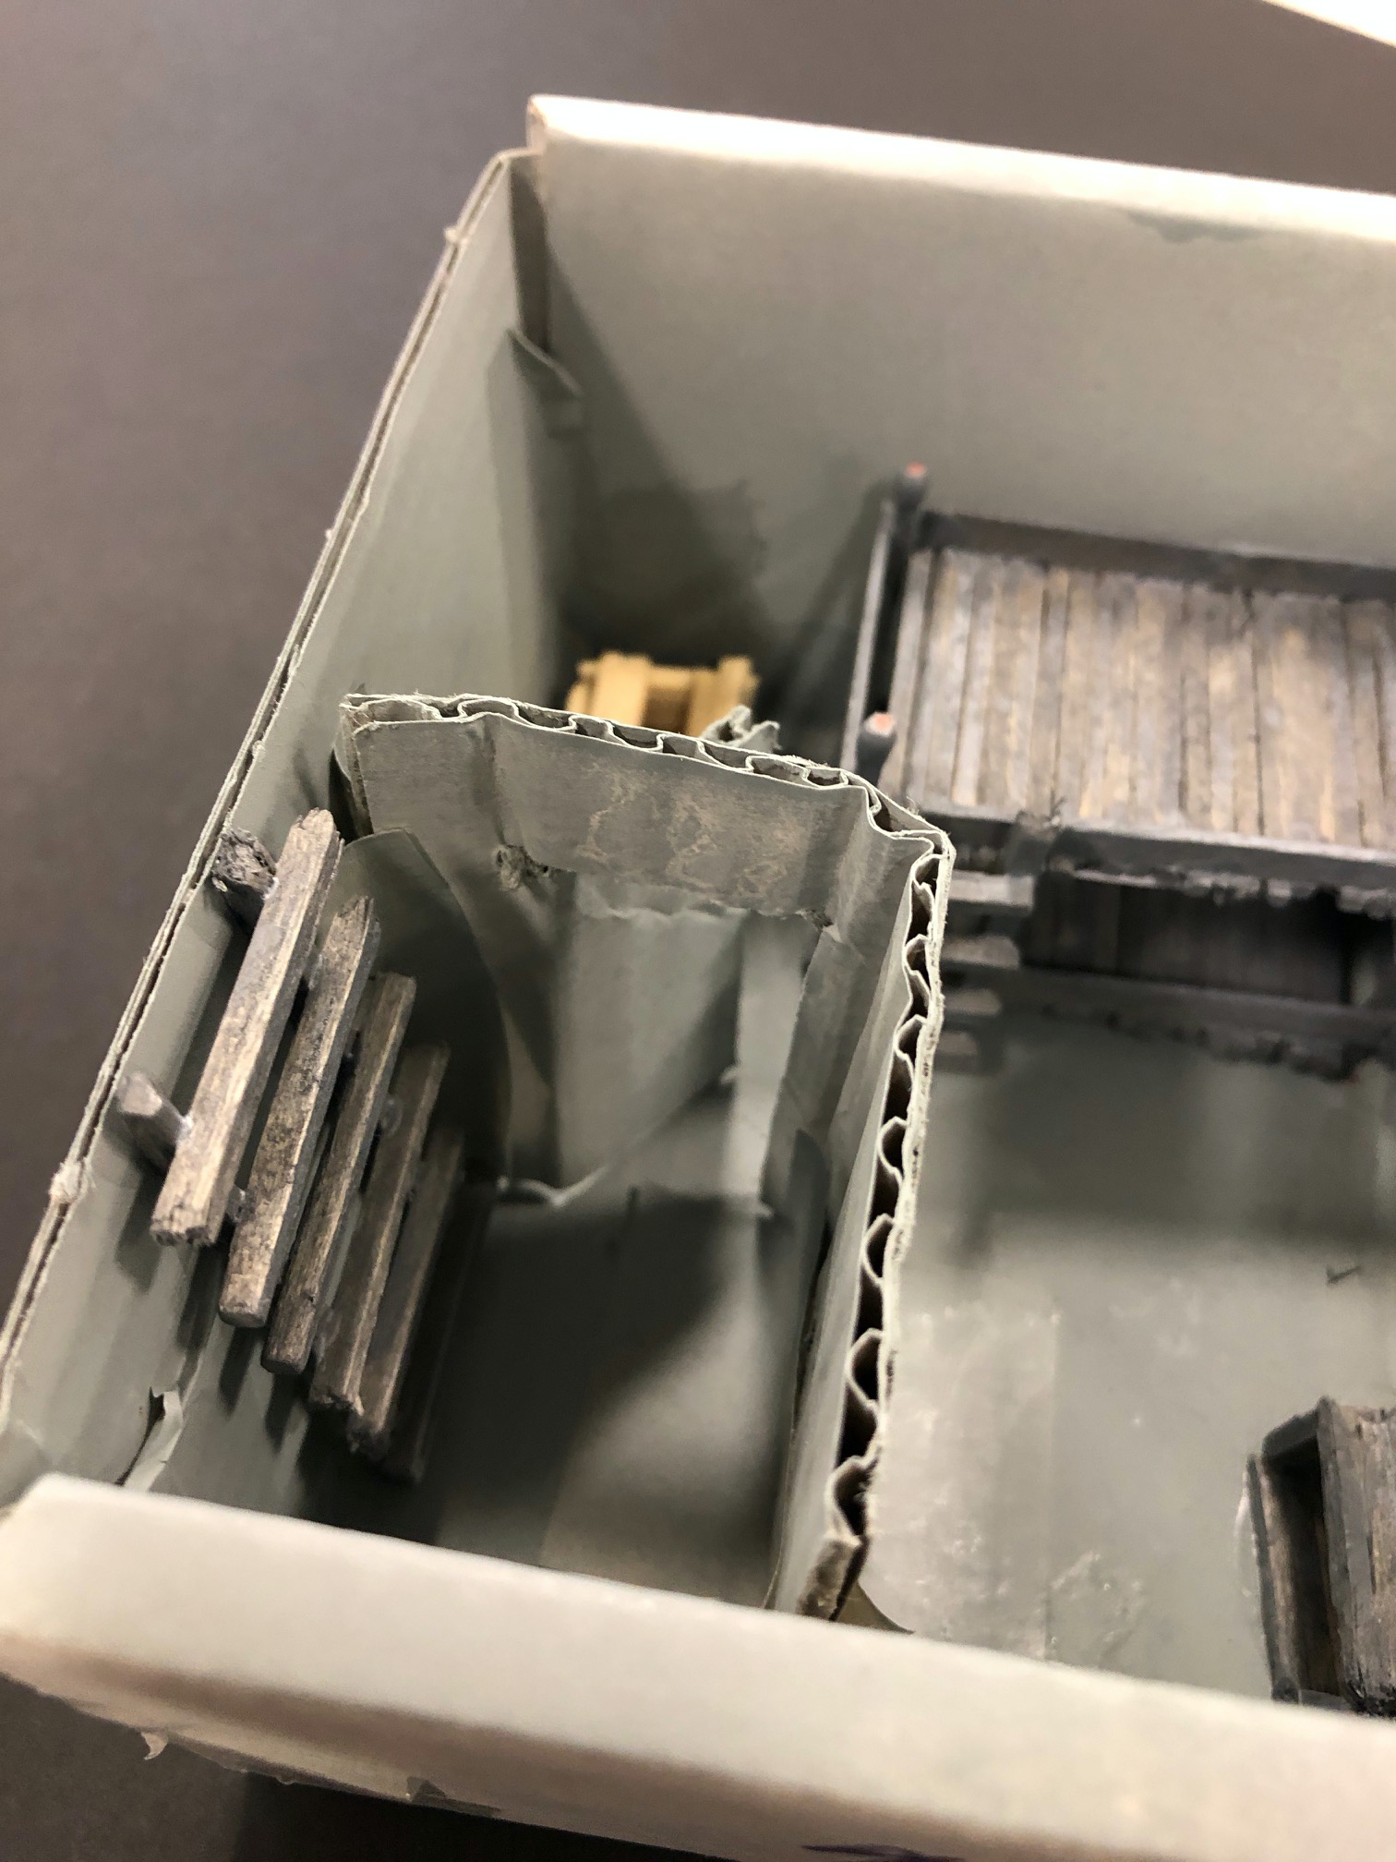

Slide 16
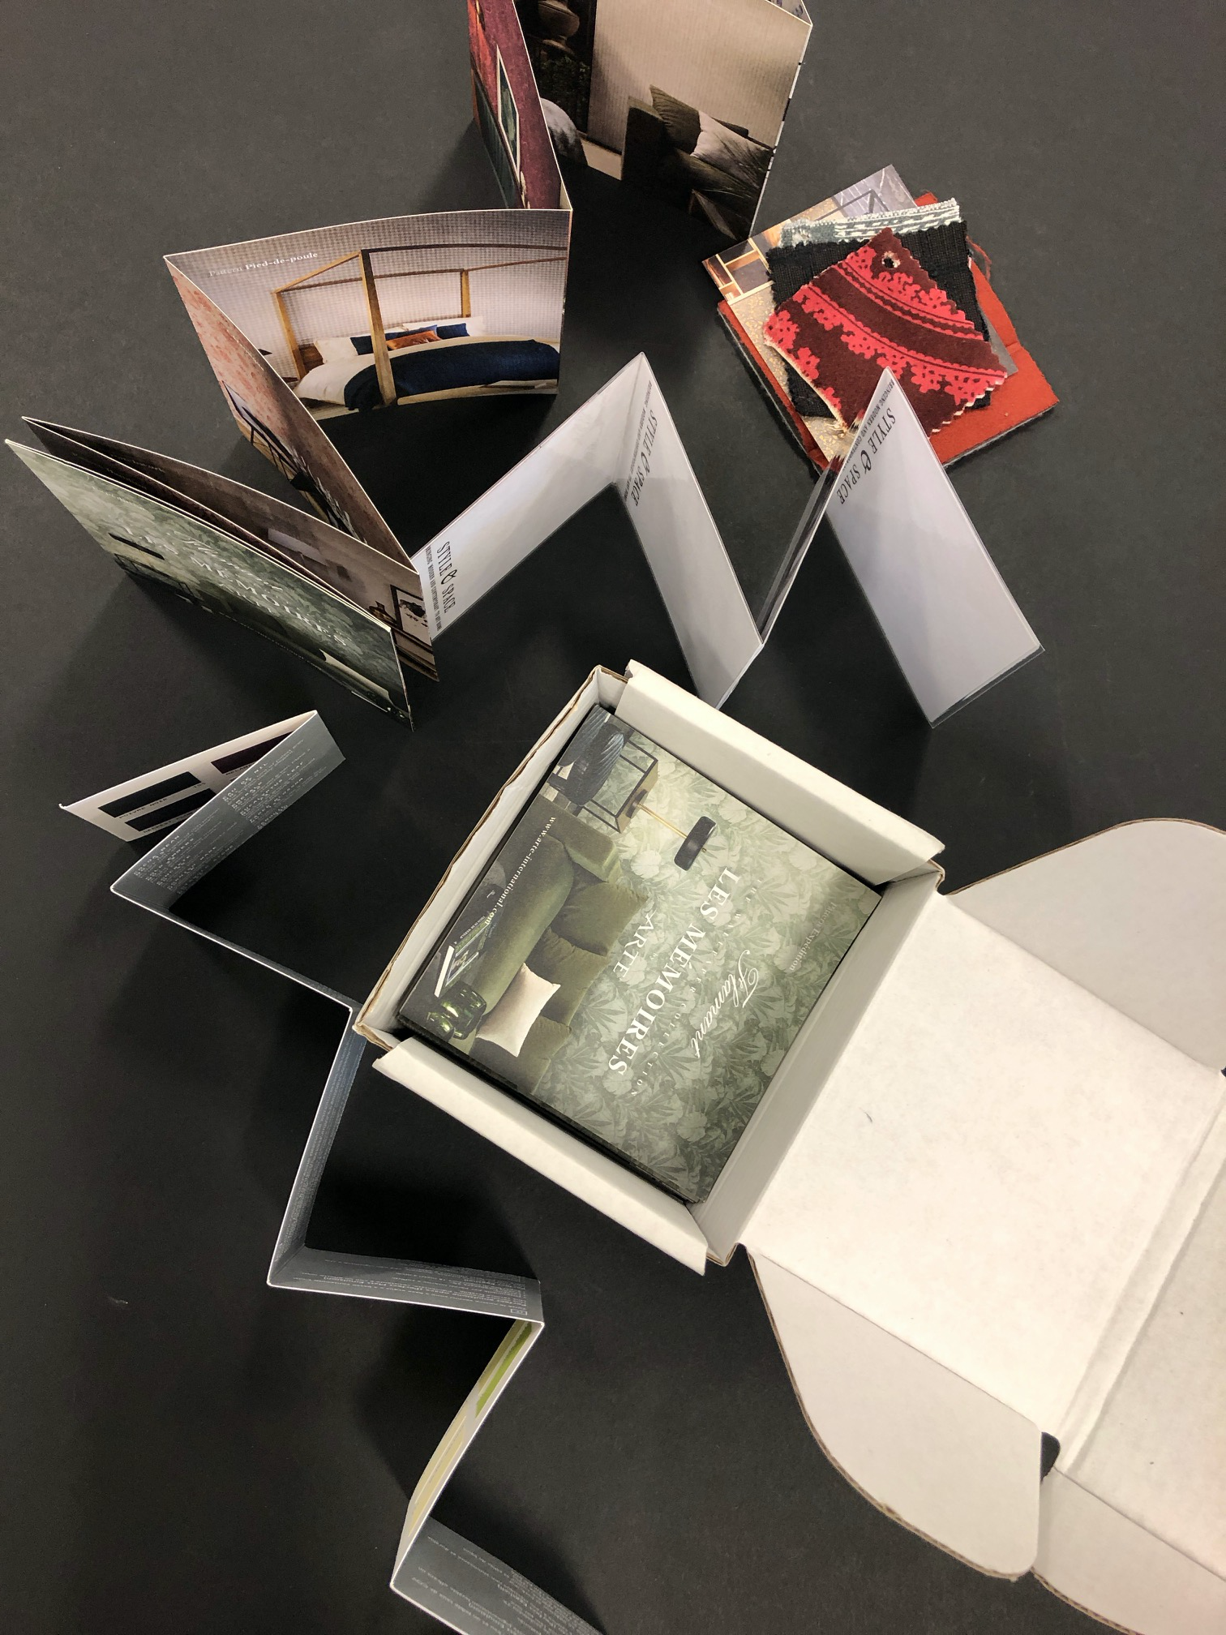
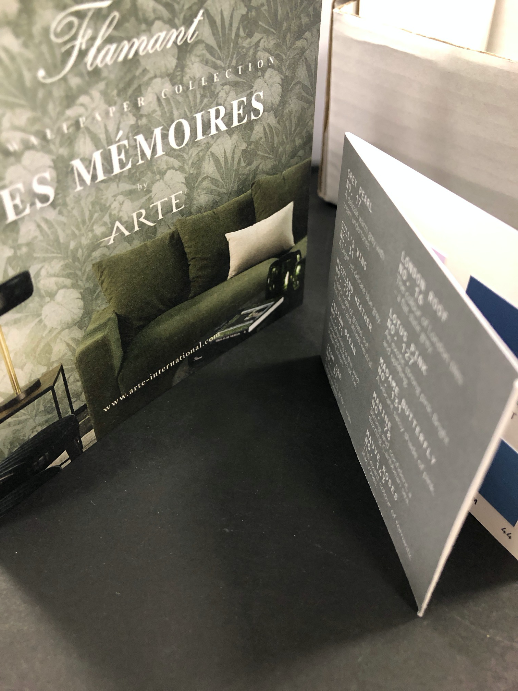

Slide 17
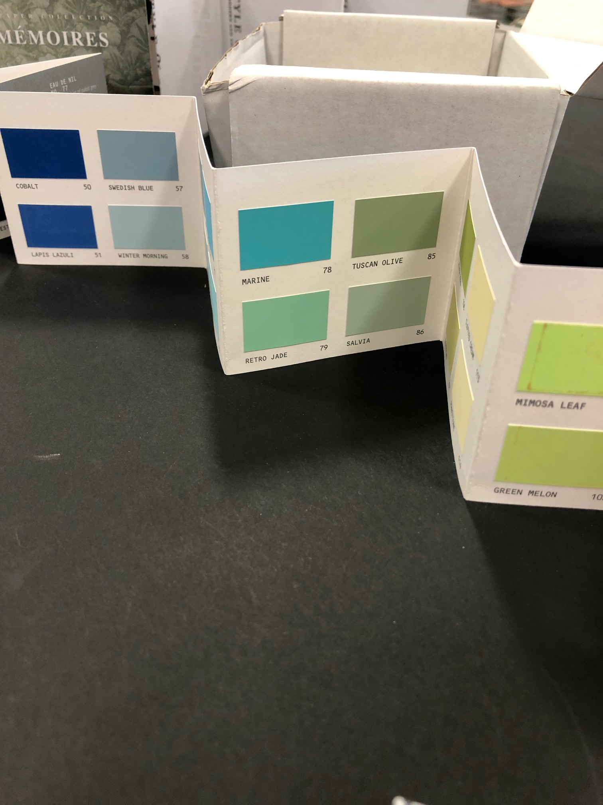
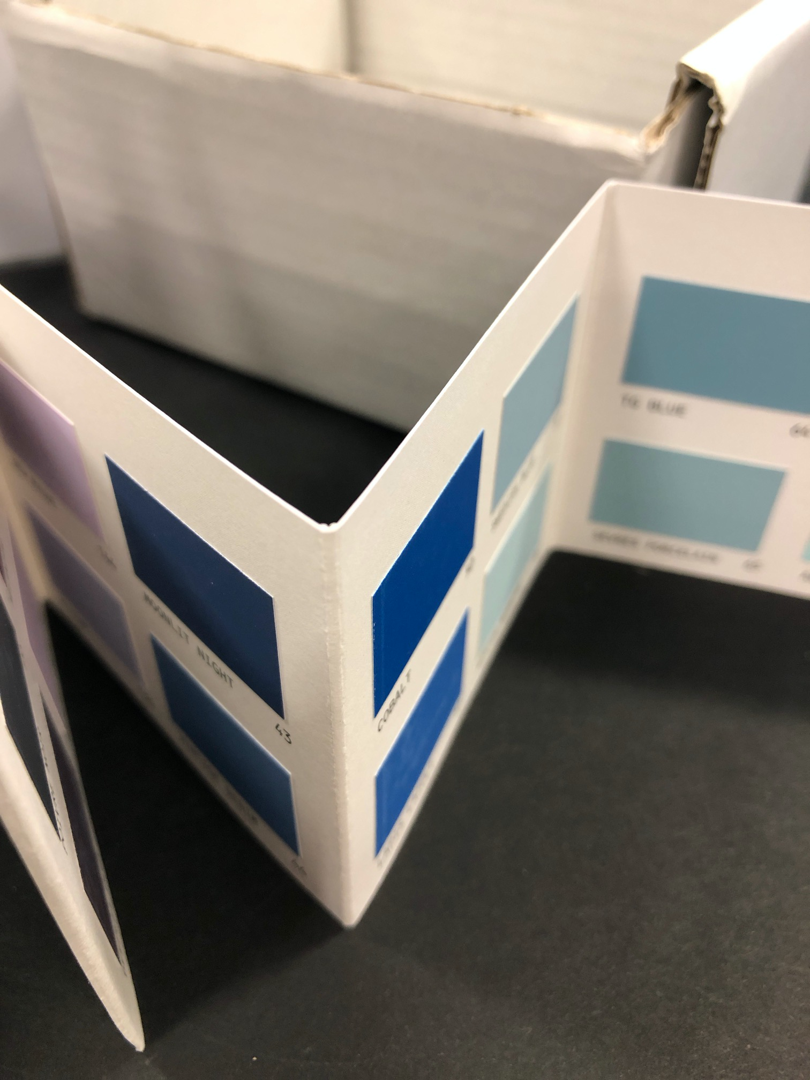

Slide 18
A PROTEST IN A BOX
Step One
Research Two Artists / See handout
Step Two
Research your chosen topic / See handout
Step Three
Begin to make the components of your box / These can be made digitally using Creative Suite
Or handmade using collage techniques

