Slide 1
MANUAL CAMERA
FAST SHUTTER SPEED / HIGH SPEED PHOTOGRAPHY

Slide 2
STUDENT WORK
SEE THE A&D STUDENT GALLERY WEBSITE FOR FURTHER EXAMPLES

Slide 3
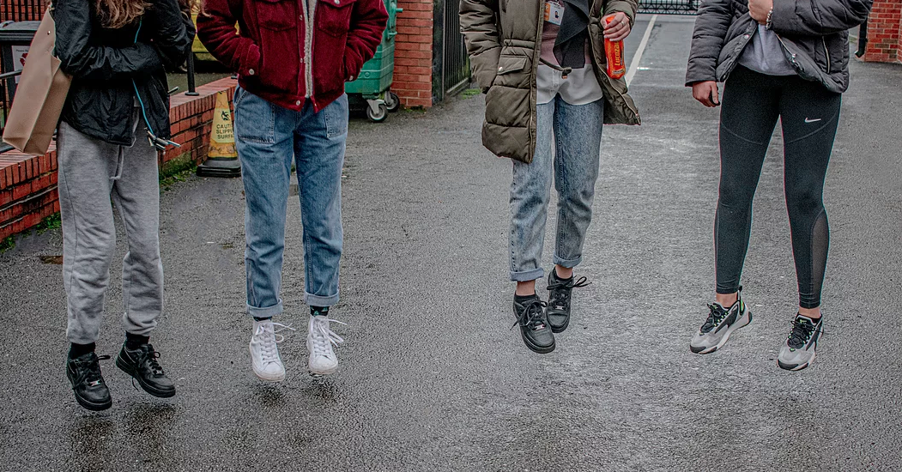

Slide 4
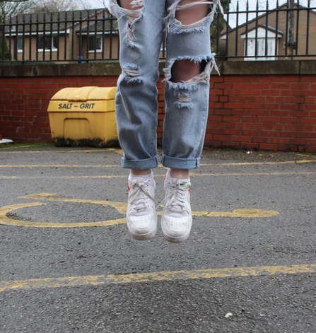

Slide 5
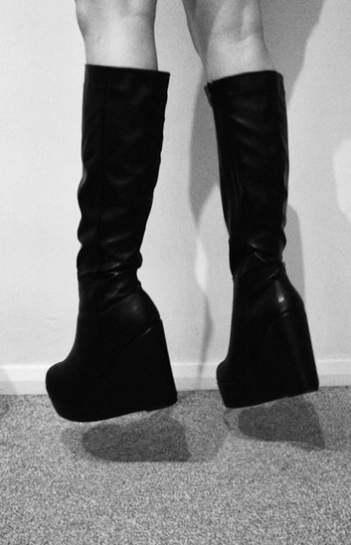
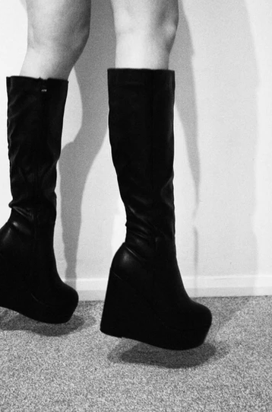

Slide 6
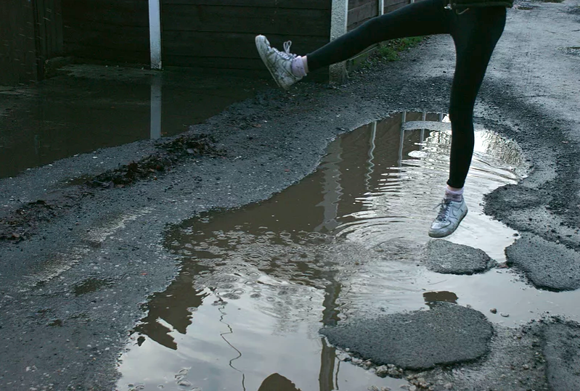
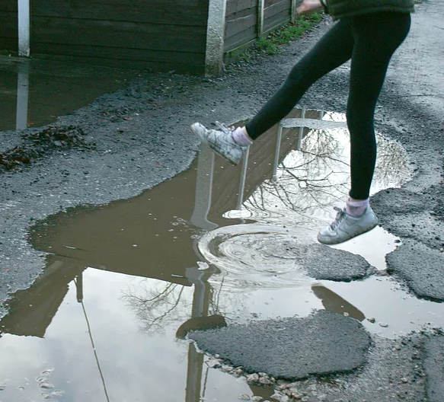

Slide 7

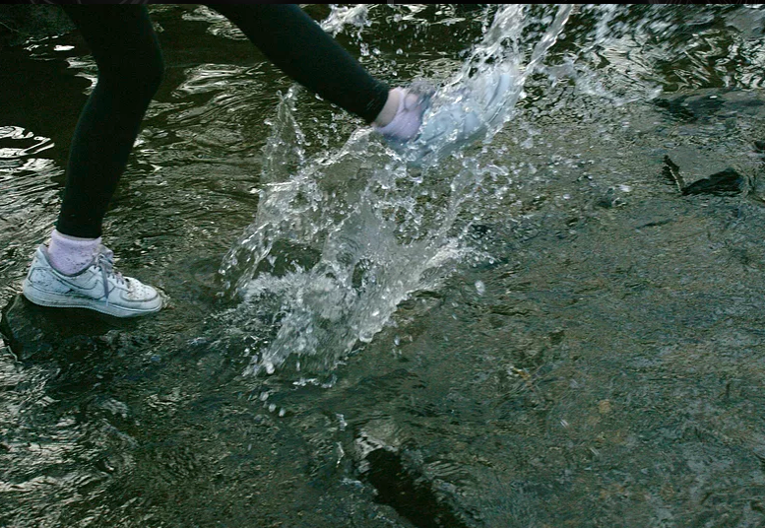

Slide 8

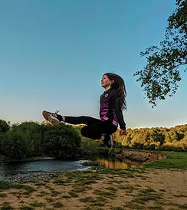


Slide 9
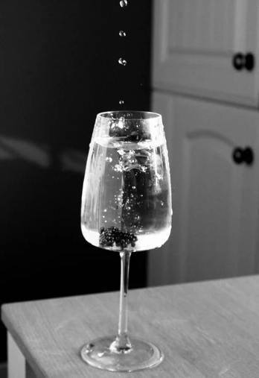
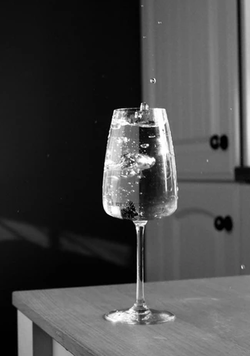

Slide 10


