Slide 2
‘fascinated with the idea of constructing a camera whose viewpoint is not some external subject, but instead one having the capability of looking back in on itself toward its own darkness. An instrument designed with the intention of recording its own mechanism and features. A singular entity bearing no relationship to anything other than its own intricate and elaborate operation’.
STEVEN PIPPIN, 2003

Slide 3
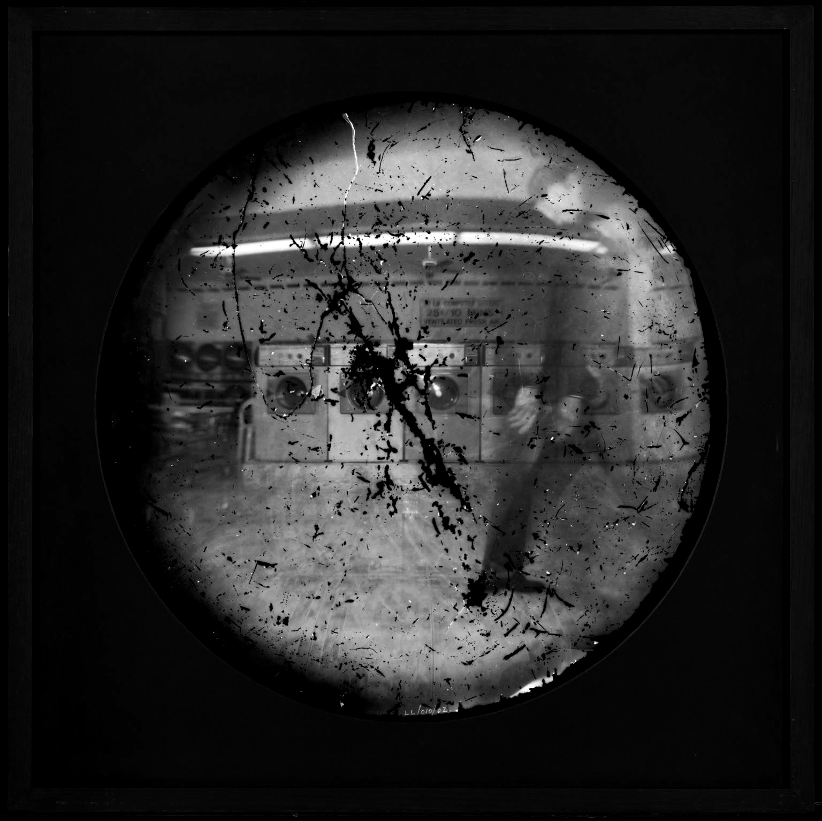
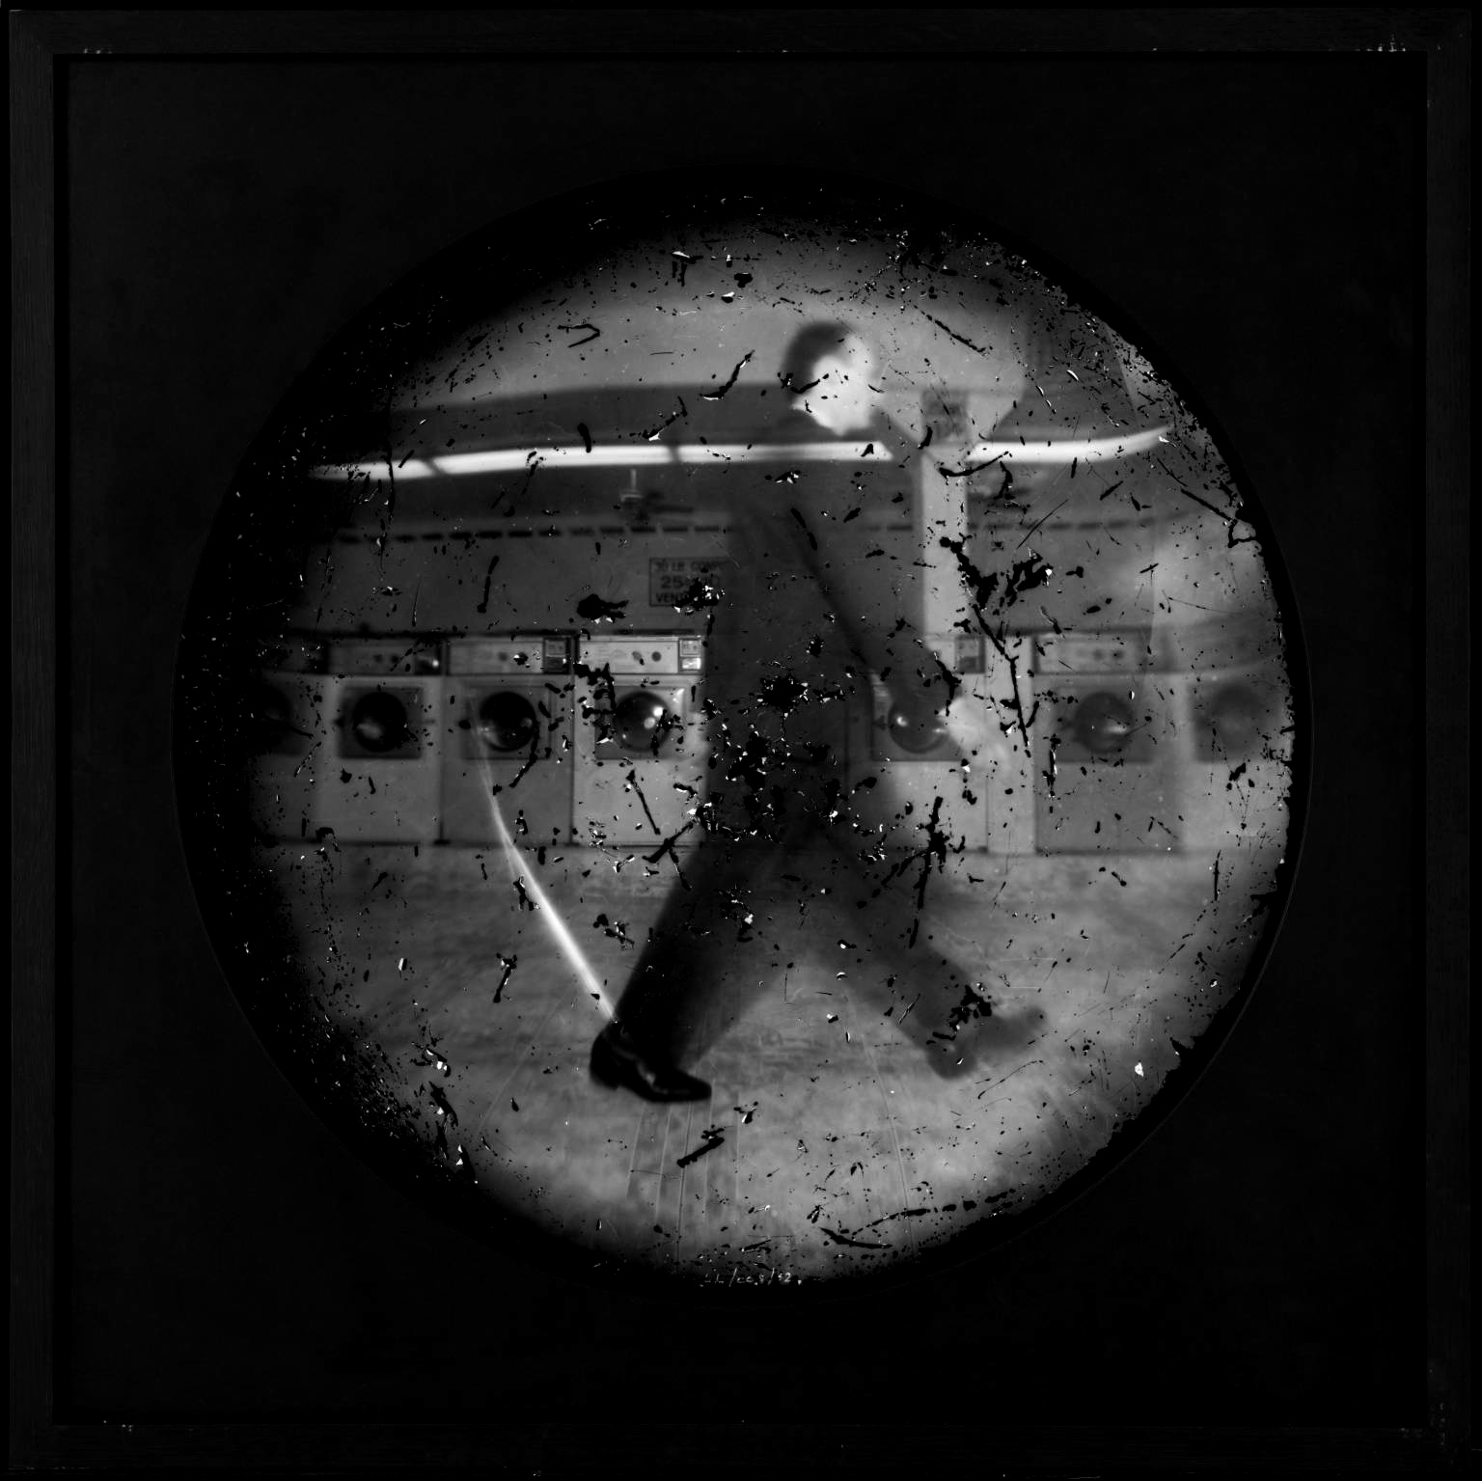
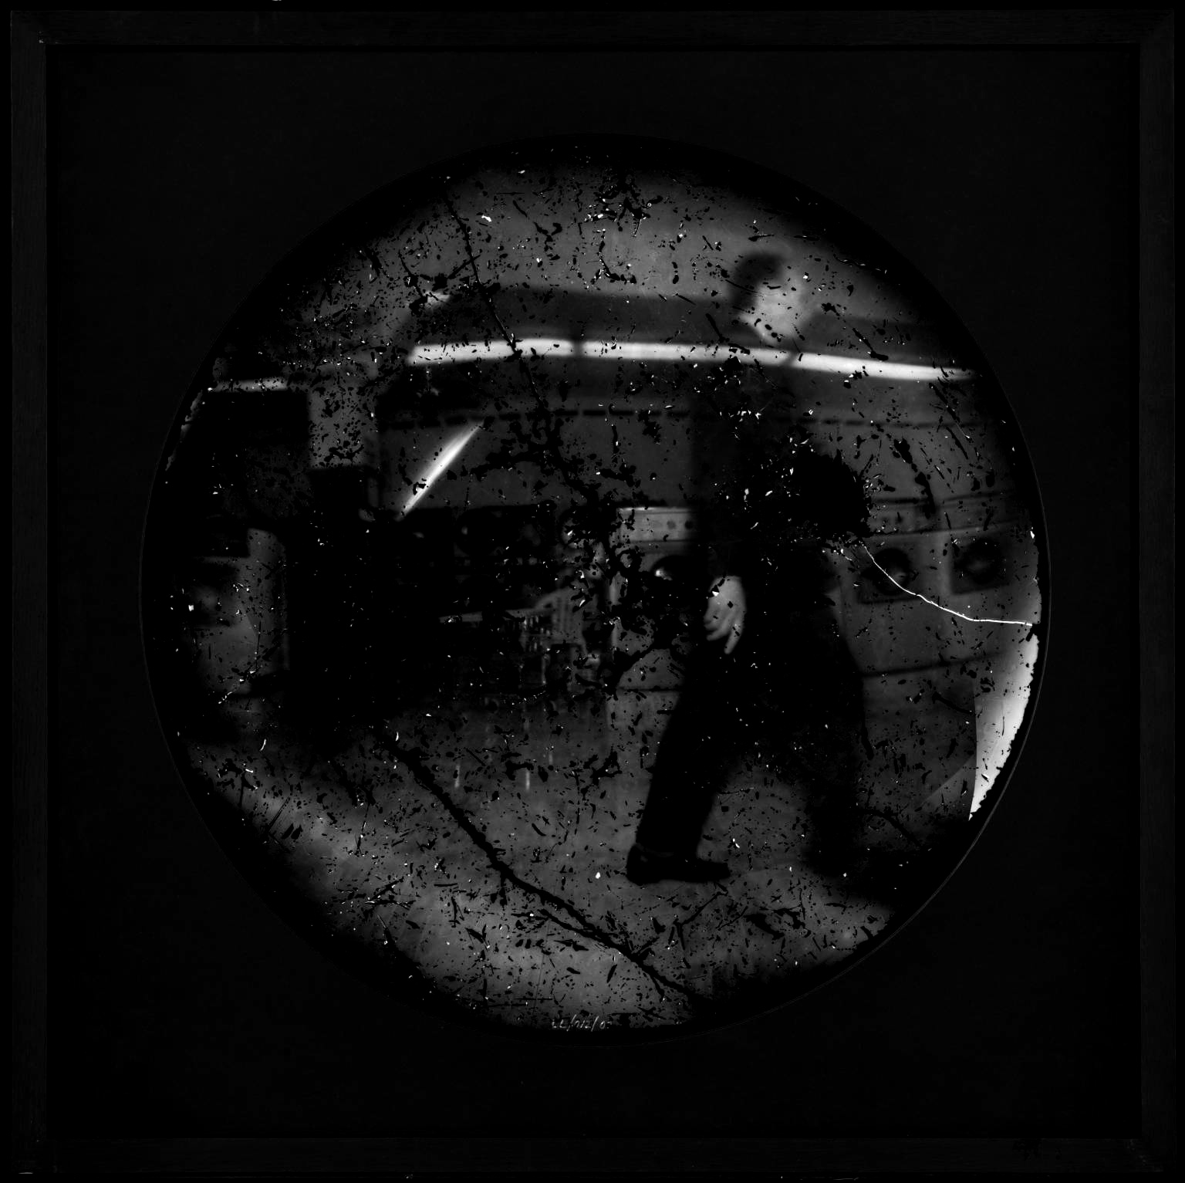
STEVEN_PIPPIN.
LAUNDROMAT

Slide 4
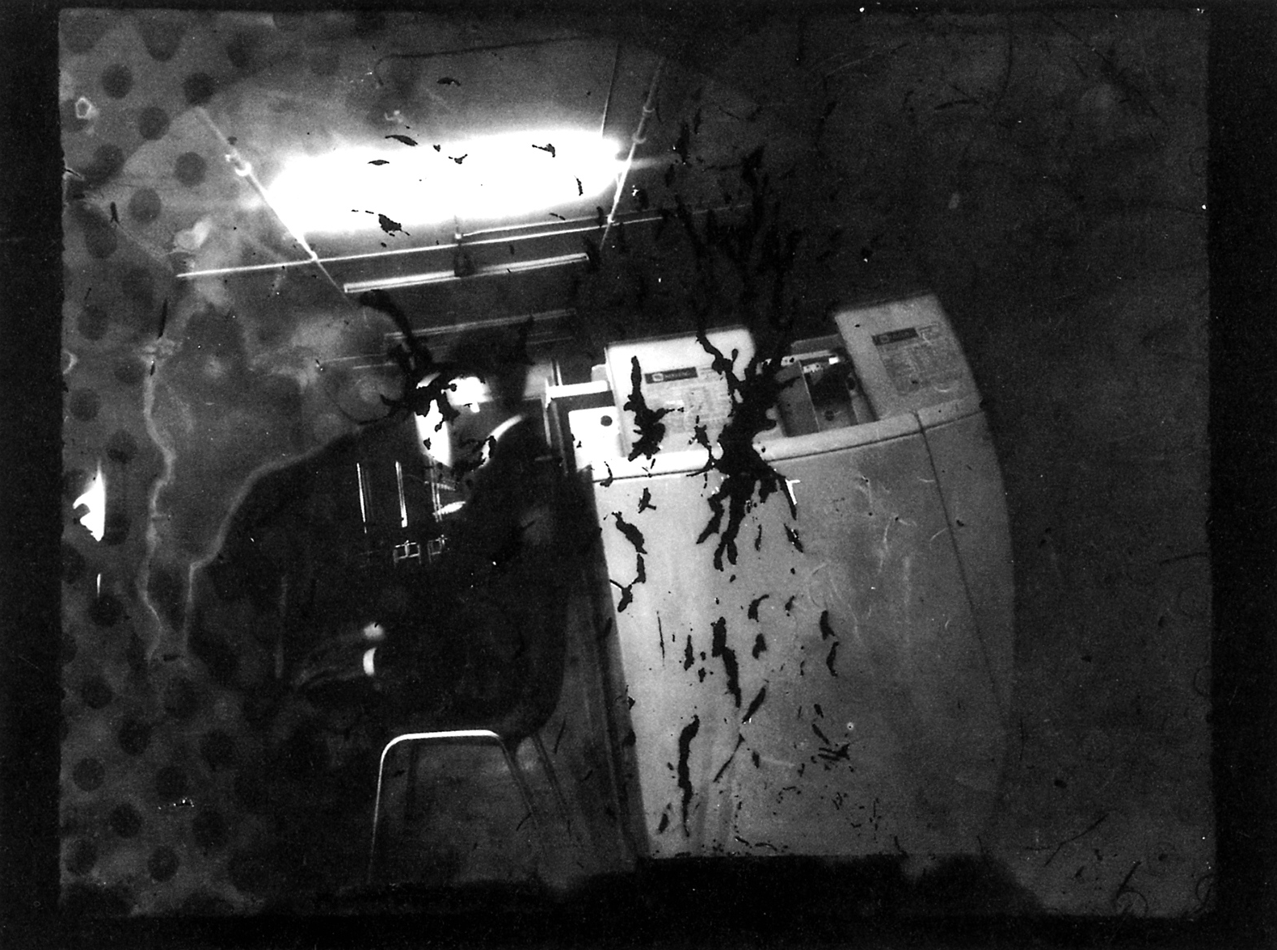
STEVEN_PIPPIN.
LAUNDROMAT SELF-PORTRAIT

Slide 5
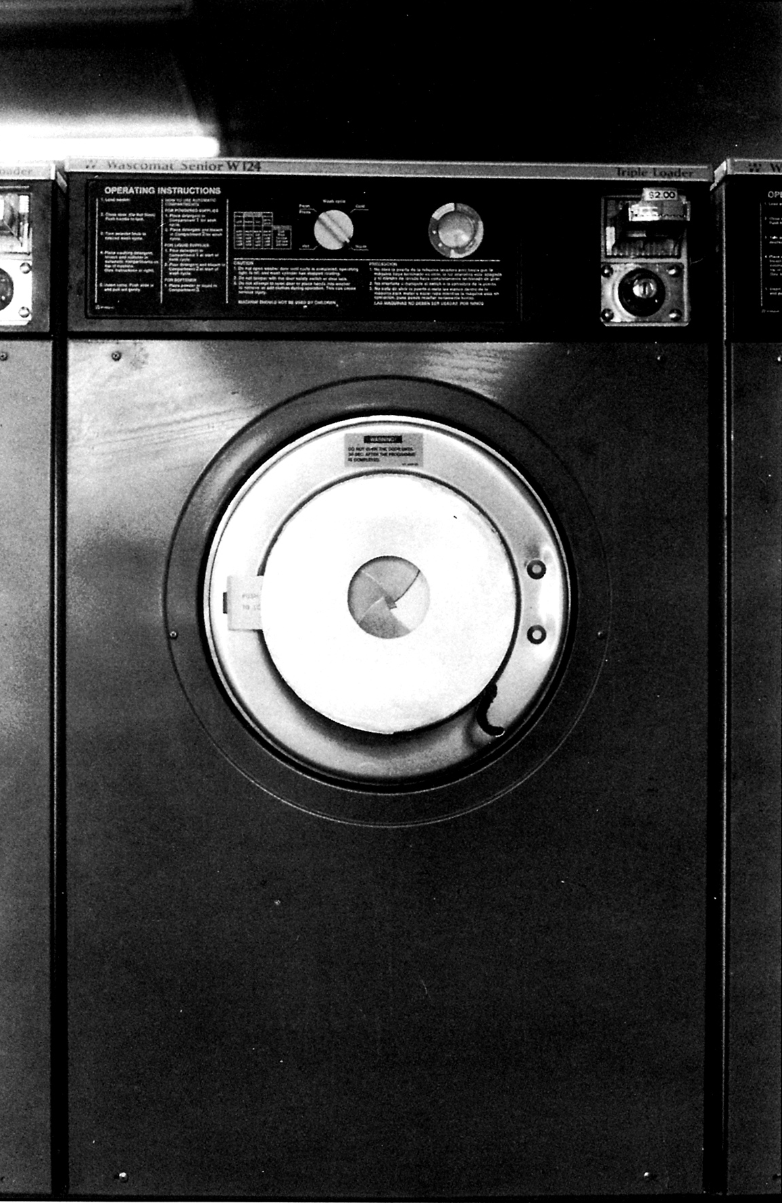
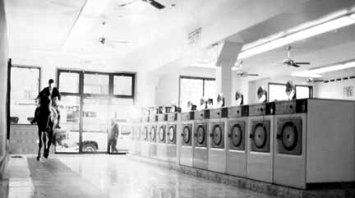
STEVEN_PIPPIN.
LAUNDROMAT

Slide 6
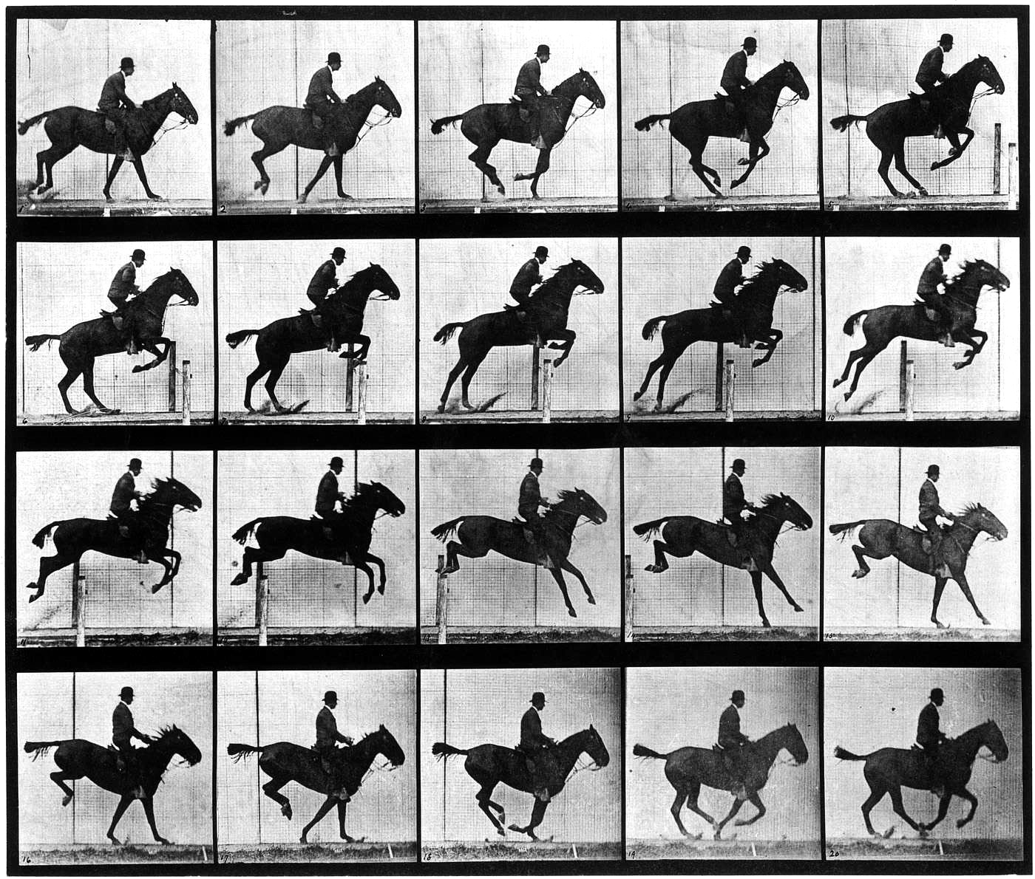
E.MUYBRIDGE.

Slide 7
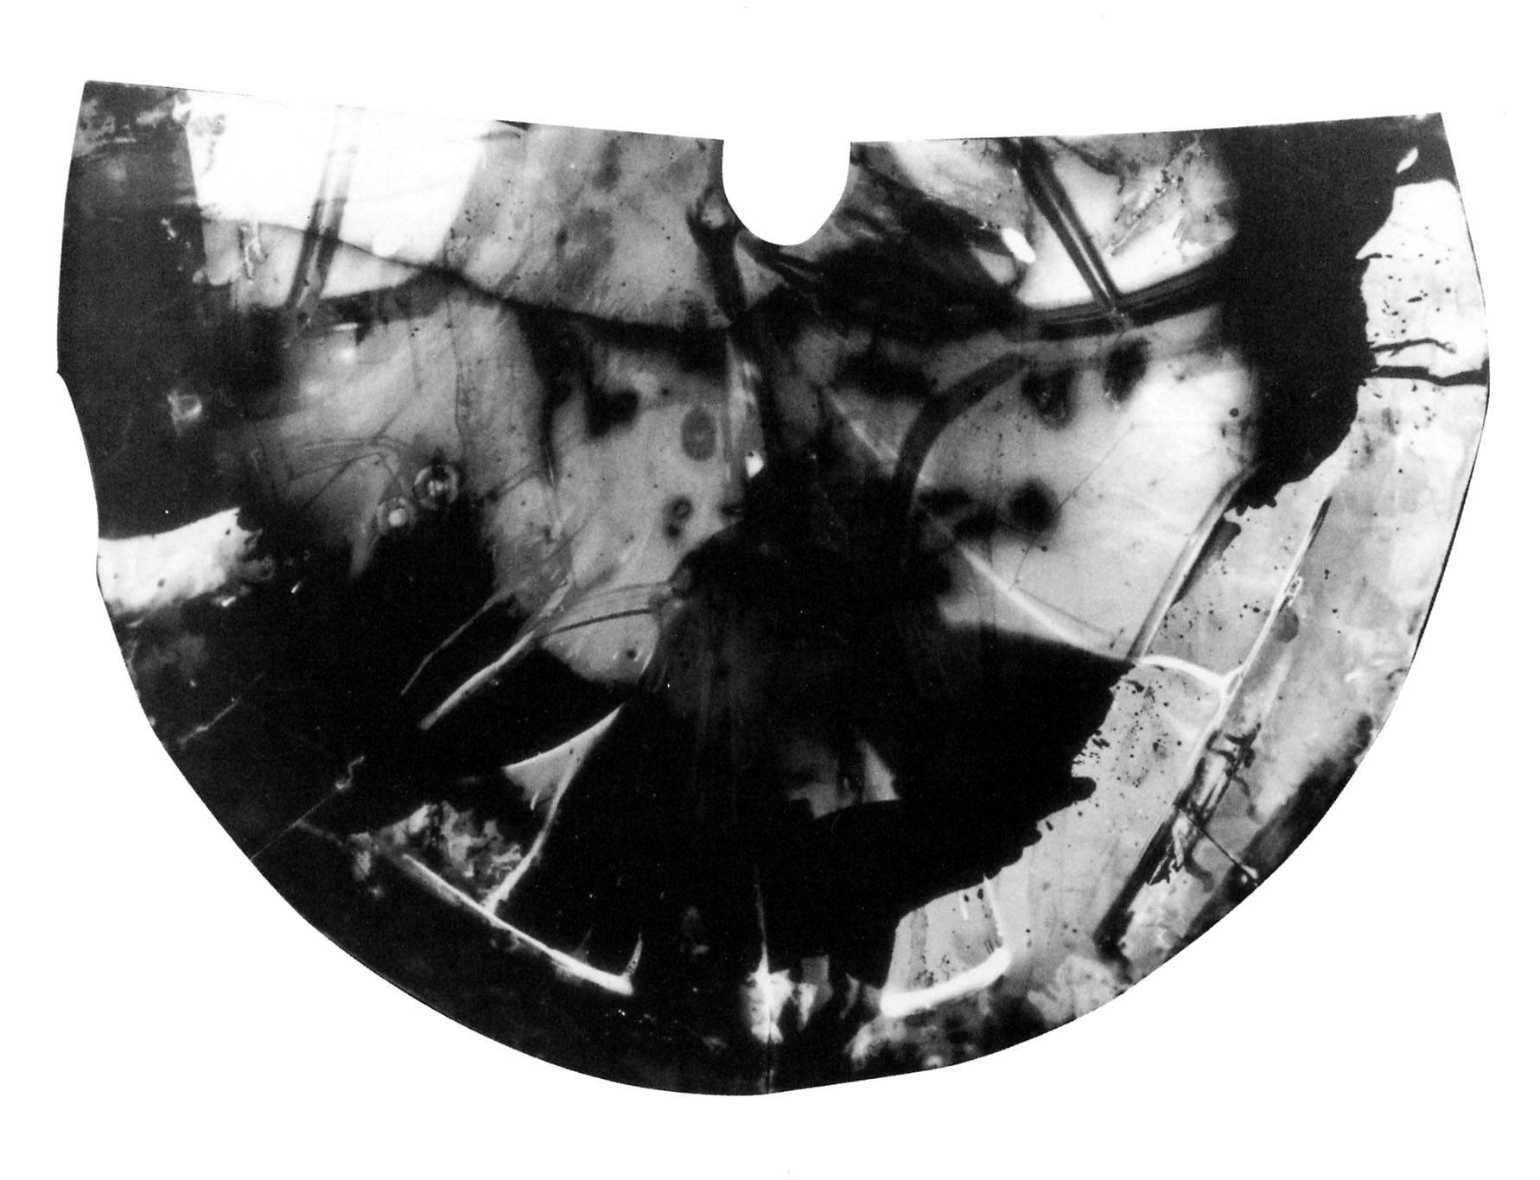
STEVEN_PIPPIN.
TRAIN TOILET

Slide 8
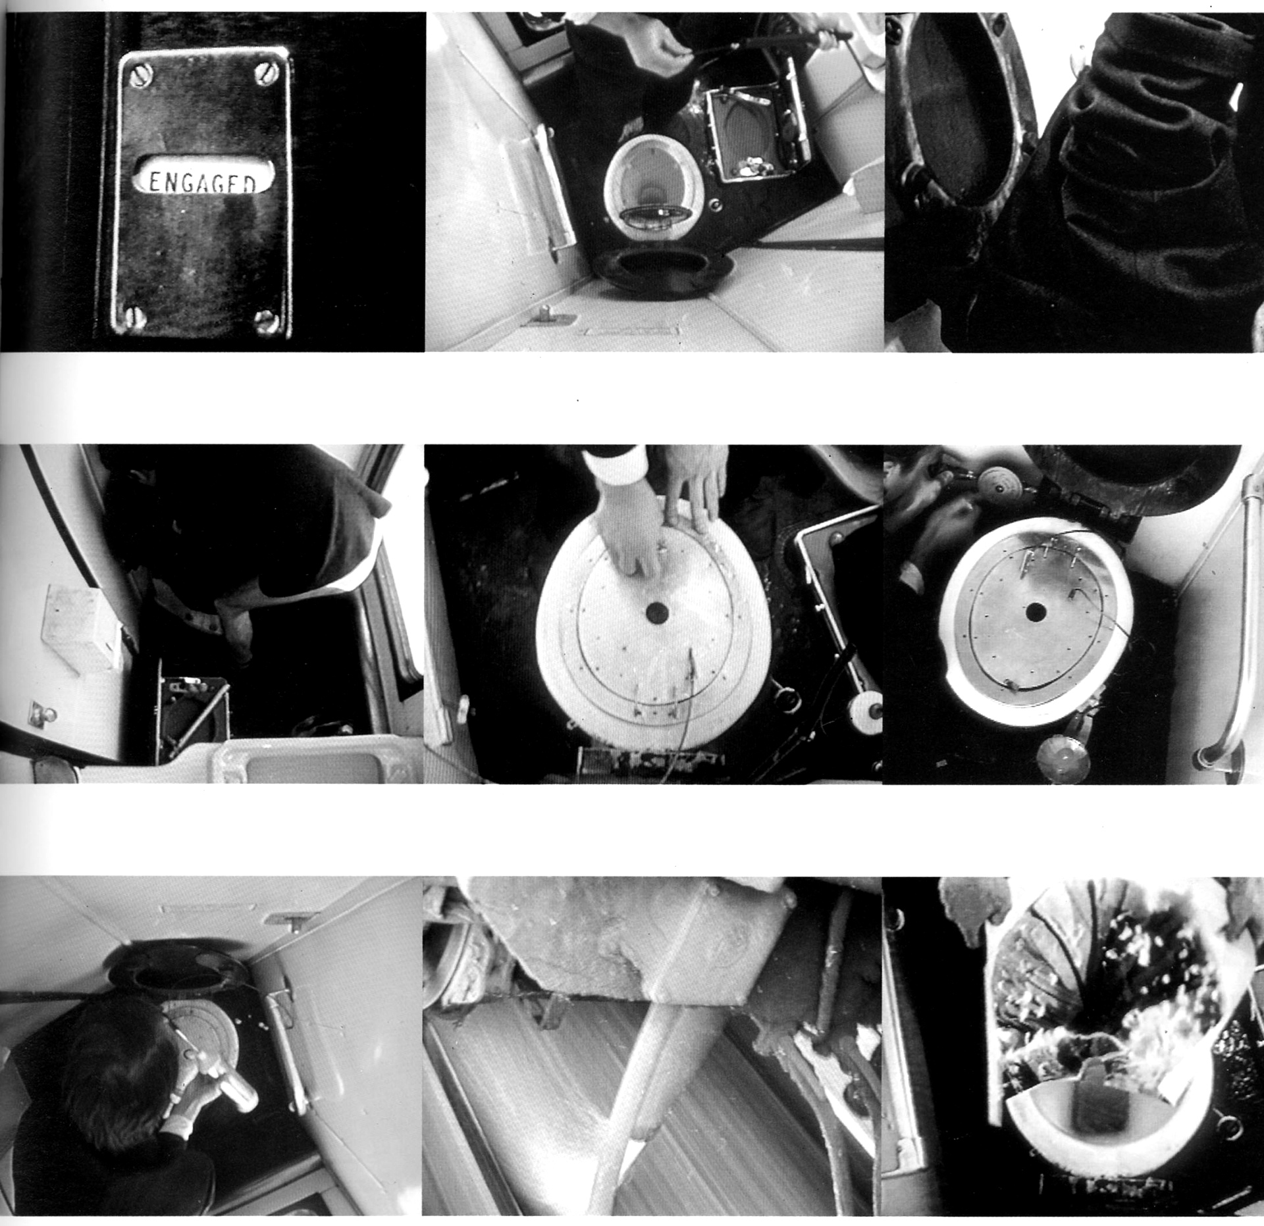
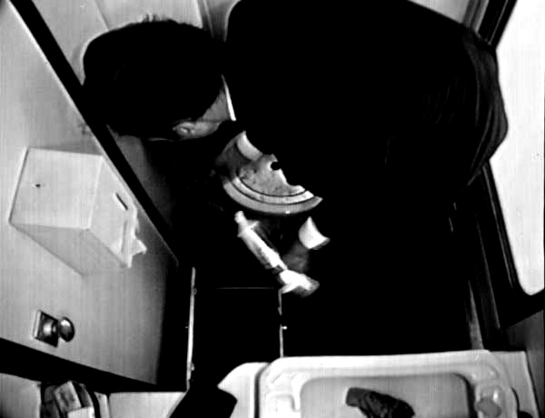
STEVEN_PIPPIN.

Slide 9
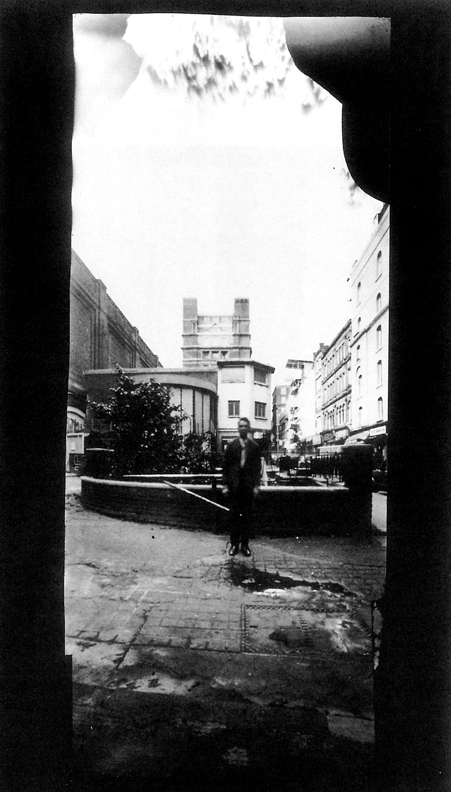
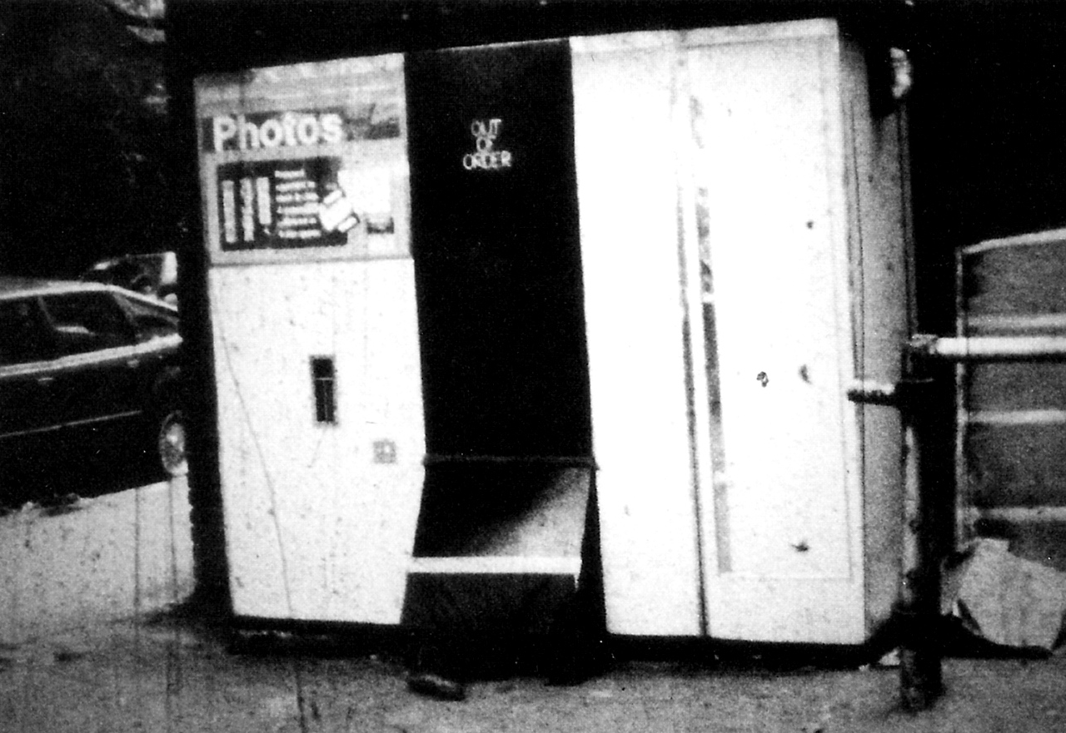
STEVEN_PIPPIN.
PHOTOBOOTH

Slide 10
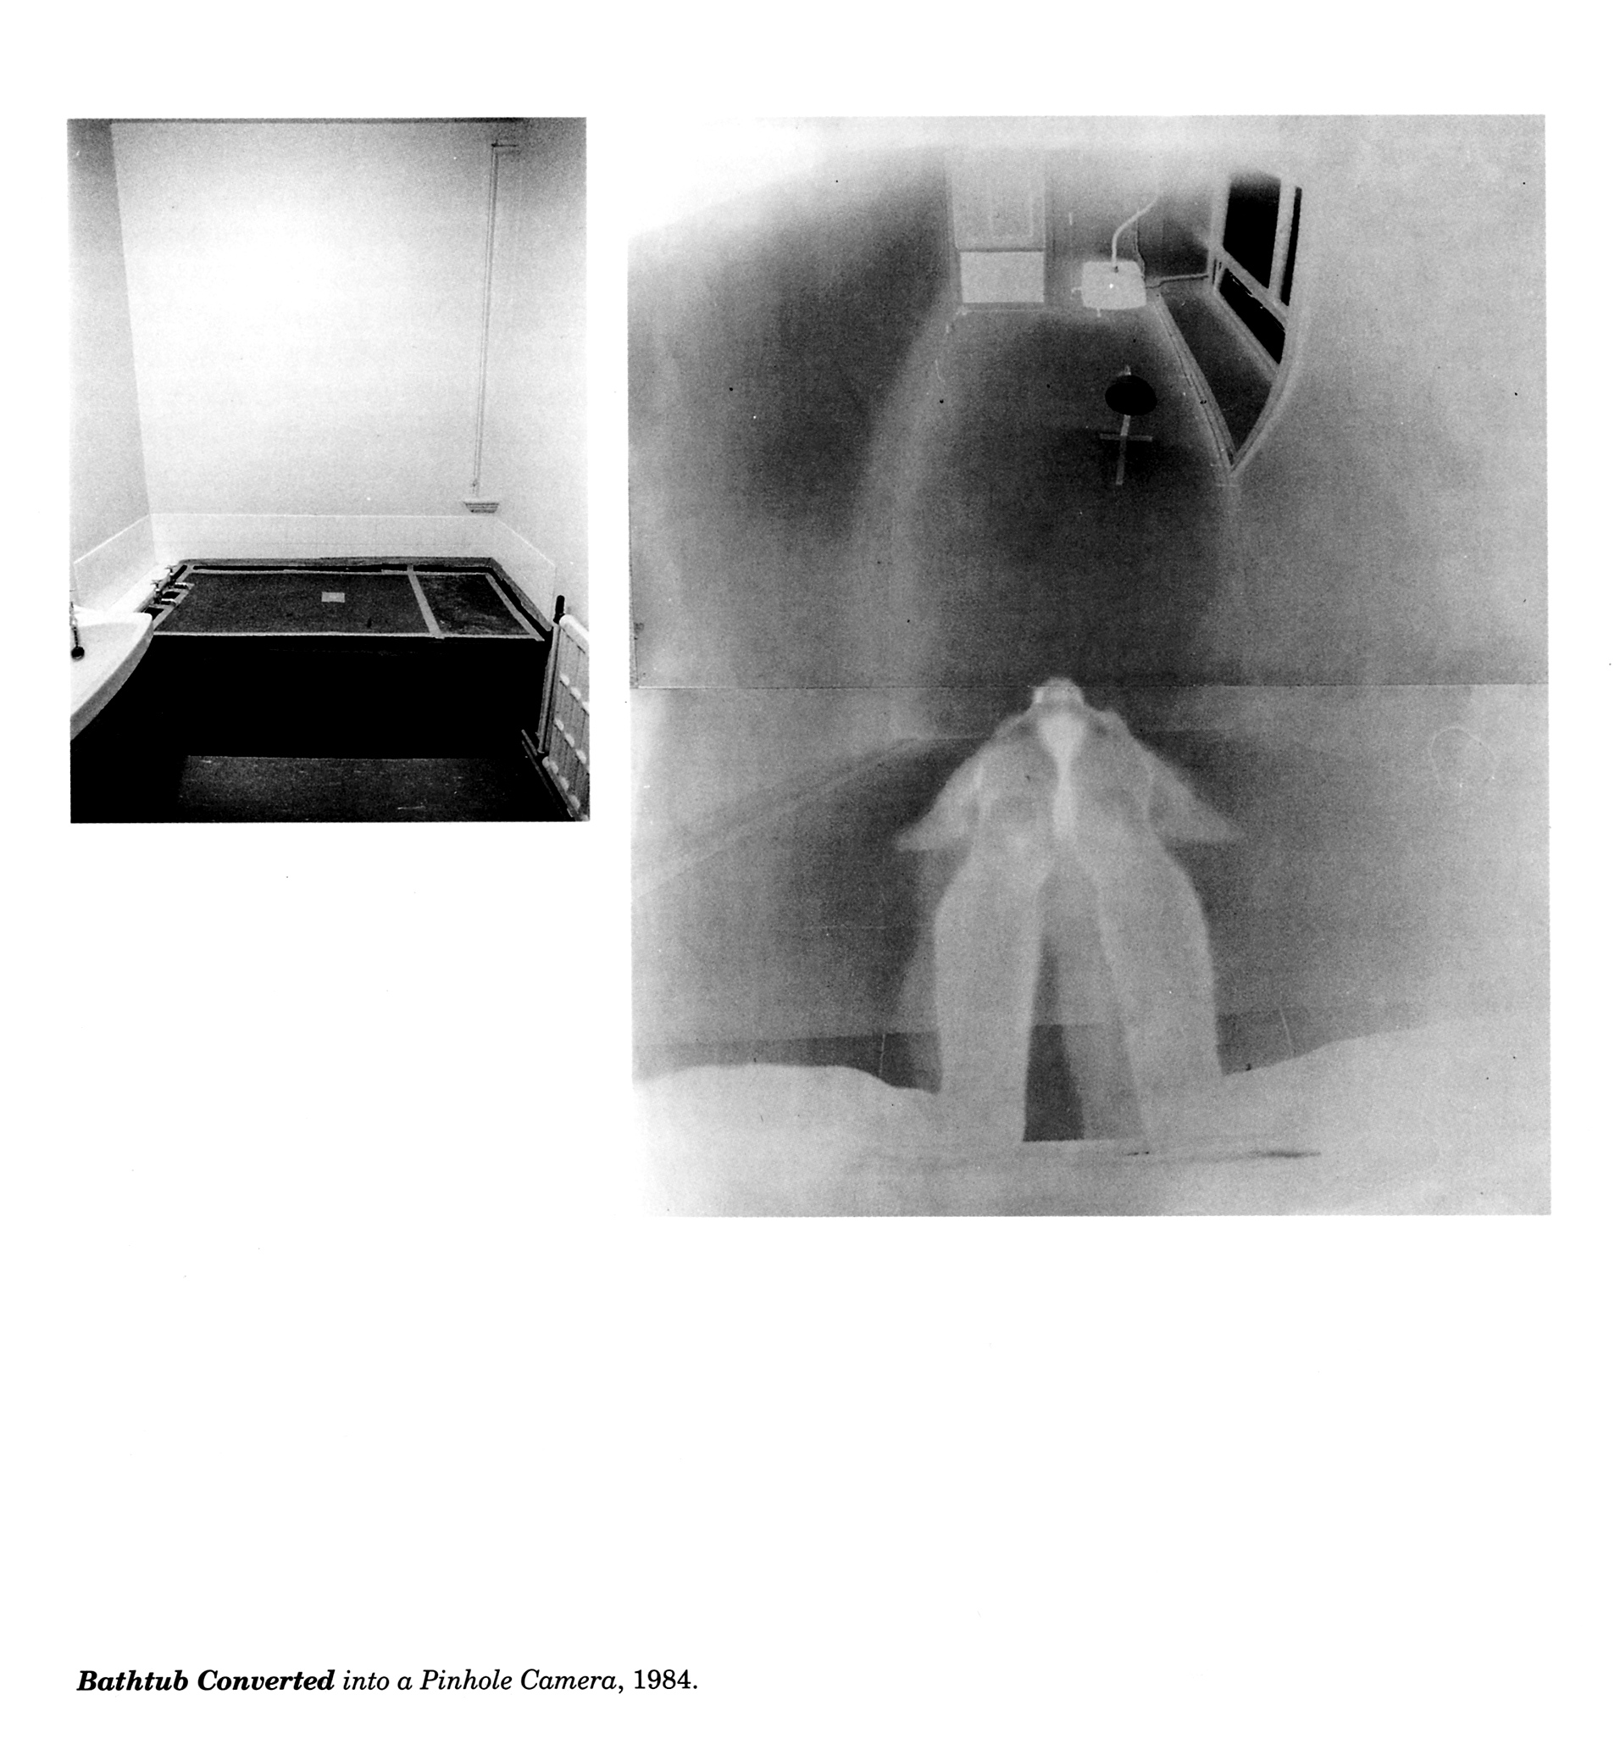
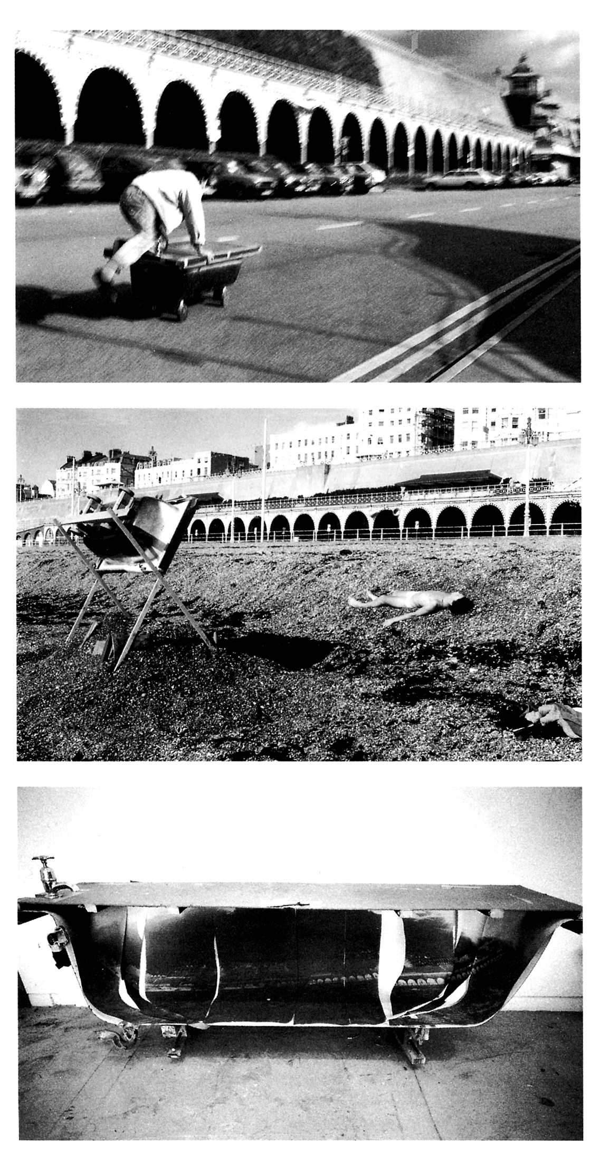
STEVEN_PIPPIN.
BATHTUB

Slide 11
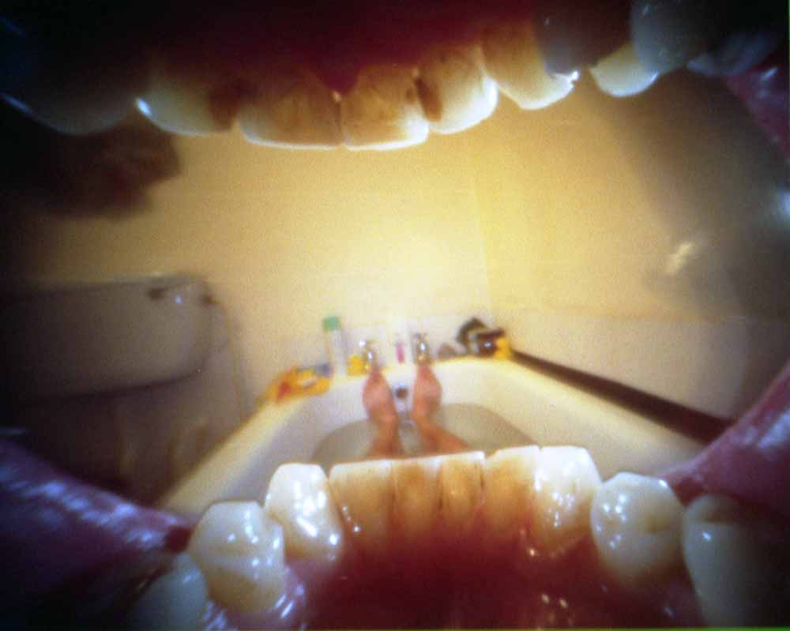
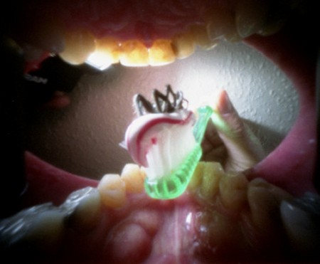
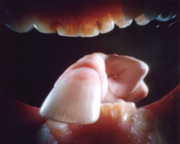
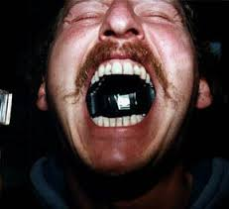
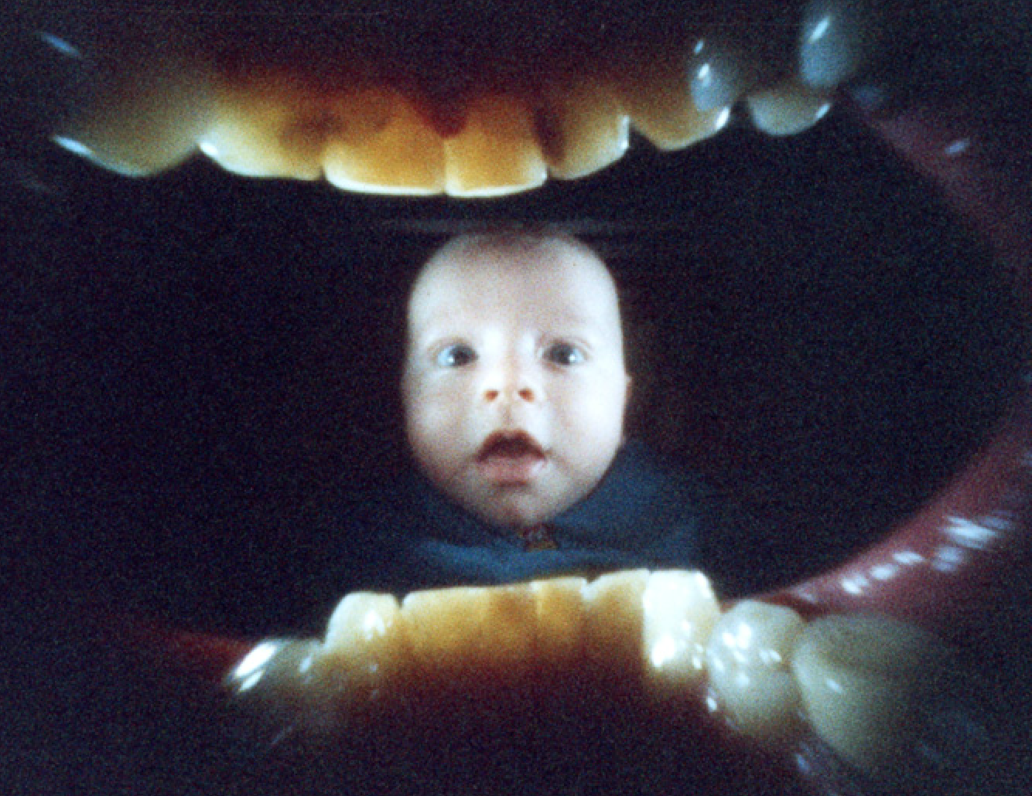
JUSTIN_ QUINNELL.
MOUTH PIECE

Slide 12
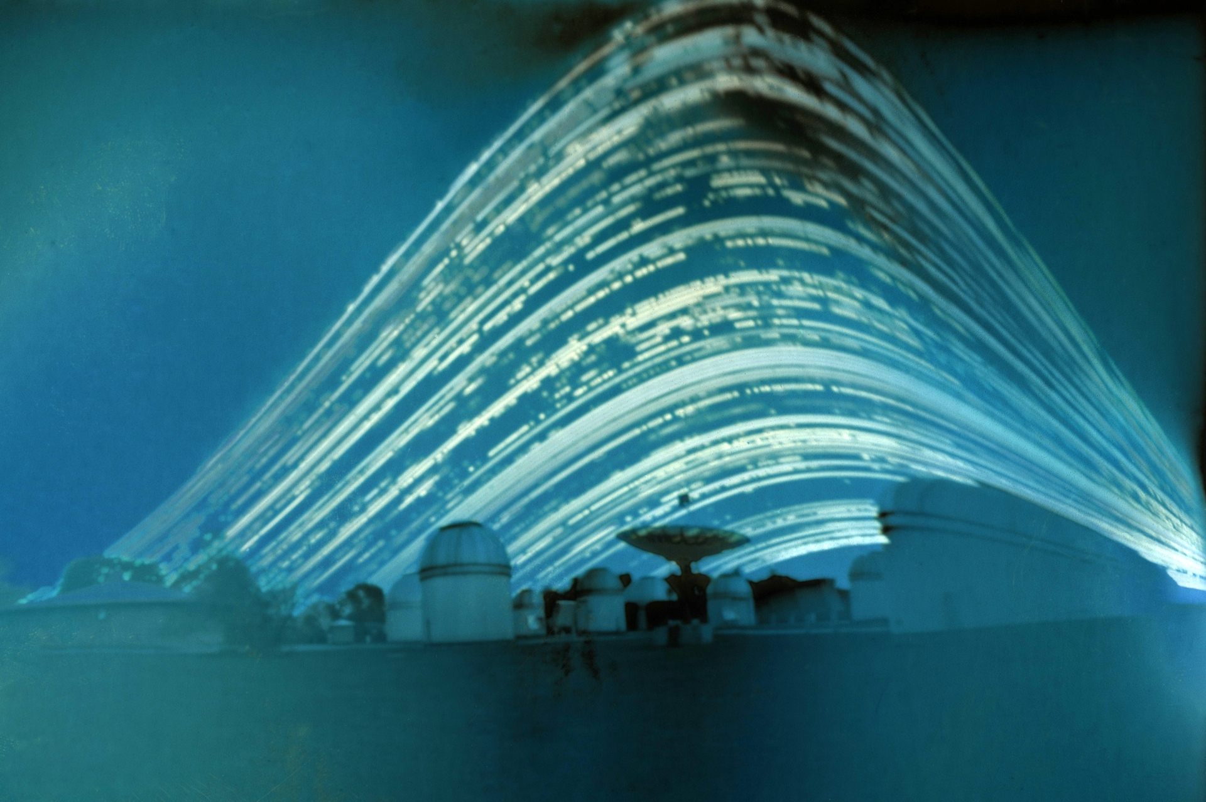
JUSTIN_ QUINNELL.
BEER CAN

Slide 13
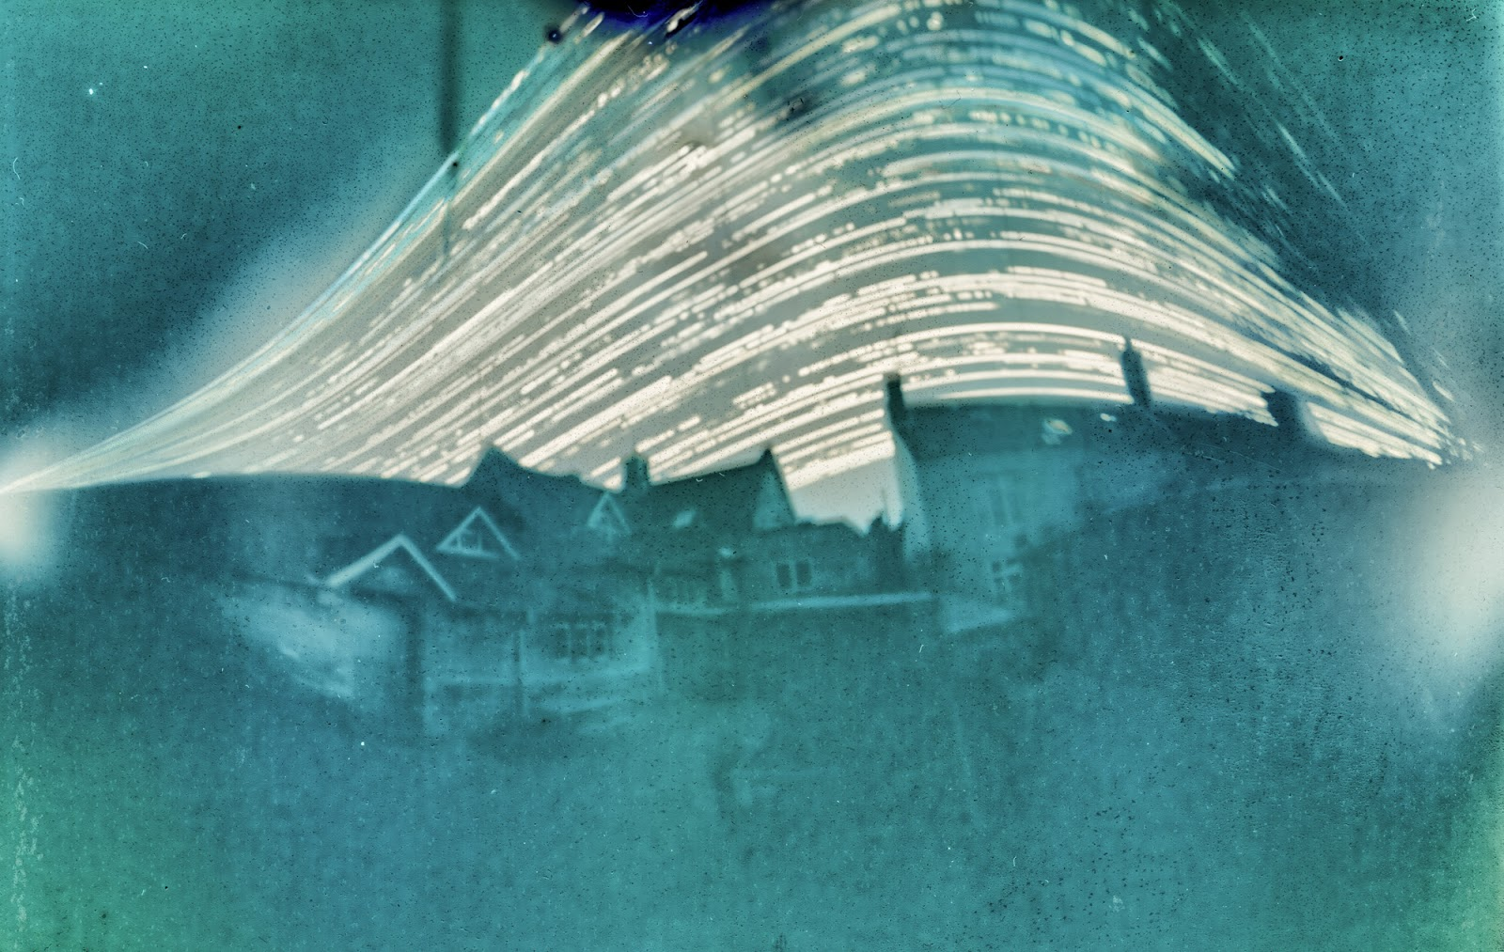
JUSTIN_ QUINNELL.
6 MONTH EXPOSURE

Slide 14
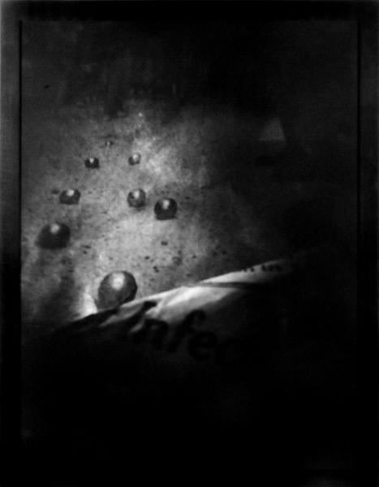
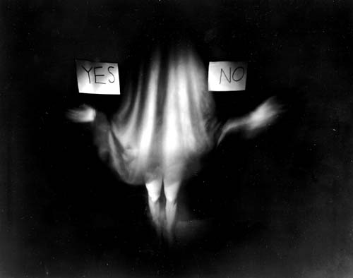
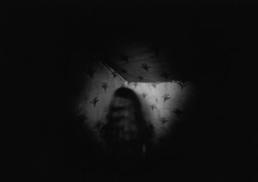
BARBARA_ESS

Slide 15
LONDON GRAMMAR

Slide 16
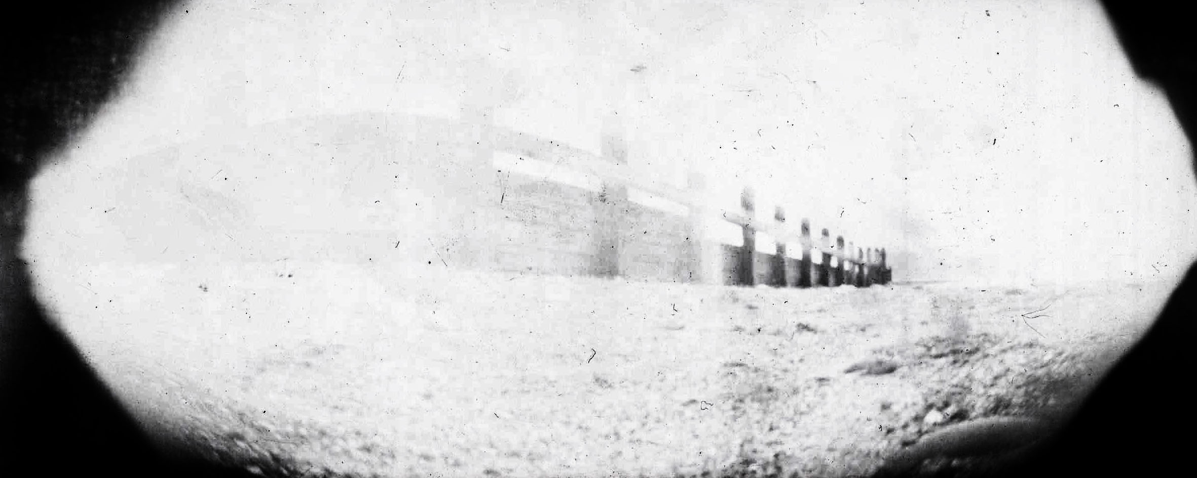
PAINT_CAN _ PINHOLE

Slide 17
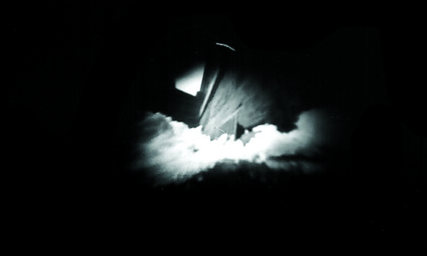
MATCHBOX _ PINHOLE

Slide 18
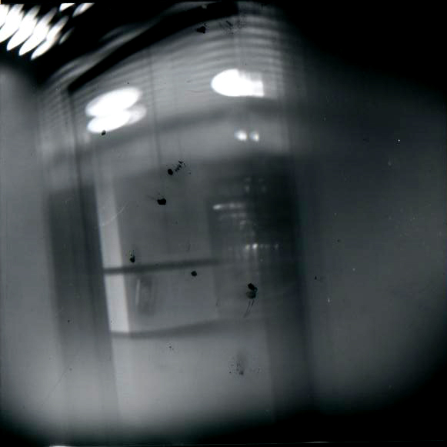
PAINT_CAN _ PINHOLE

