Slide 1
TAKE A BOX FOR A WALK

Slide 2
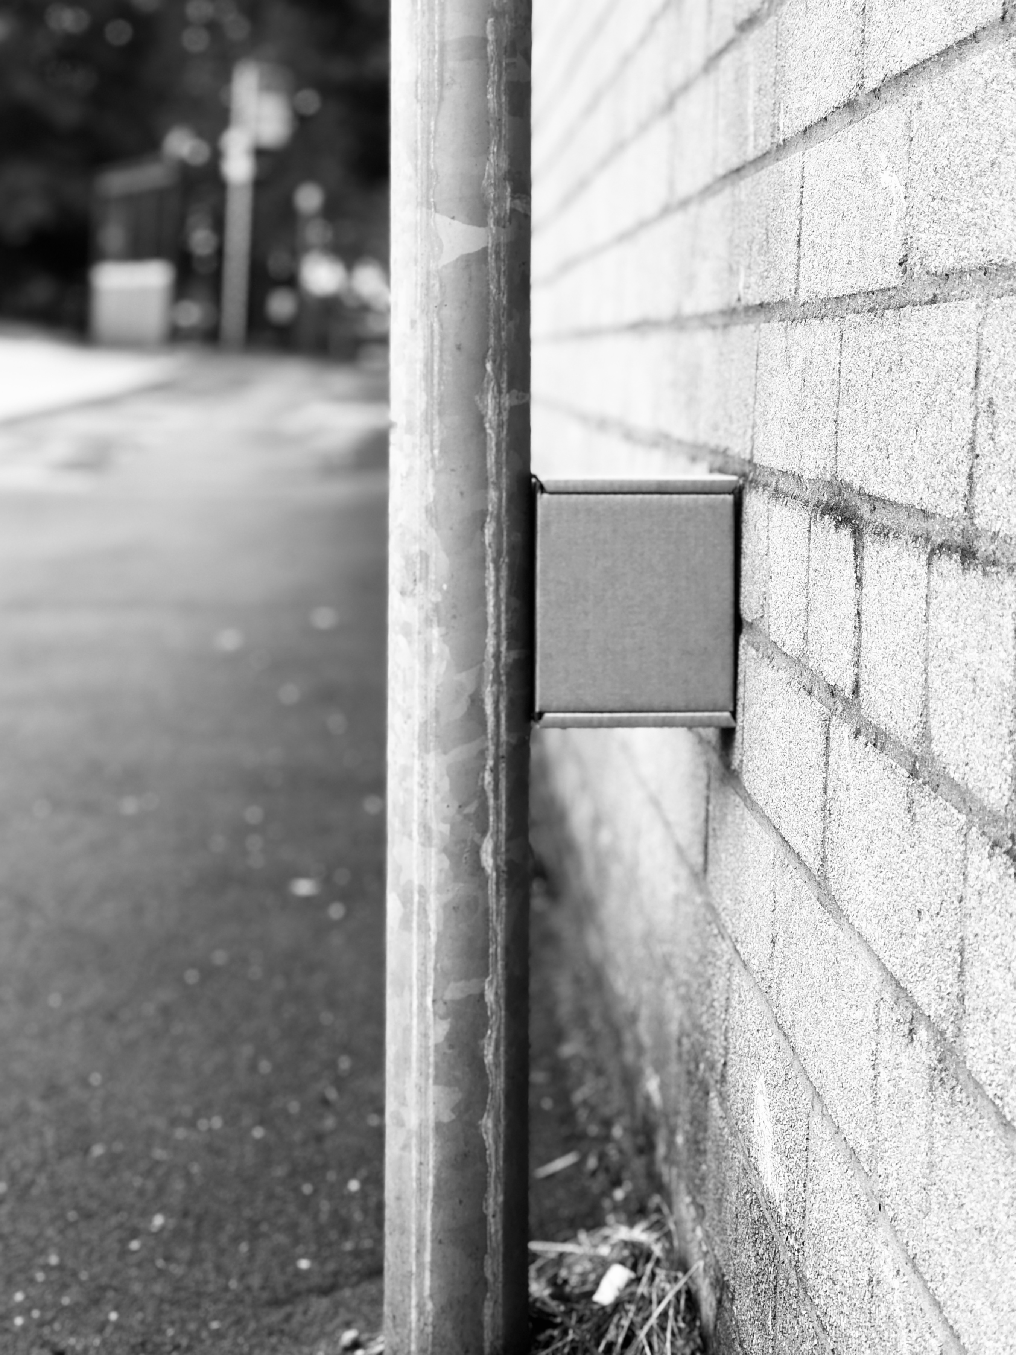
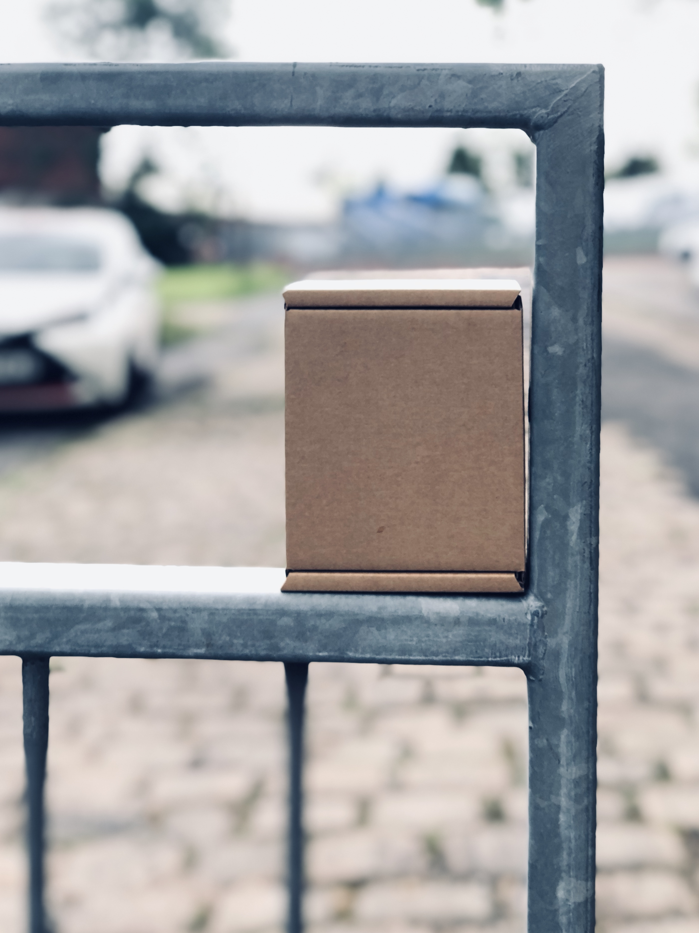
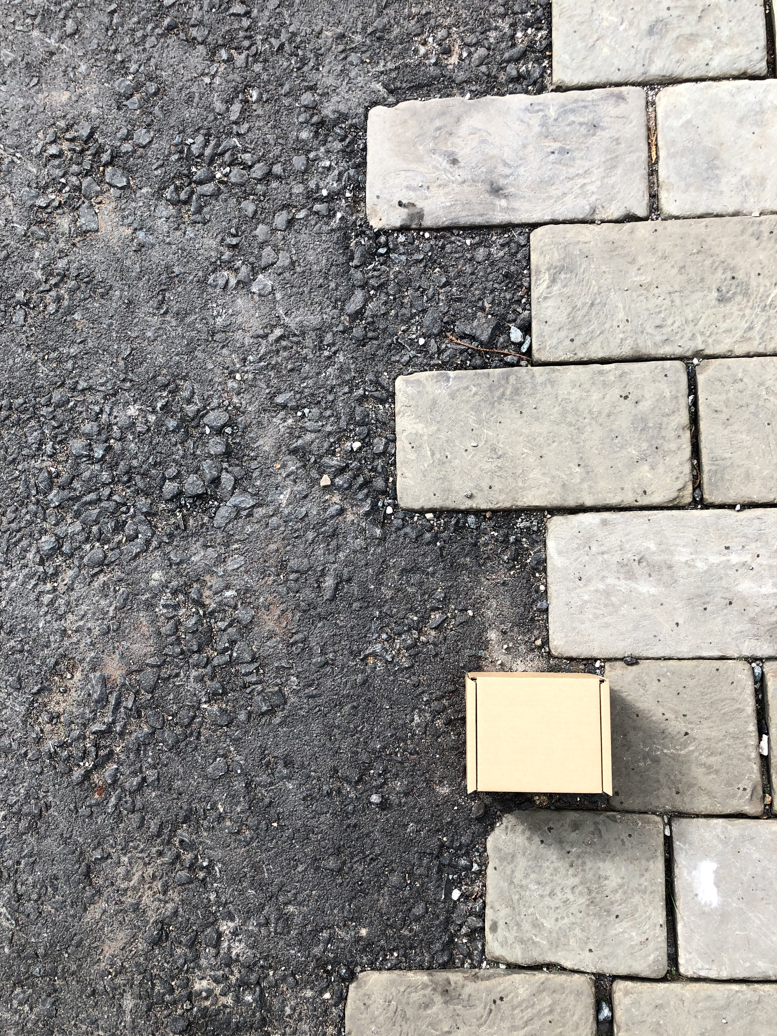

Slide 3
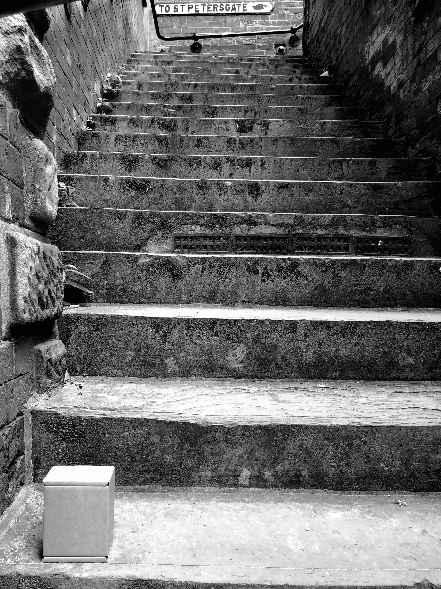
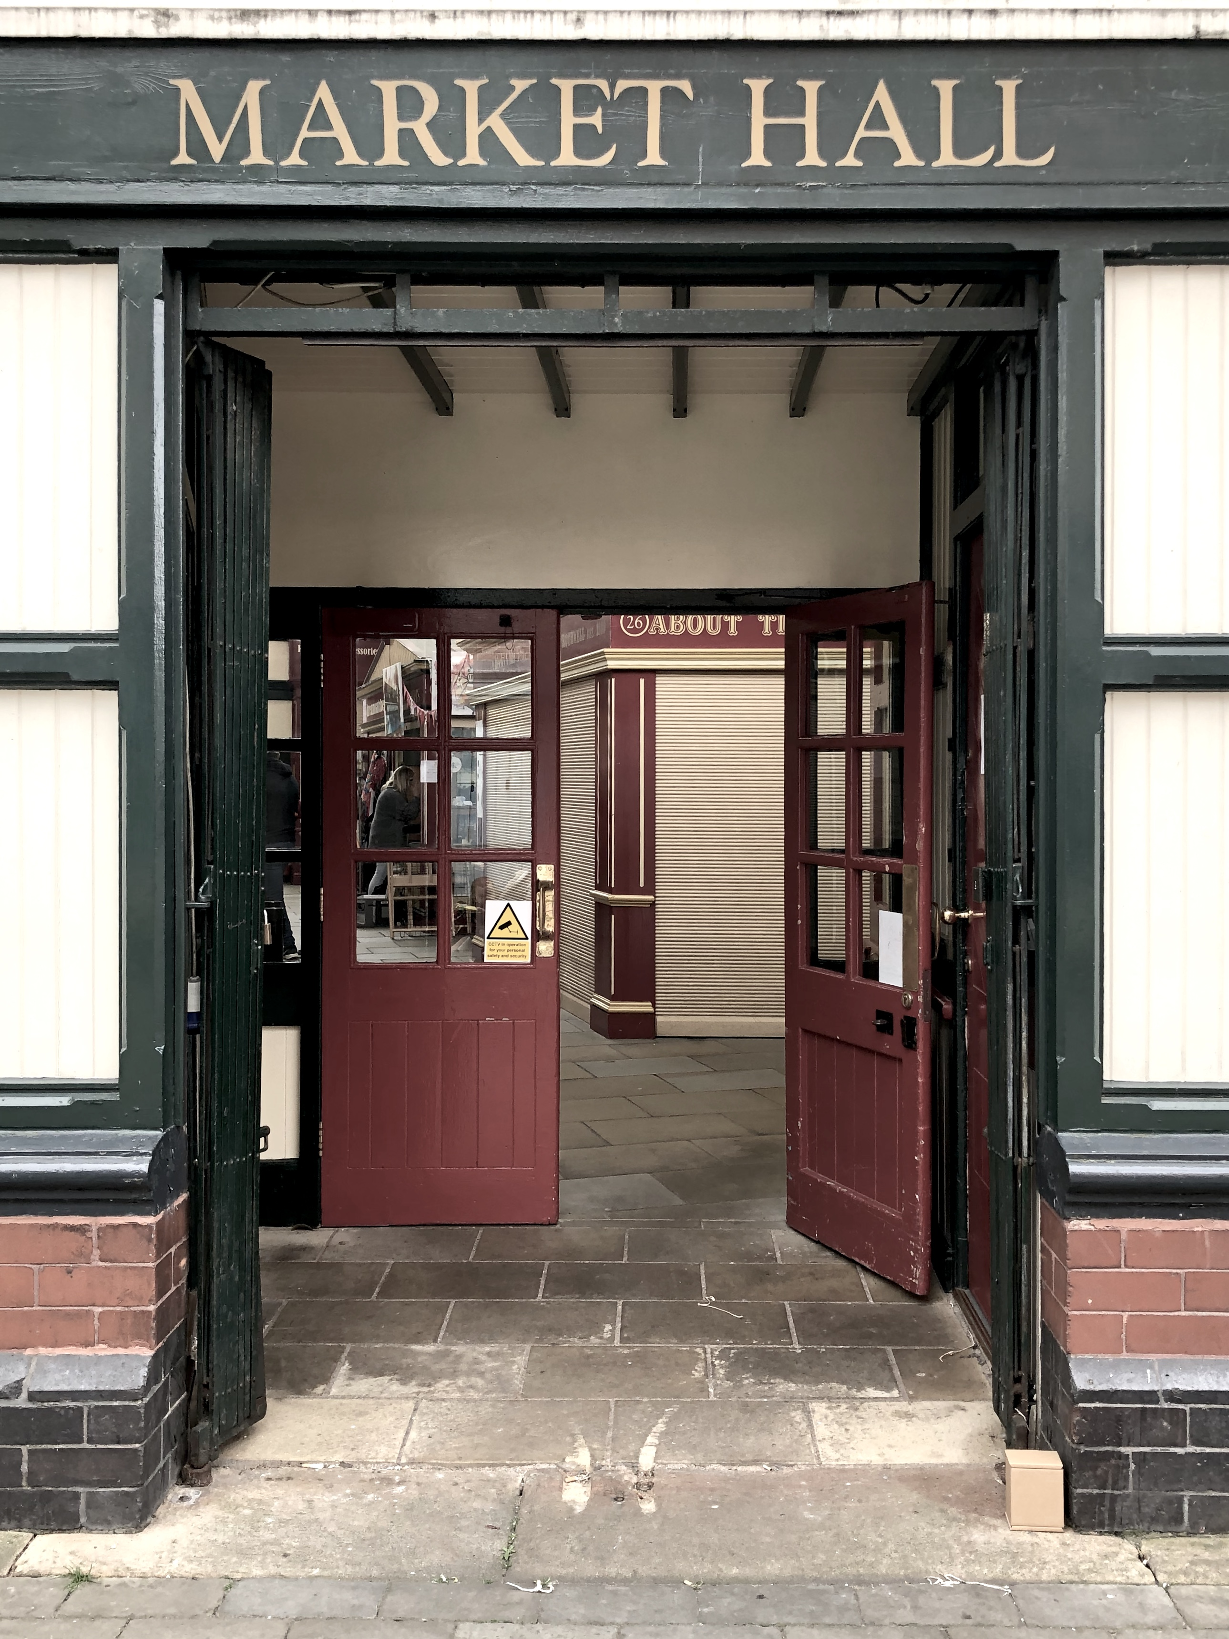

Slide 4
ARTIST RESEARCH

Slide 5
ELEANOR ANTIN
100 BOOTS

Slide 6
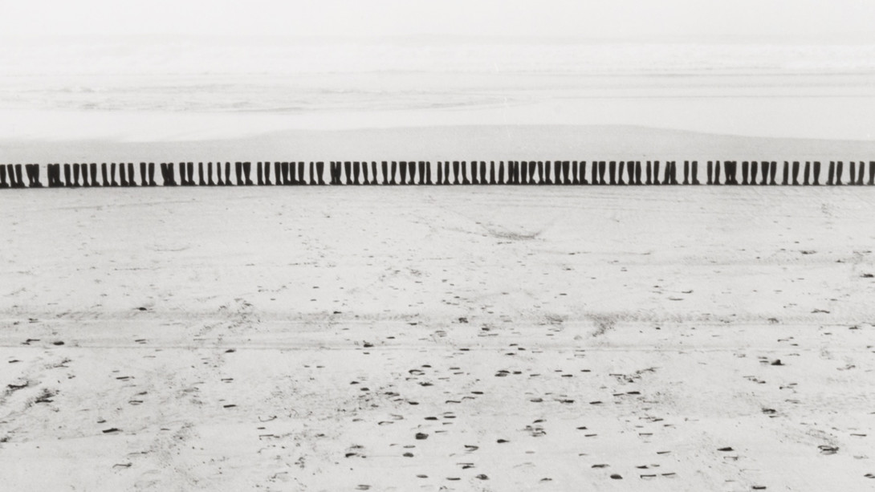
ELEANOR ANTIN

Slide 7
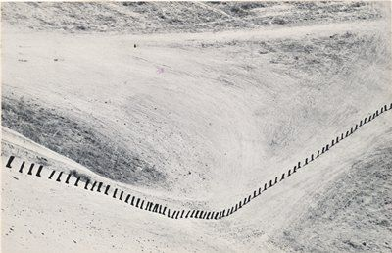
ELEANOR ANTIN

Slide 8
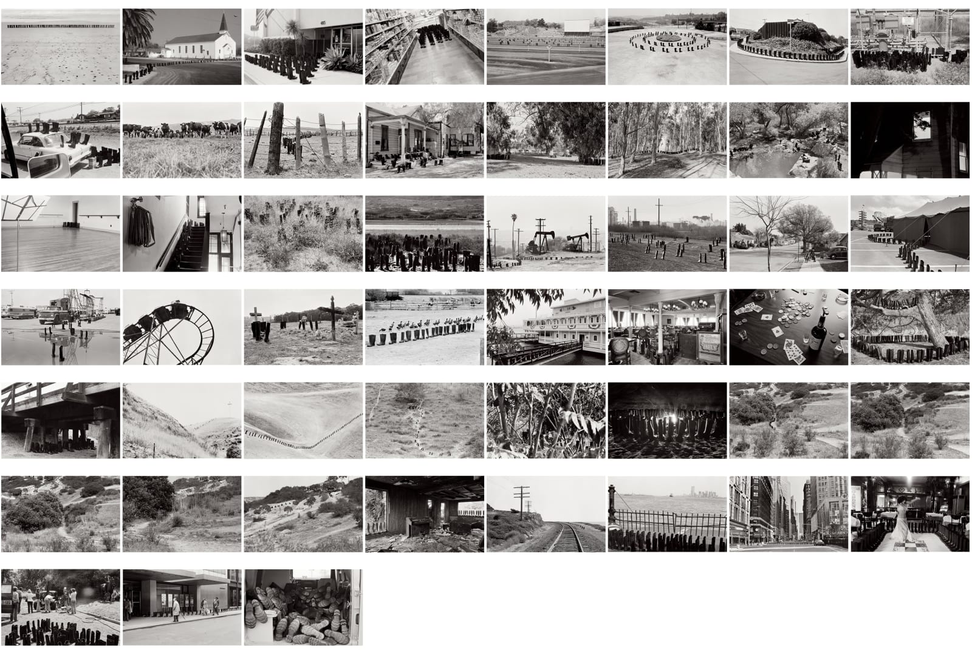
ELEANOR ANTIN

Slide 9
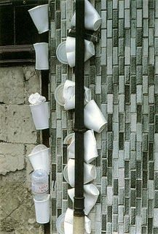
RICHARD WENTWORTH
MAKING DO AND GETTING BY

Slide 10
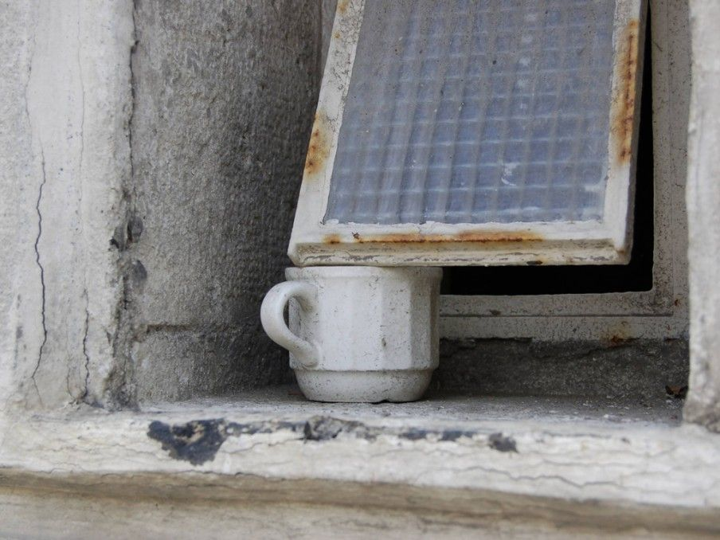
RICHARD WENTWORTH

Slide 11
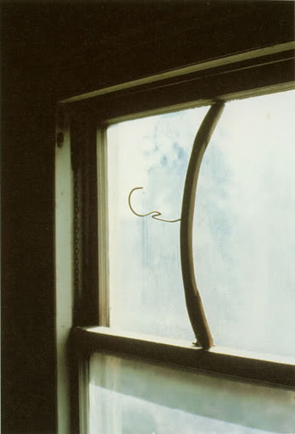
RICHARD WENTWORTH

Slide 12
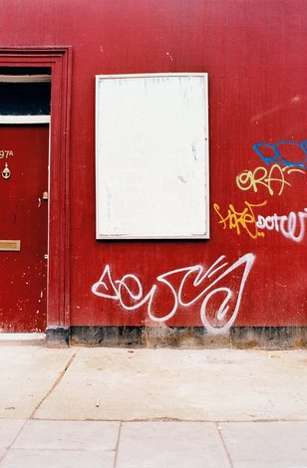
DAVID BATCHELOR
MONOCHROMES

Slide 13
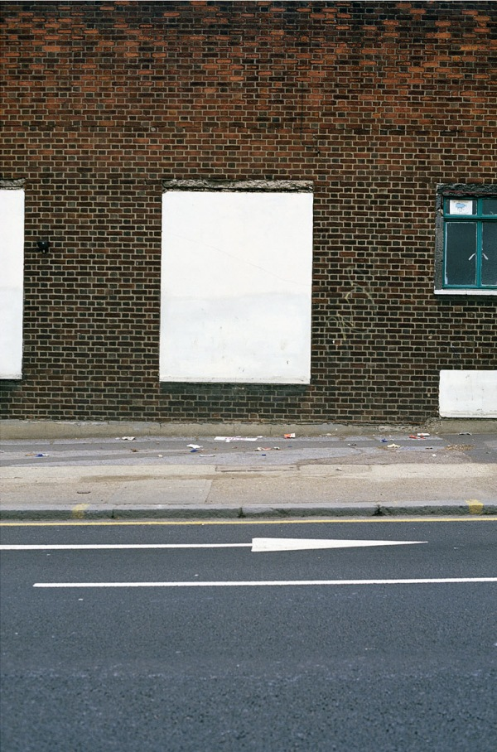
DAVID BATCHELOR

Slide 14
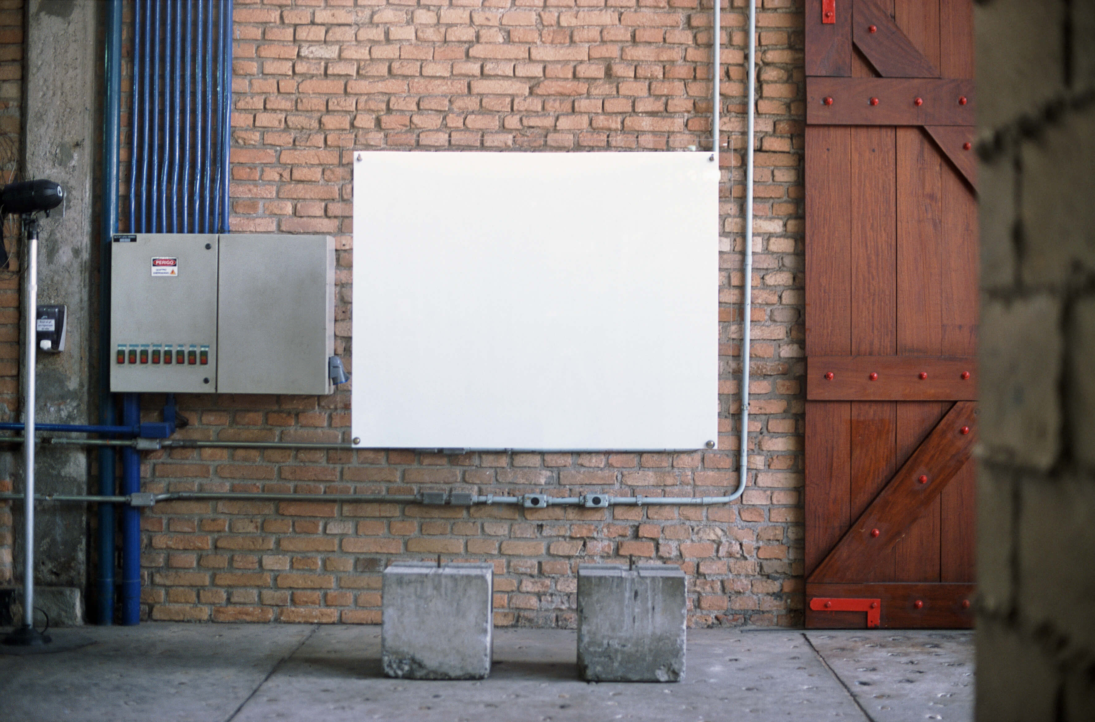
DAVID BATCHELOR

Slide 15
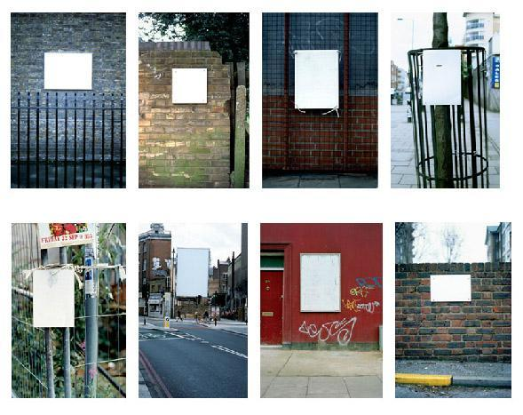
DAVID BATCHELOR

Slide 16
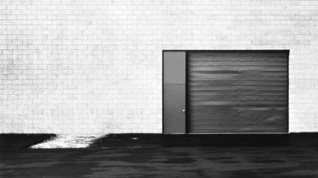
LEWIS BALTZ
THE NEW INDUSTRIAL PARKS…

Slide 17
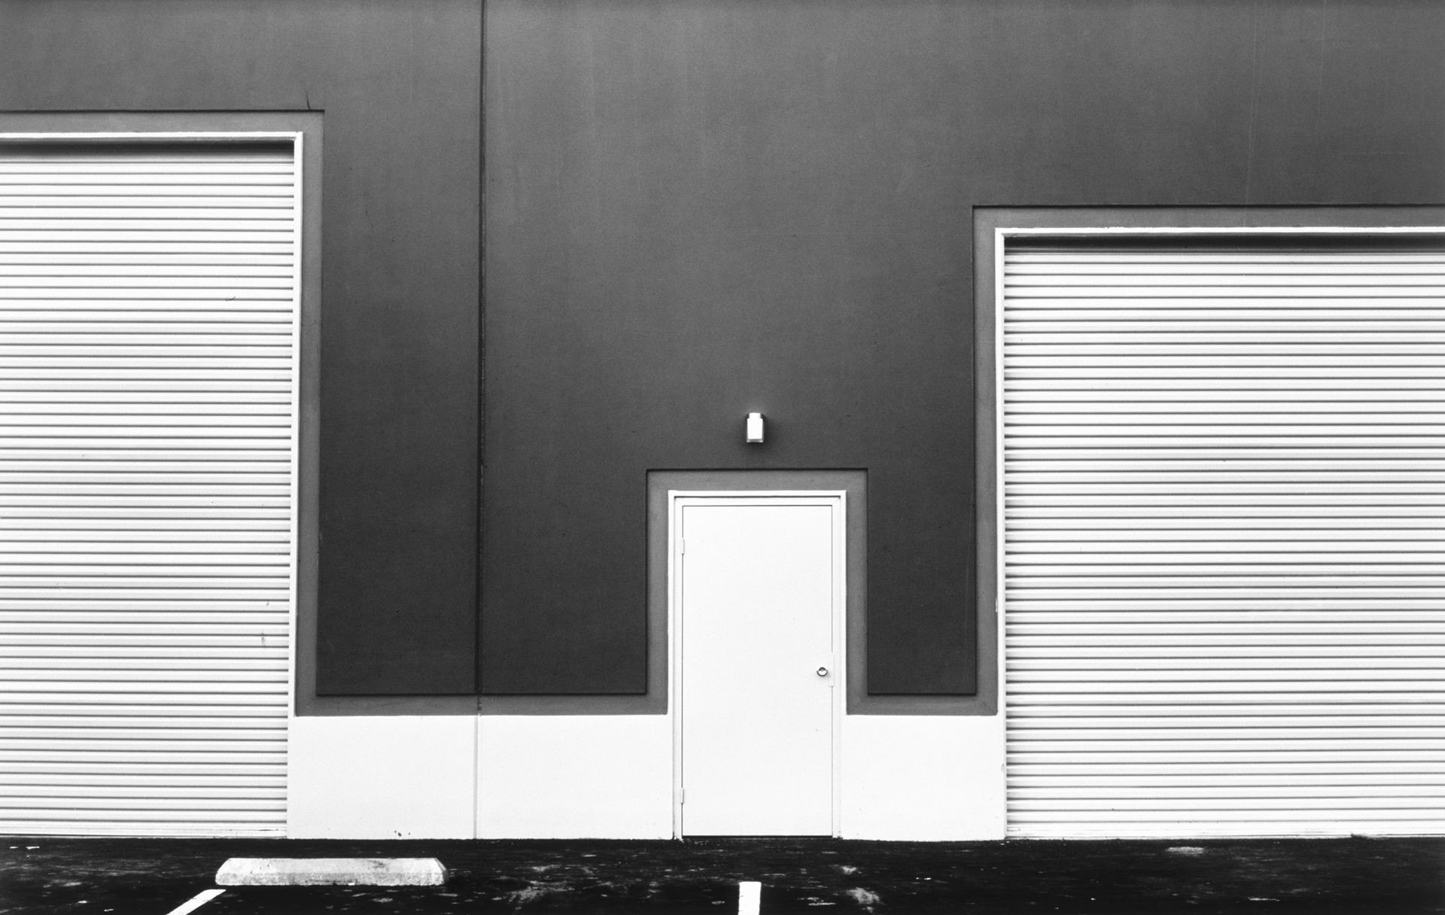
LEWIS BALTZ

Slide 18
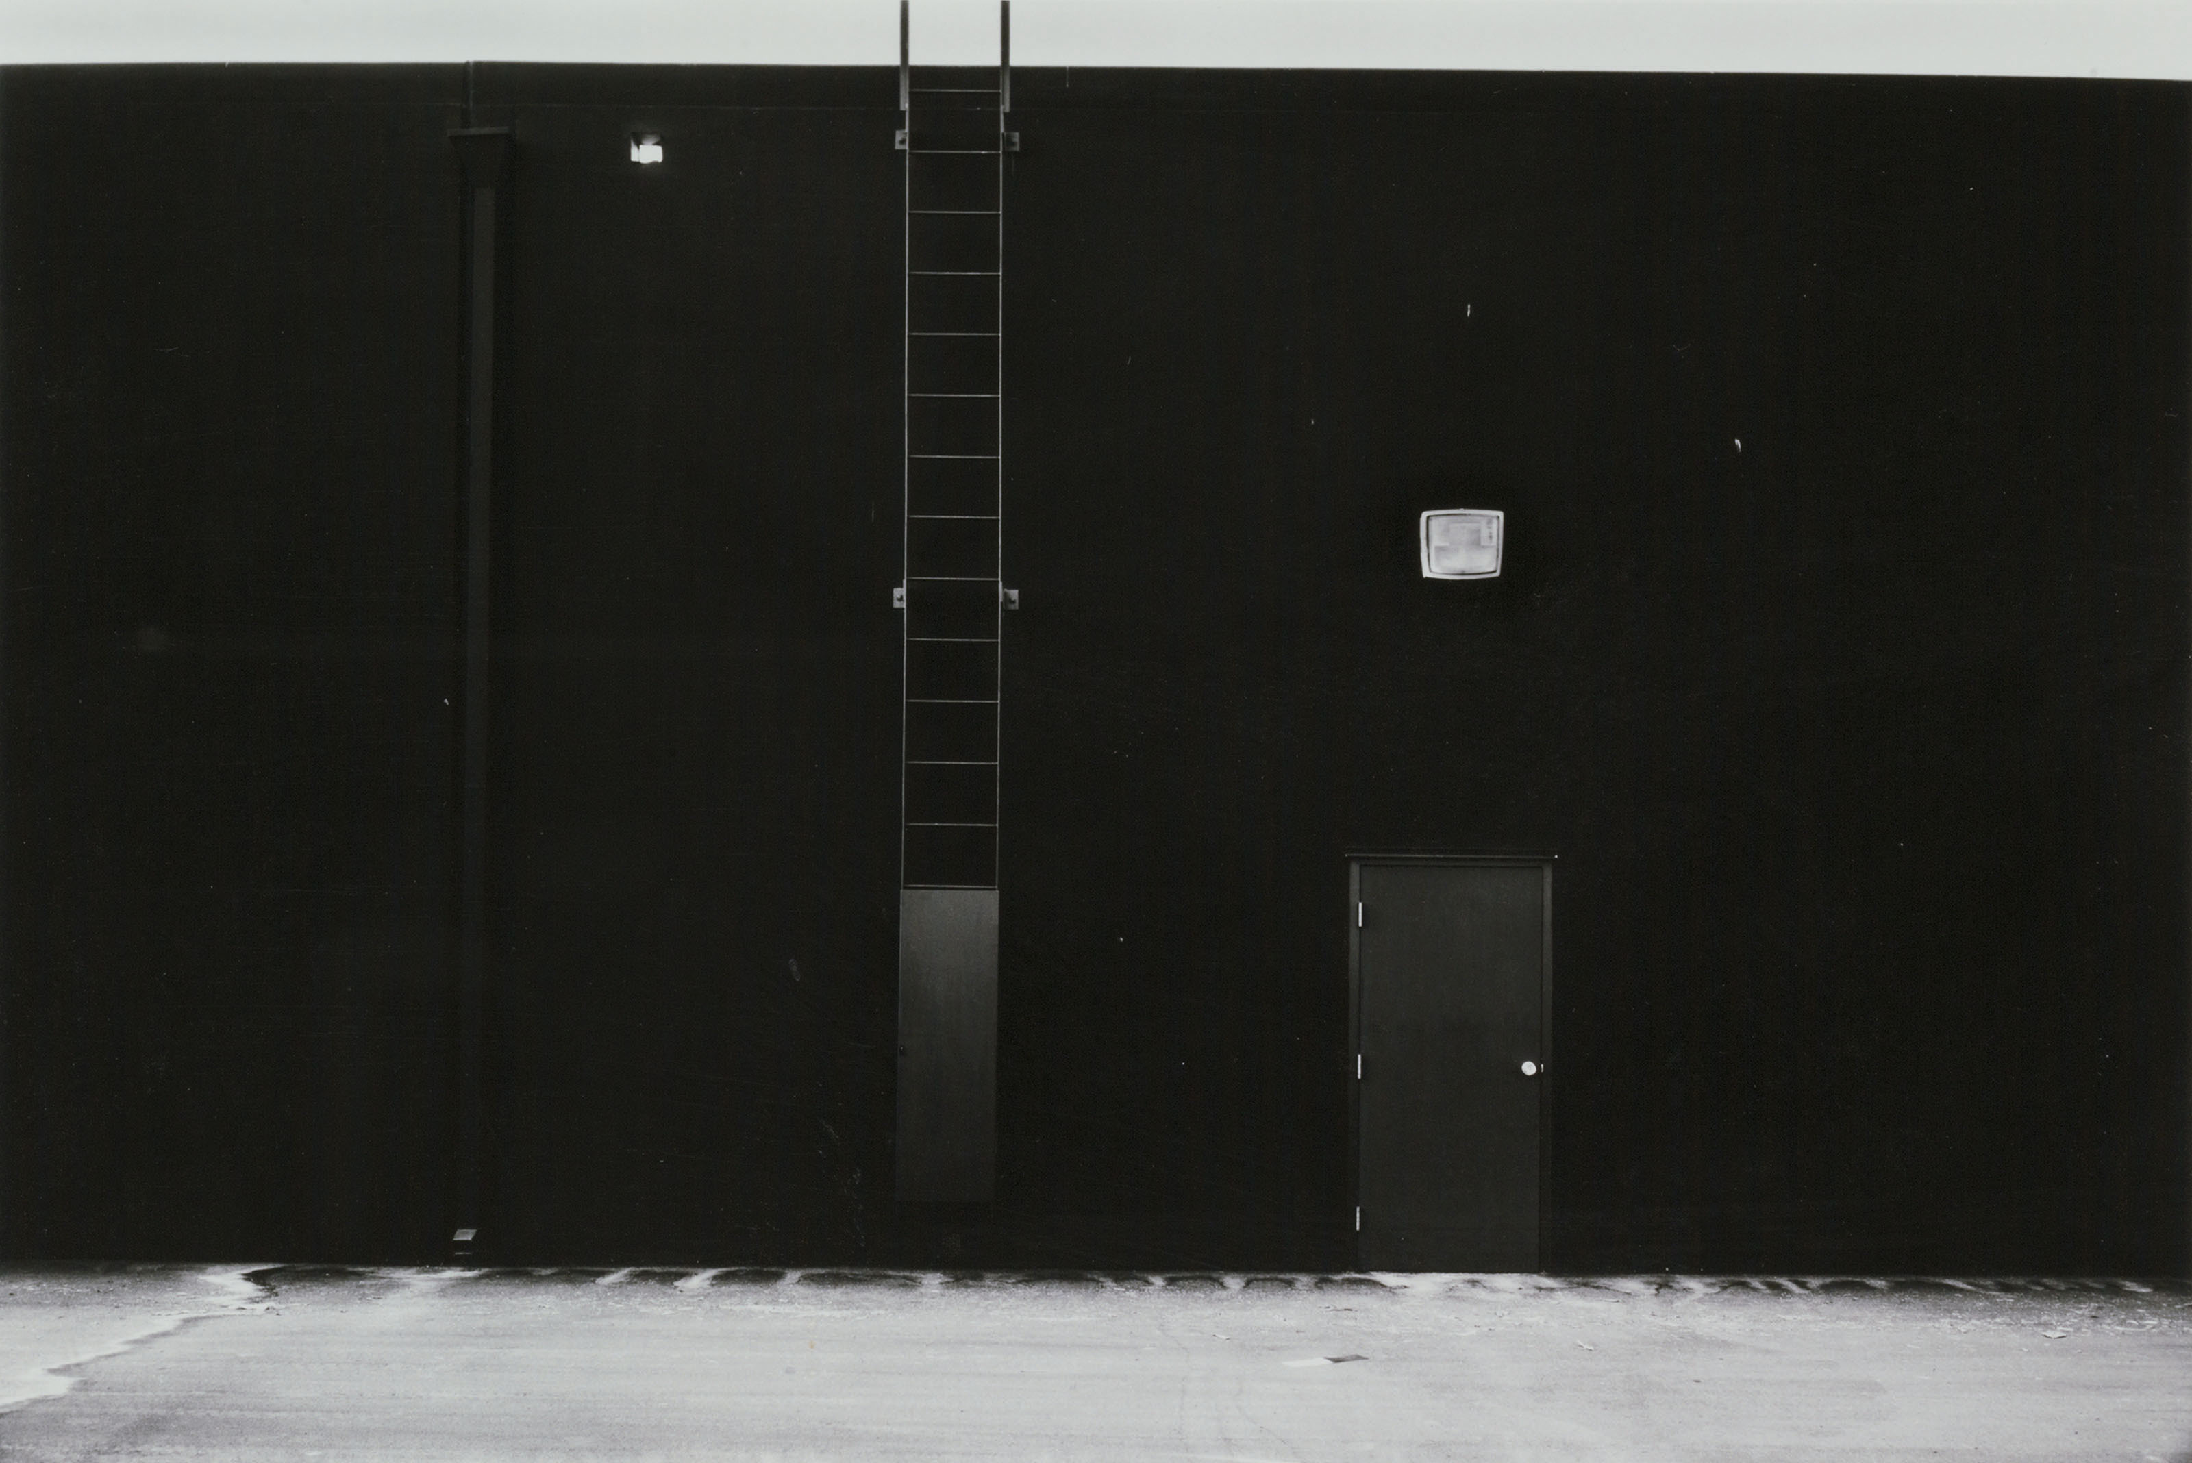
LEWIS BALTZ

Slide 19
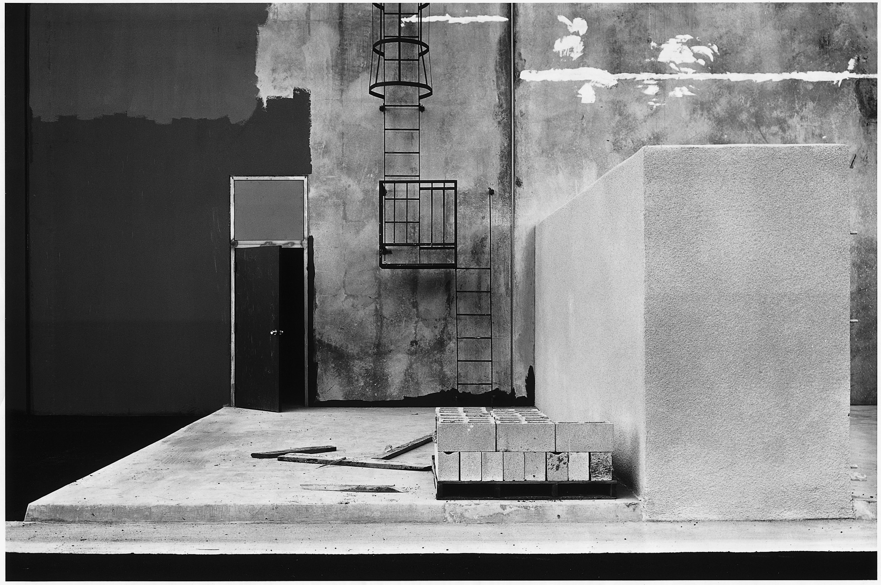
LEWIS BALTZ

Slide 20
ANTHONY HERNANDEZ
LANDSCAPES FOR THE HOMELESS

Slide 21
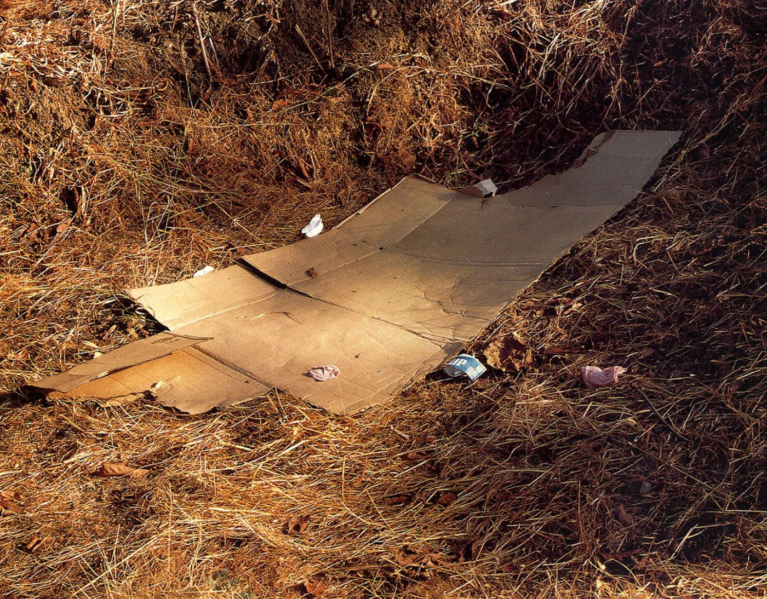
ANTHONY HERNANDEZ

Slide 22
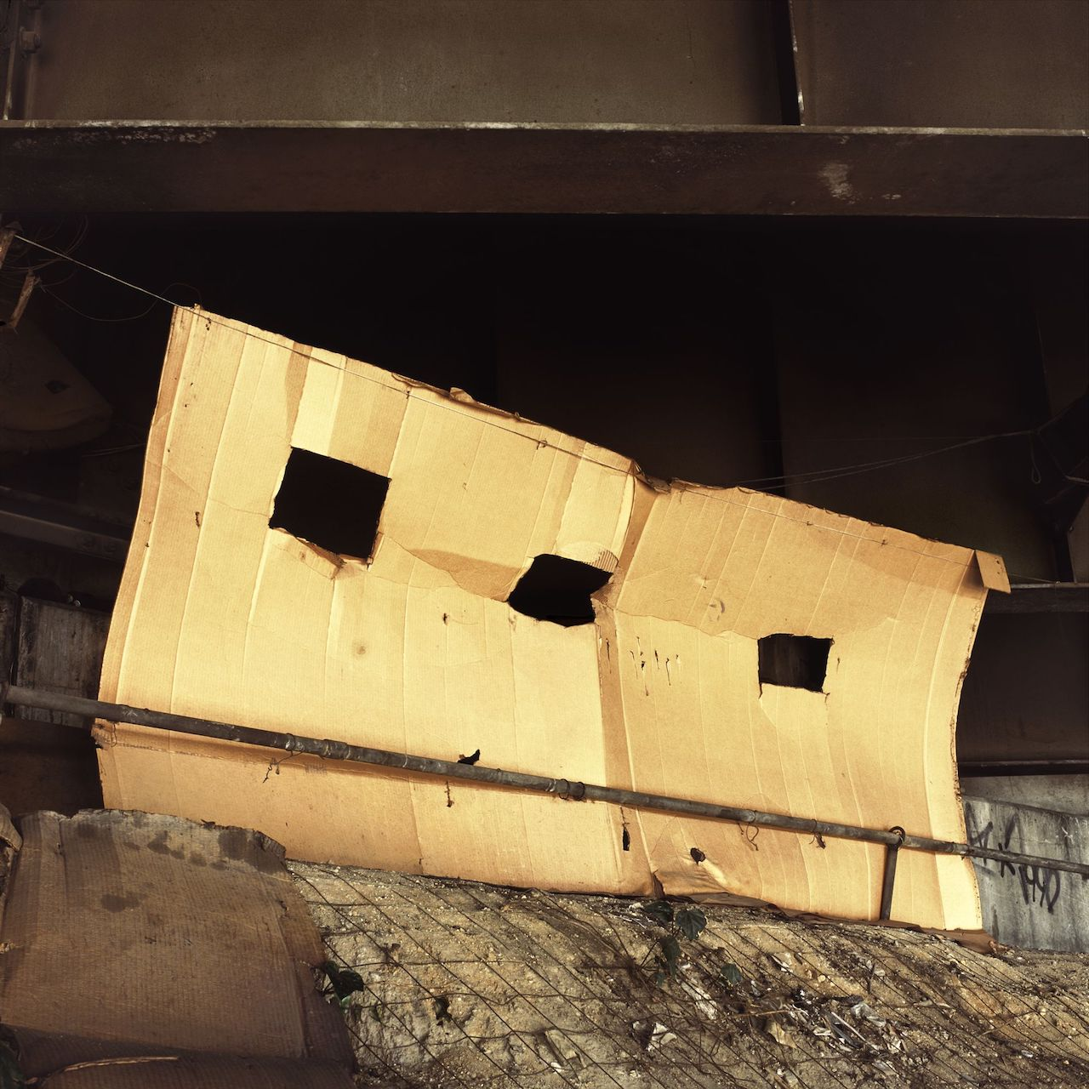
ANTHONY HERNANDEZ

Slide 23
COMPOSITION:
CONSIDER WHERE YOU PLACE YOUR BOX AND HOW YOU FRAME IT. THINK ABOUT WHAT YOU INCLUDE IN THE 4 CORNERS OF THE FRAME.
LOOK FOR EXISTING LINES IN THE LANDSCAPE
THINK ABOUT THE POSITION , ANGLE AND HEIGHT OF YOUR CAMERA.

Slide 25
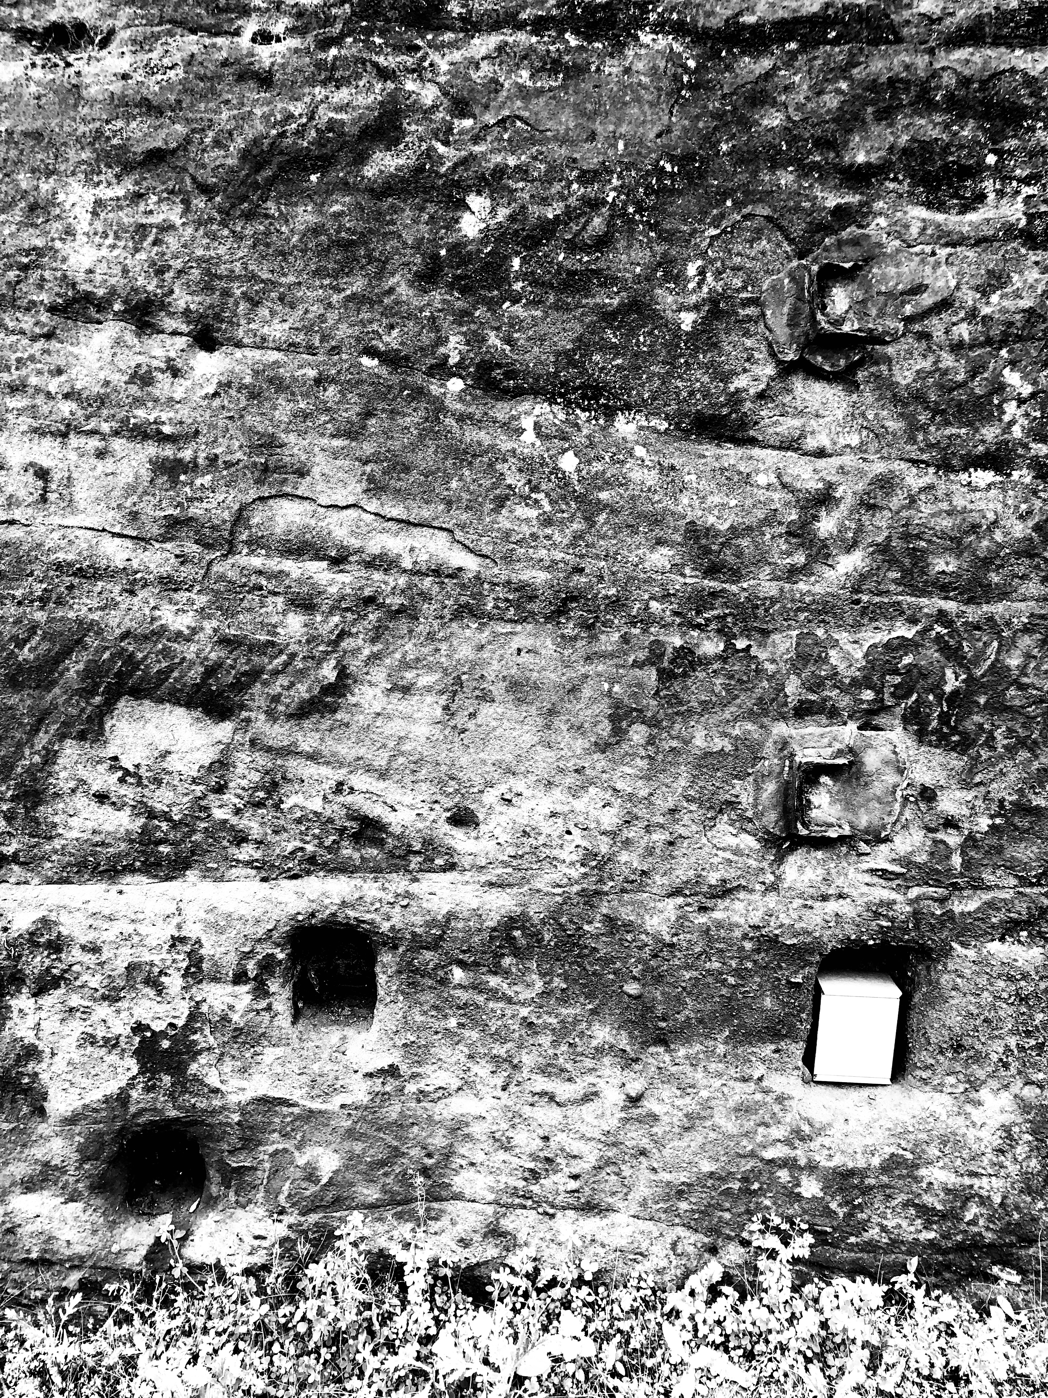
LOOK FOR SPACES

Slide 26
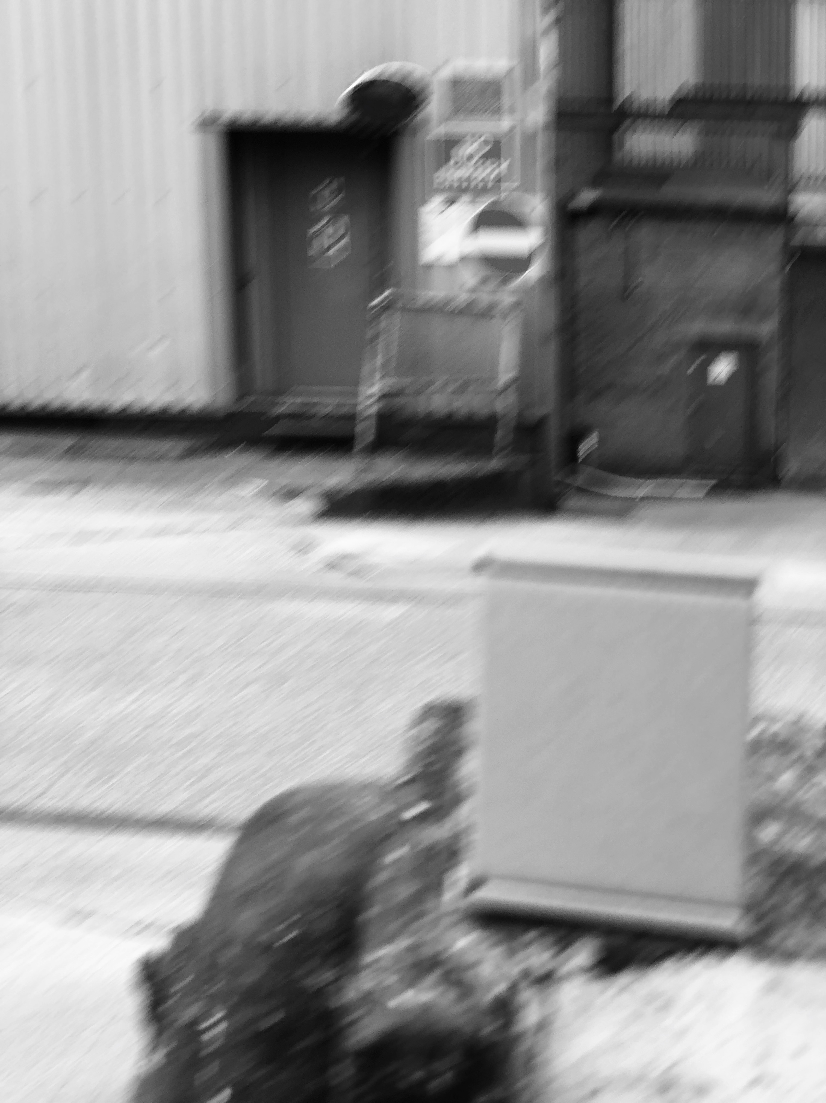
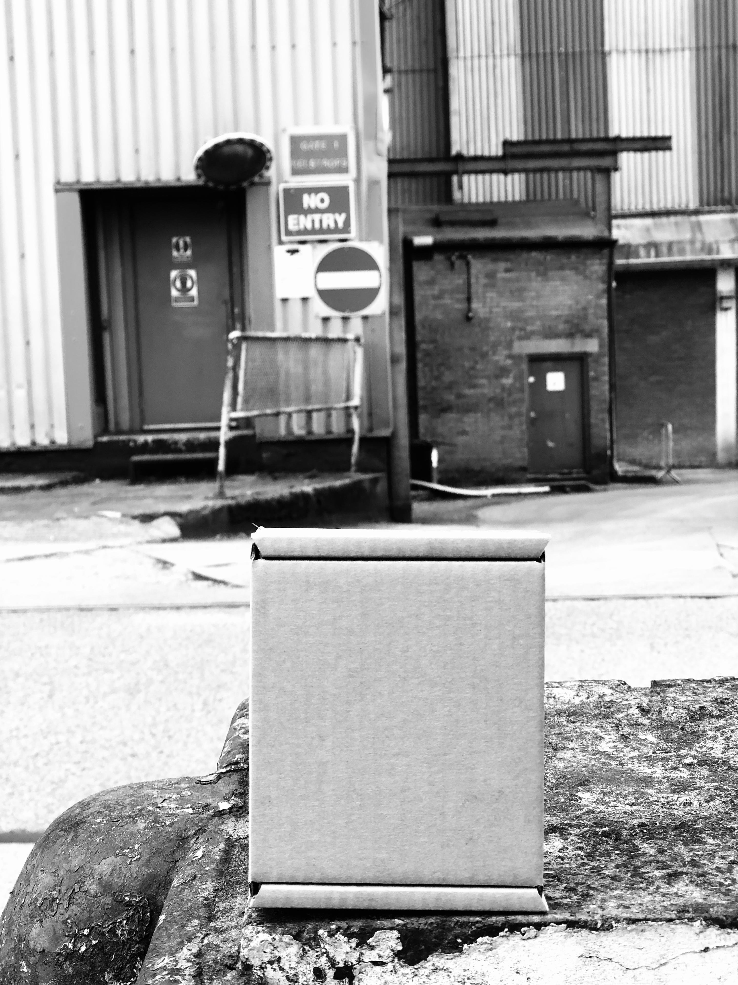
BOX MUST BE IN FOCUS

Slide 27
SHOW THE LOCATION YOU VISIT

Slide 28
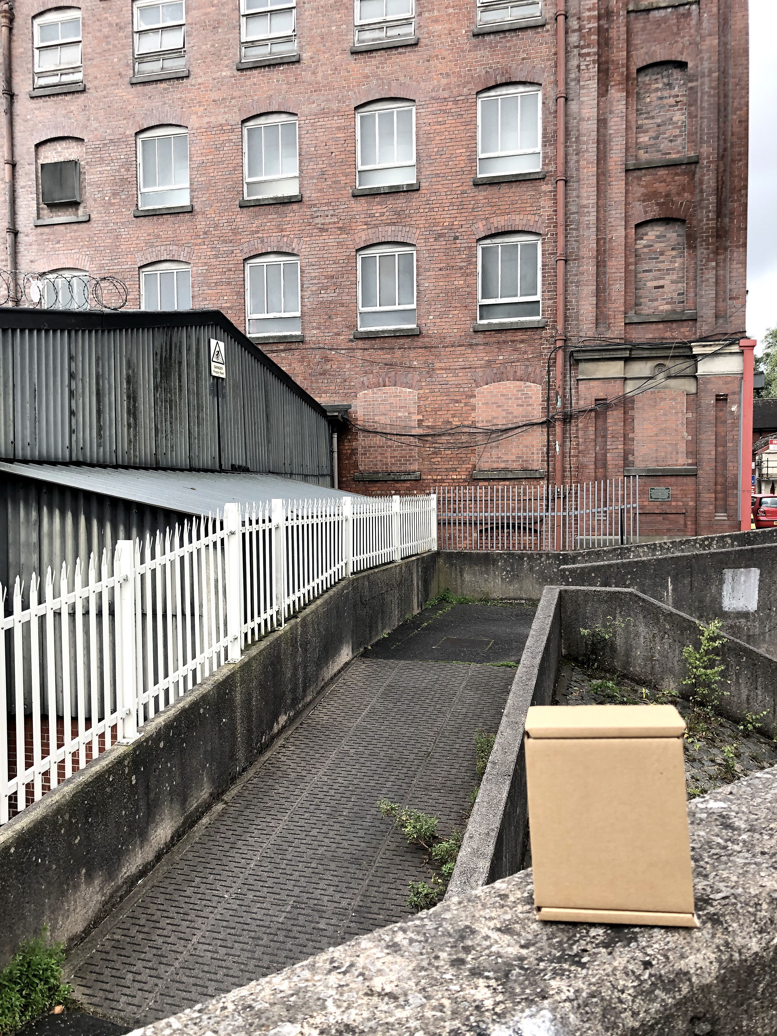
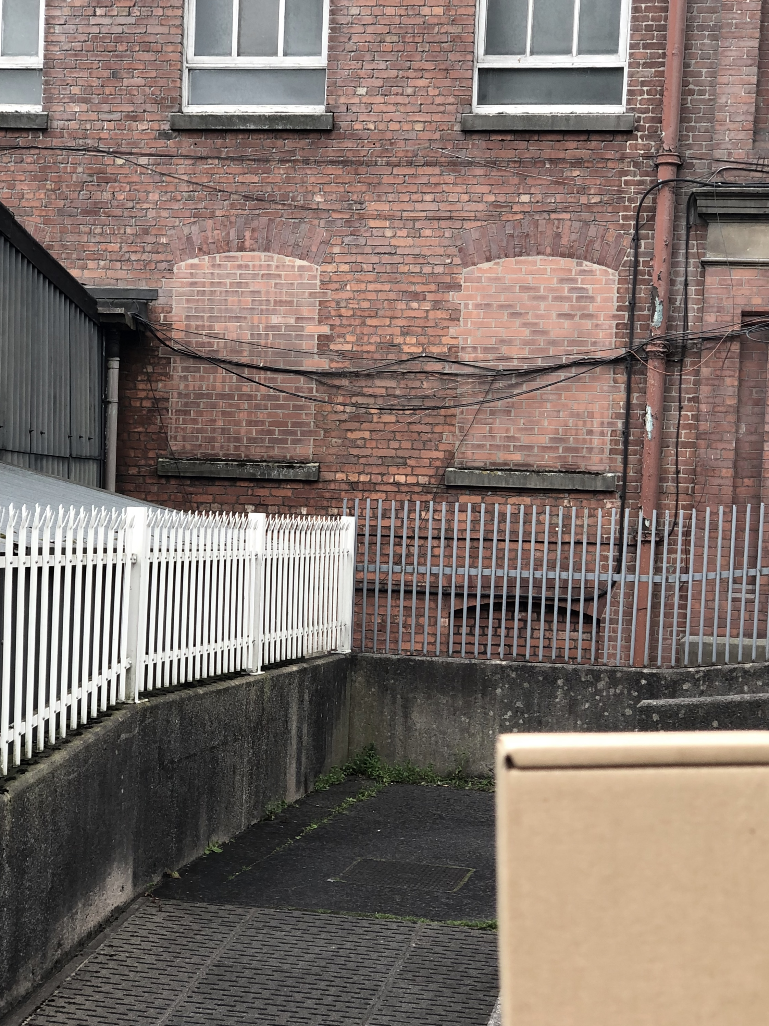
BOX MUST BE IN FOCUS AND WITHIN THE FRAME

Slide 29
MIRROR EXISTING SHAPES IN THE LANDSCAPE

Slide 30
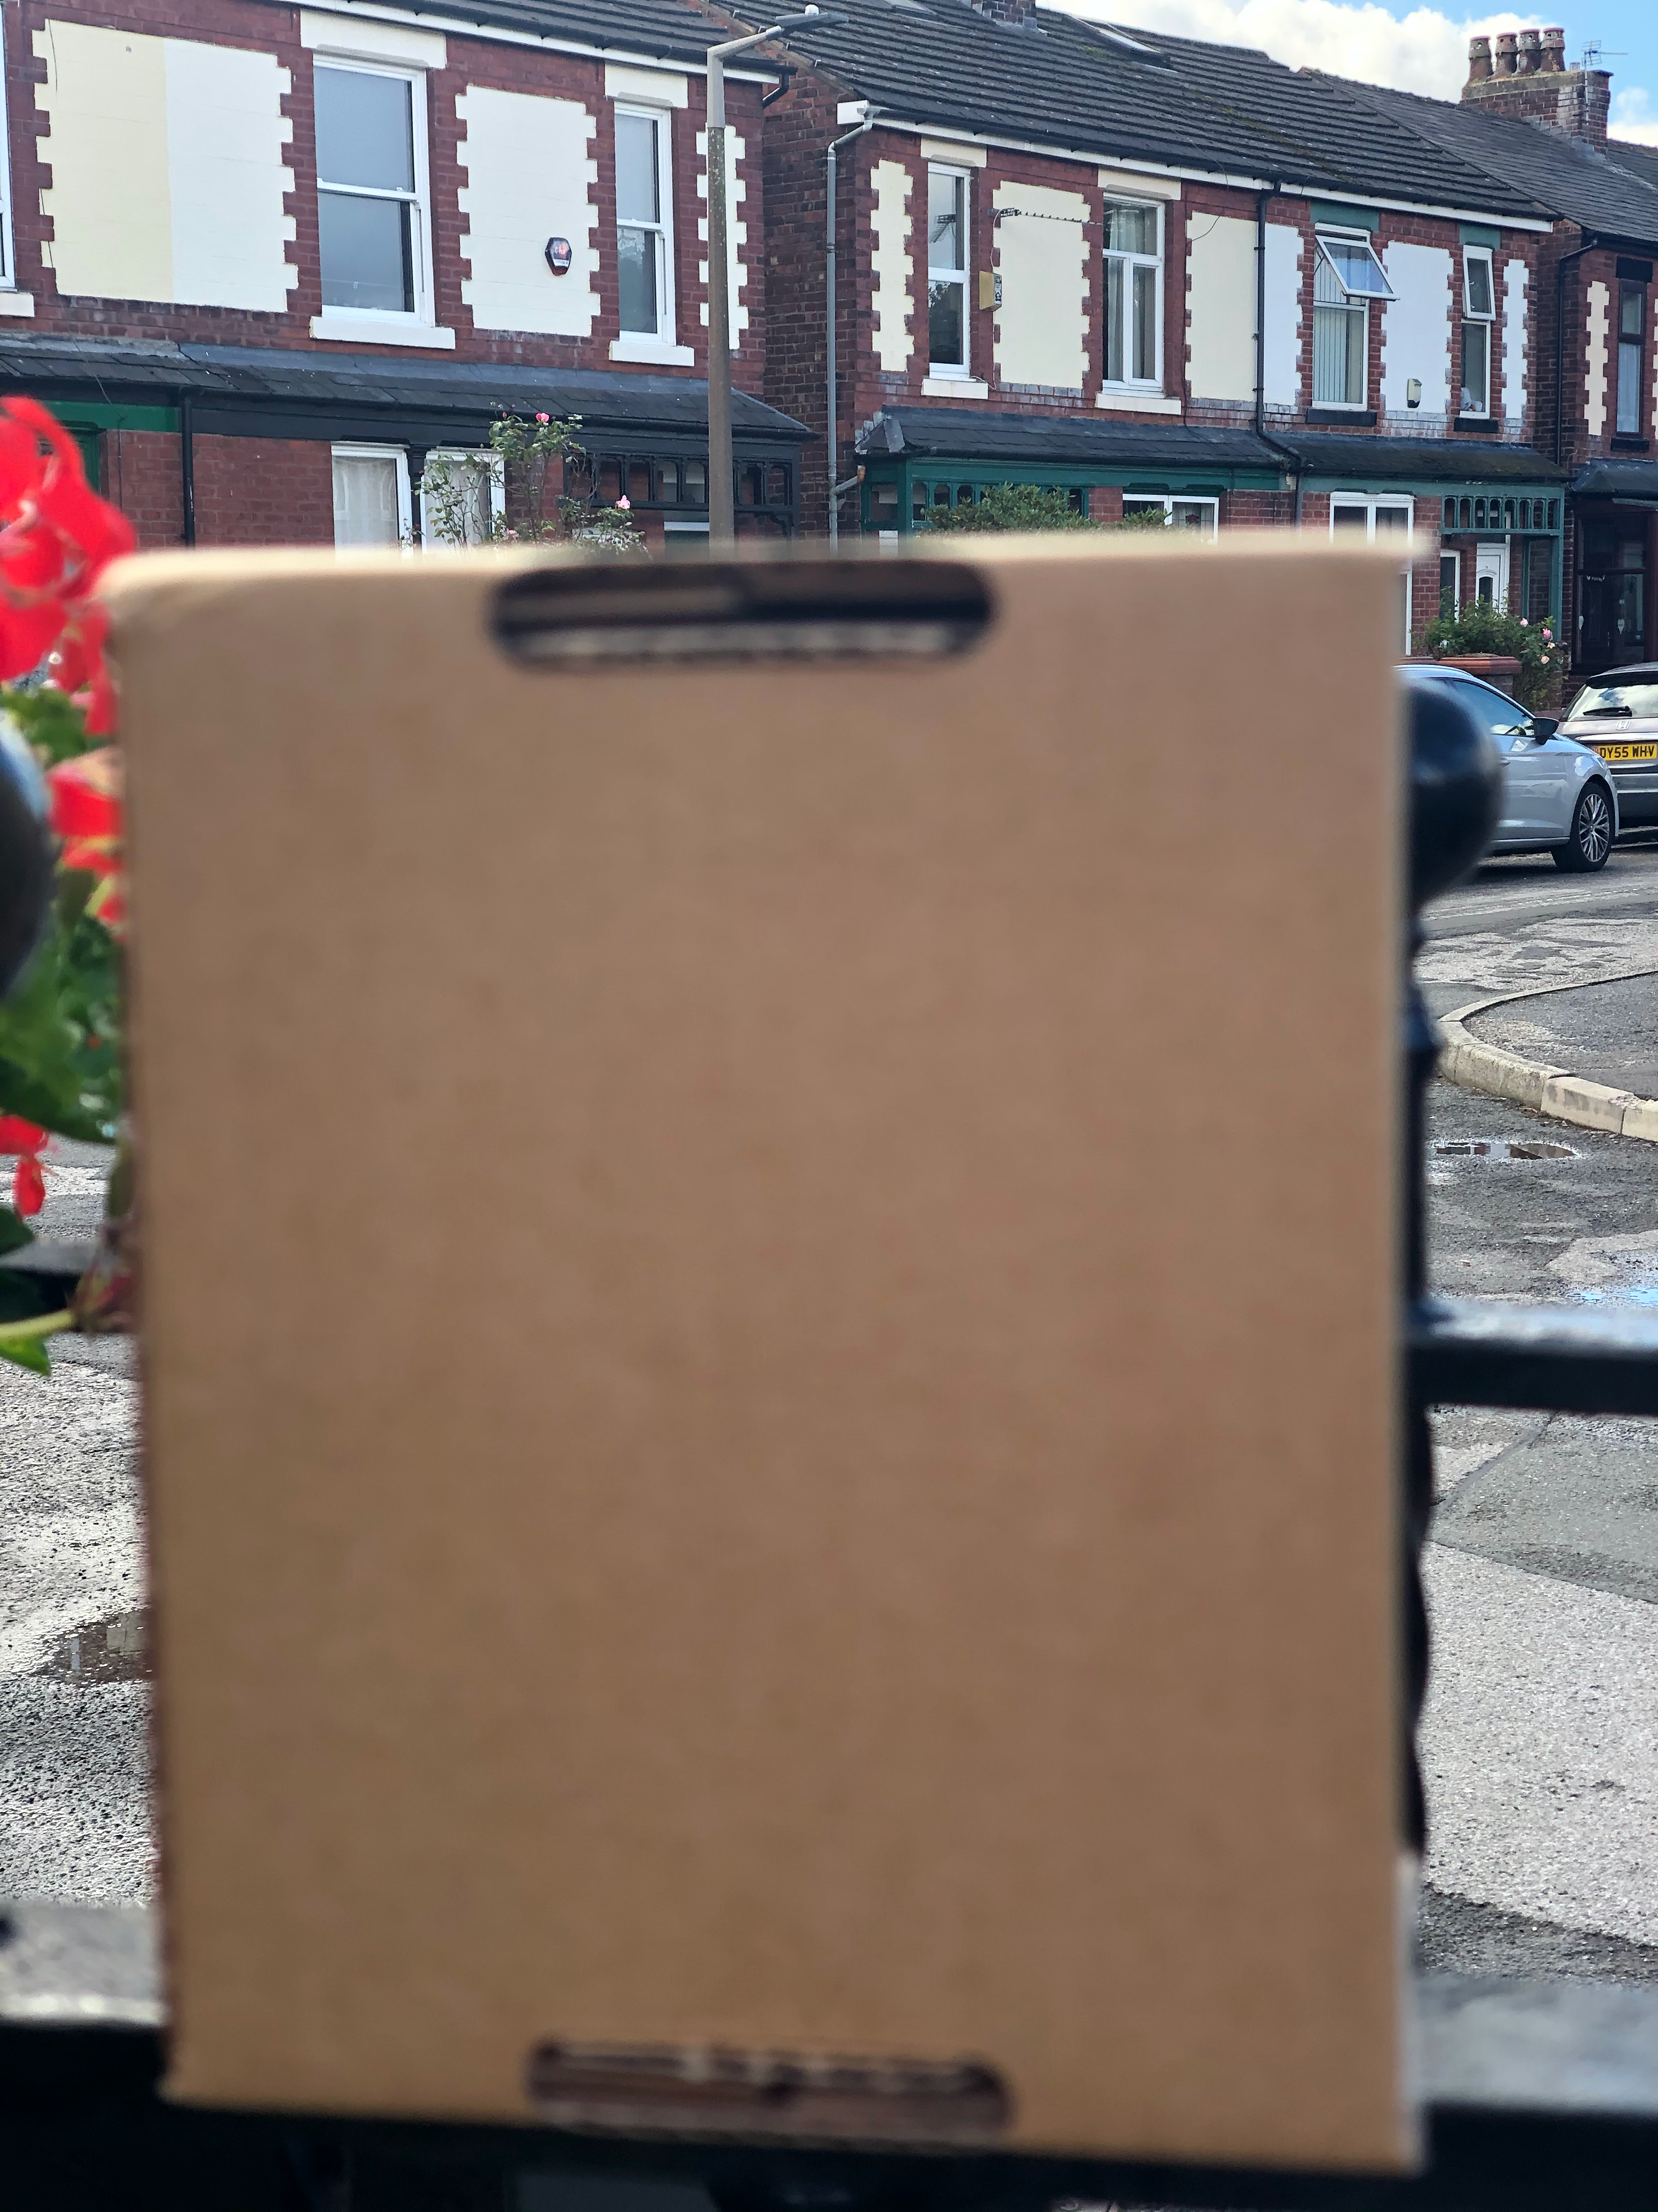
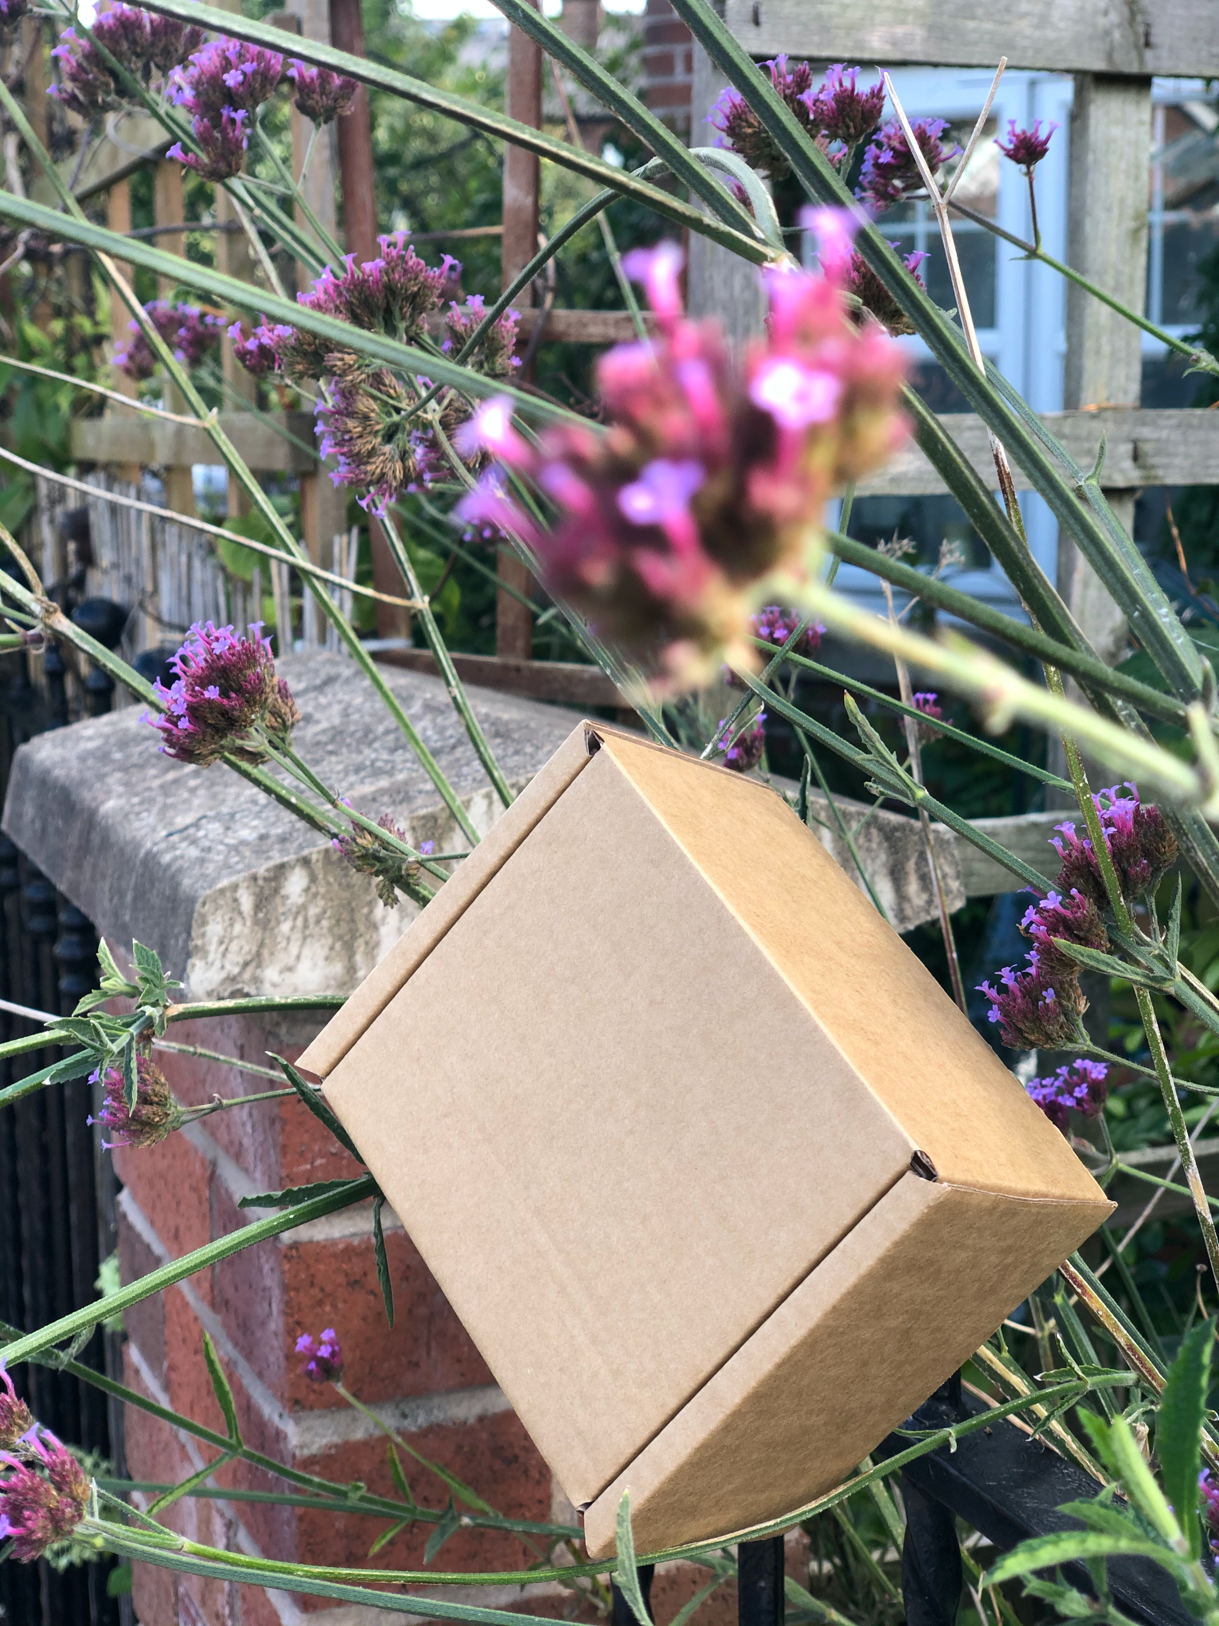
AVOID JAUNTY ANGLES & KEEP THE FOREGROUND IN FOCUS

Slide 31
“Consulting the rules of composition before taking a photograph is like consulting the laws of gravity before going for a walk.”
- EDWARD WESTON

Slide 32
COMPLETE FOR TUESDAY 20TH SEPT
TAKE YOUR BOX FOR A WALK
DOCUMENT THE JOURNEY WITH 50 - 100 PHOTOGRAPHS
PRESENT YOUR PHOTOGRAPHS ON A PPT/KEYNOTE SHOWREEL
YOUR BEST 16 - 20 IMAGES, B+W, LEVELLED
FINISH YOUR FIRST CRITICAL LINK
LAYOUT_RESEARCH_IMAGES_QUOTE

